Slide 1
Model Calibration and Circuit Optimization for Quantum Hardware
Dissertation Defense by Stefan Krastanov Doctoral Advisor Prof. Liang Jiang
The work done during my doctoral studies would not have been possible without valuable input from many colleagues, including Chang-Ling Zou, Chao Shen, Kyungjoo Noh, Michel Devoret, Philip Reinhold, Reinier Heeres, Robert Schoelkopf, Sisi Zhou, Steven Flammia, Steven Girvin, and Victor Albert.
Notes:
Hello, all, and thanks for being here.
I will be covering a few topics dealing with modeling and designing for quantum computing hardware, but first let’s set the stage.
Why care about quantum computing.

Slide 2
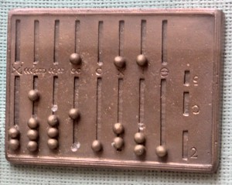
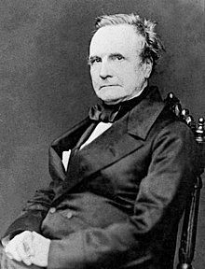
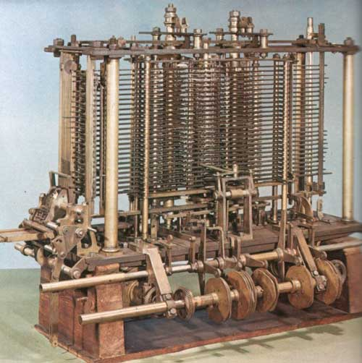
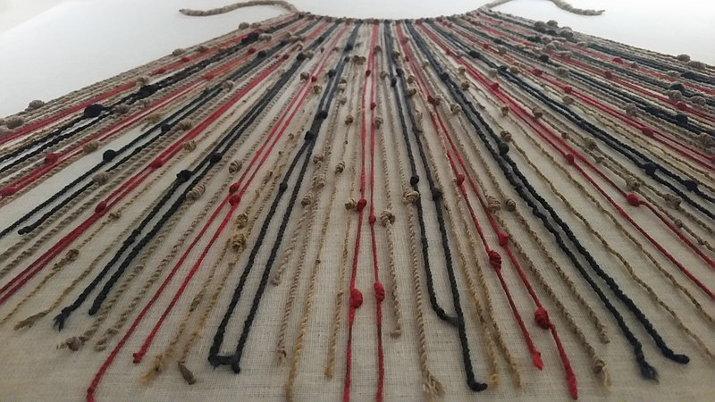
Brief (Opinionated) History of Computing Machinery
A Roman Abacus and an Inca Quipo; abacus in use since 2700 BCE
Babbage’s Analytical Engine, late 1800s
Notes:
Let us look at the history of computing.
We have been using simple tools to help with arithmetics since forever.
But in the last few centuries we started doing advanced computations that needed long cumbersome-to-produce tables, helping with even longer and more cumbersome scientific or engineering calculations.
Babbage tried to automate the creation of these tables, suggesting the first computer… a mechanical one.

Slide 3
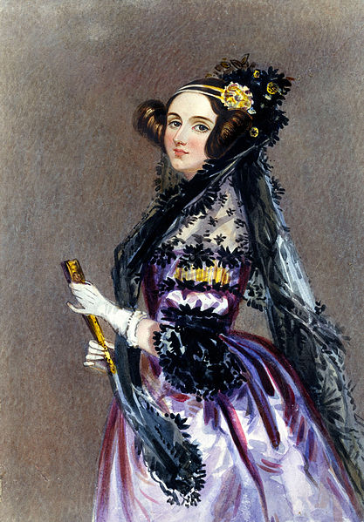
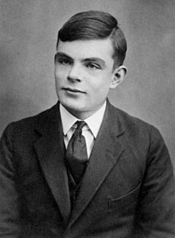
The Notion of Universality*
"[...] the Analytical Engine weaves algebraical patterns just as the Jacquard loom weaves flowers and leaves."
Ada Lovelace late 1800s
“The idea behind digital computers [... is] to carry out any operations which could be done by a human computer.”
Alan Turing
mid 1900s
*Universality: the notion that a computer is a general purpose problem solver that can simulate any other computer / problem solver.
Notes:
There was something peculiar about the machine he suggested…
Ada Lovelace saw that such machines can be used for all manners of “human” “non-arithmetic” pursuits, like manipulating music or text.
Turing, less than a century later suggested that such a machine can be a “general purpose problem solver”, not just a calculator capable of only one thing.
The notion of universality was born, the idea that we do not need special purpose machines for each problem, because a general computer can simulate any other general computer.

Slide 4
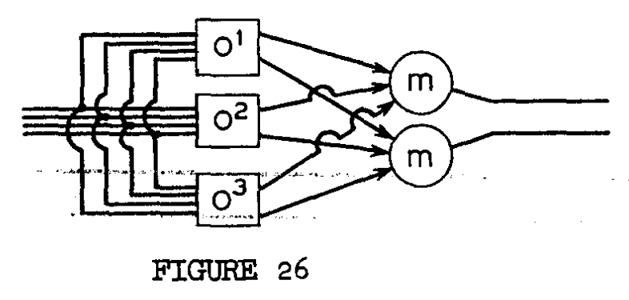
Ideal Machines Can Be Difficult to Build in The Real World
Babbage never completed the Analytical Engine.
Many doubted that cogs or relays or vacuum tubes could ever be sufficiently noiseless.
Thankfully, von Neumann proved a “threshold theorem” providing a noise reducing “gadget”.
A triply-redundant implementation of an otherwise unreliable operation.
“[...] The Synthesis of Reliable Organisms […]”, von Neumann, 1952
Notes:
But there was a practical problem…
Thankfully, it was solved.

Slide 5
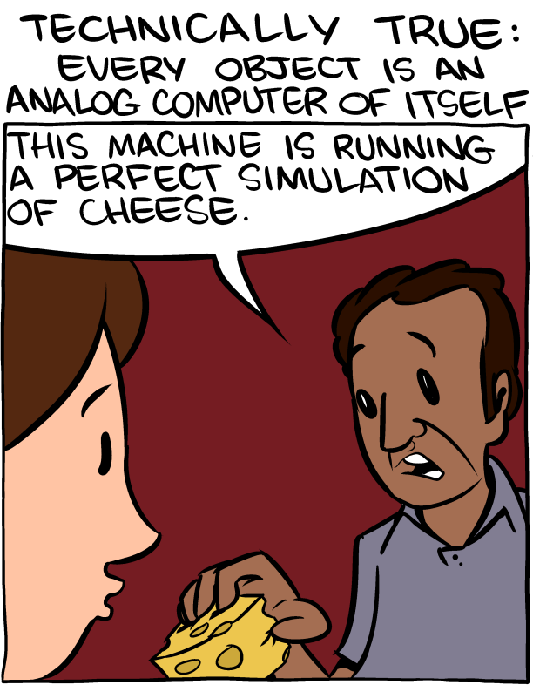
How Much Computational Power Do the Laws of the Physical* Universe Ultimately Provide?
Some problems are difficult, but the universe still solves them.
Quantum mechanics, in particular, is difficult to simulate.
Use a quantum system to simulate the quantum system.
smbc-comics.com, 2013
*Skipping scalable analog computers and hypercomputation as unphysical.
Notes:
Then a new question appeared. Can we build something more powerful than Turing’s machine. There are good reasons to think we can.

Slide 6
Quantum Computers can be universal! And they outperform* classical ones!
Computable and Noncomputable, Yuri Manin, 1980
Simulating Physics with Computers, Richard Feynman, 1982
Quantum Theory, the Church-Turing Principle and the Universal Quantum Computer, David Deutsch, 1985 Universal Quantum Simulators, Seth Lloyd, 1996
*Probably...

Slide 7
However, Imperfect Quantum Hardware is Hard to Control even more so than Babbage’s cogs and cams
In that spirit, an Outline
Control and Calibration
Purifying Resources with Imperfect Circuits
Notes:
Naturally, today someone building a quantum computer needs to deal with realistic noisy hardware, not unlike how von Neumann was explaining in the 50s that you can build reliable classical computers out of unreliable classical components.
In that spirit, I will cover two related topics.
First, I will discuss how one can characterize the noise present in the imperfect quantum components we are using.
Then I will discuss ways that you can build useful intermediate scale circuits, even if the building blocks you are using are imperfect.

Slide 8
Control and Calibration
STochastic Estimation Algorithm for DYnamical variables
arxiv:1812.05120 / QST 2019

Slide 9
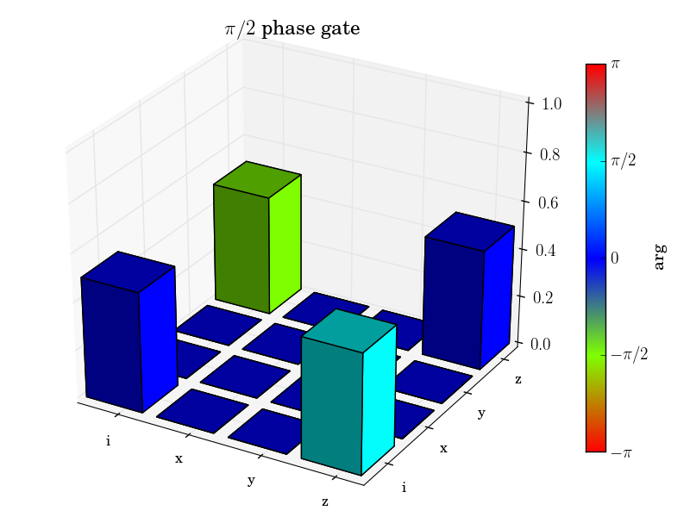
How Control and Calibration Work naive interpretation of a theorist
Perform measurements validating the quality of the control protocol.
Devise some control protocol, informed by the model.
Measure the model parameters governing the hardware.
e.g. Process Tomography or Randomized Benchmarking
e.g. SNAP based control or the OCT work by Reinier and Philip or Philip and Wenlong’s error resistant control

Slide 10
Survey of Methods: Parameter Estimation/Evaluation let us start with a simplified version of Process Tomography
Susceptible to State Preparation and Measurement Errors
A Quantum Process
We can use Process Tomography to measure all coefficients :
is a linear map (super-operator)
1. Prepare
2. Apply the quantum process to get
3. Measure the overlap* with , which gives you
i.e. it can be represented as a matrix where each row/column corresponds to a basis vector for the output/input.
* There are some questions of orthogonality to address.

Slide 11
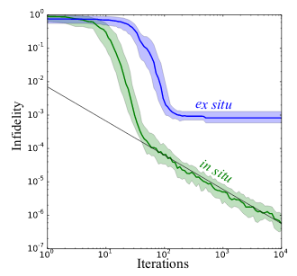
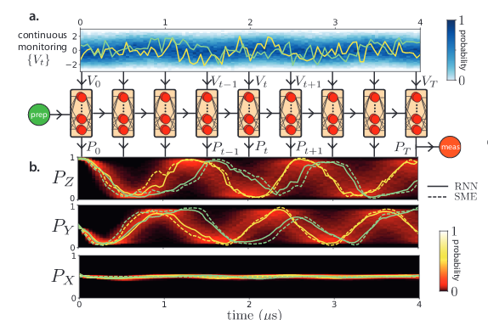
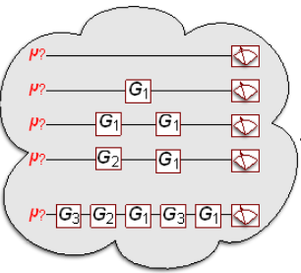
Survey of Methods: Parameter Estimation/Control/Evaluation (biased and incomplete)
Stochastic in situ Methods
Recurrent Neural Nets
Process Tomography
Gate Set Tomography
Randomized Benchmarking
1. Inefficient dense representation 2. Expensive 3. SPAM*-sensitive
1. Inefficient dense representation 2. Expensive 3. Immune to most SPAM*
1. Only overall “scalar” fidelity 2. Immune to SPAM*
1. Very inefficient 2. Model independent 3. Immune to SPAM* 4. Very high quality Phys. Rev. A 91, 052306
1. Inscrutable black-box model 2. Can be sparse 3. Very general arXiv:1811.12420
Only verification, not informative on how to improve control.
*SPAM: State Preparation and Measurement errors

Slide 12
We want it all!
Immune to SPAM*
Sparse Efficient Representation
Continuous (for use in optimal control)
Saturating Information Theory Bounds
General while still Interpretable
*State Preparation and Measurement errors
Notes:
Careful transition to this slide!

Slide 13
What is a Model of Controllable Hardware?
Model of the dynamics
State of the system
Control drives

Slide 14
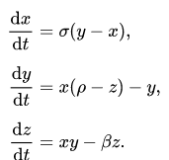
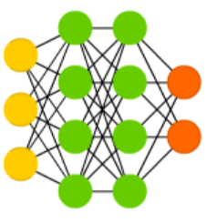
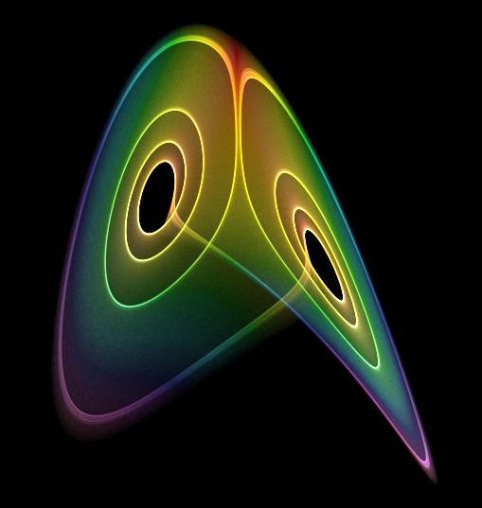
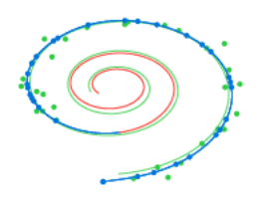
Spectrum of Models
Differential Equations
Neural ODEs
Recurrent Neural Networks
Neural Networks
Sparse, Understandable Susceptible to model errors
Dense, Inscrutable What “model error”? (Just get me more training data)

Slide 15
Model Hamiltonian
Model Hamiltonian Parameters Control Drives
“True” Hamiltonian “True” Parameters

Slide 16
Model Hamiltonian A Particular Parameterization
Model Hamiltonian Parameters Control Drives (for Q qubits) (D-dimensional vector)
Predetermined permitted operators (M different operators, not spanning the entire space of operators)
M⨉(D+1) real parameters to be estimated

Slide 17
Model Hamiltonian
General Linear Control Drives
Model Hamiltonian Parameters Control Drives
2^{2Q}⨉(D+1) real parameters to be estimated

Slide 18
Calibration
Run a bunch of random control drives.
Compare the result to the model prediction.
Fudge the model parameters until they match.

Slide 19
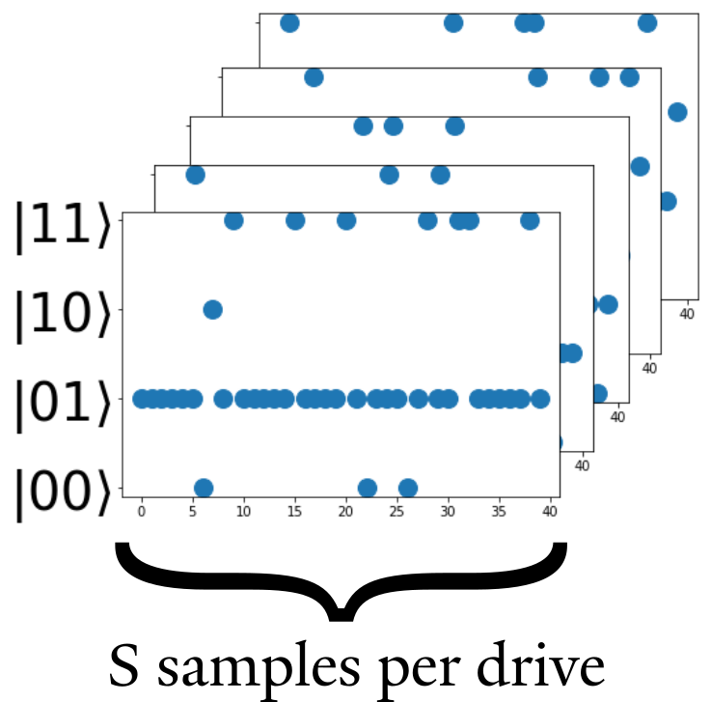
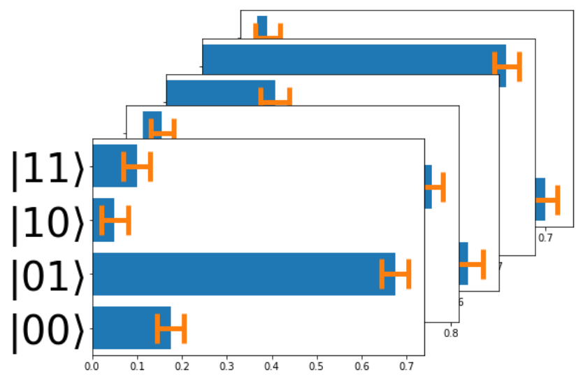
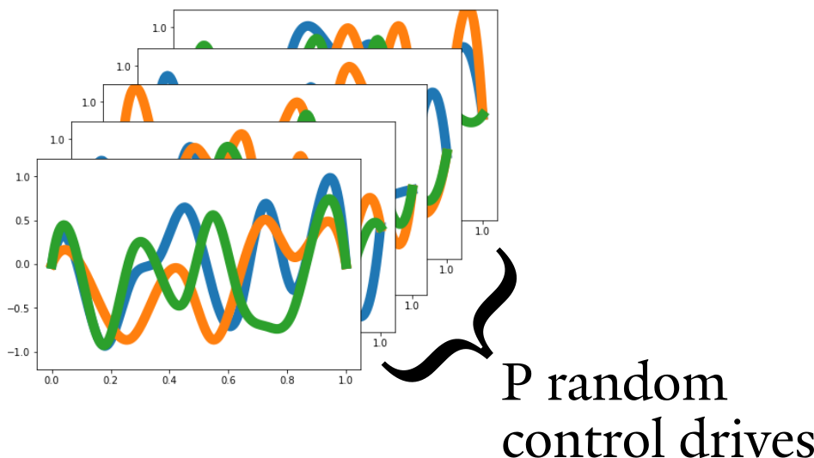
Run a Bunch of Control Drives and Repeatedly Sample
1. Prepare random pulses
2. Sample the result of each pulse repeatedly.
3. Estimate populations in each basis state

Slide 20
Compare the Result to Prediction
Fundamentally, you can not exactly measure a quantum state. You can estimate its population in a given basis with repeated projective measurements. (or a bit more generally—and more expensively—do tomography on the state)
run control drive
phases are lost in projective measurement
sample from this distribution
0
1
0
0
Finally, compare the estimate of the truth to the prediction:

Slide 21
Compare Model and Measurement
Current estimate of the hardware parameters
Fundamentally, you can not exactly measure a quantum state. You can estimate its population in a given basis with repeated projective measurements. (or a bit more generally—and more expensively—do tomography on the state)
Sum over a bunch of random control pulses
Measured estimate of the actual final state obtained from S repeated samples per pulse
Prediction given the parameters
P - number of different random pulses S - number of samples per pulse

Slide 22
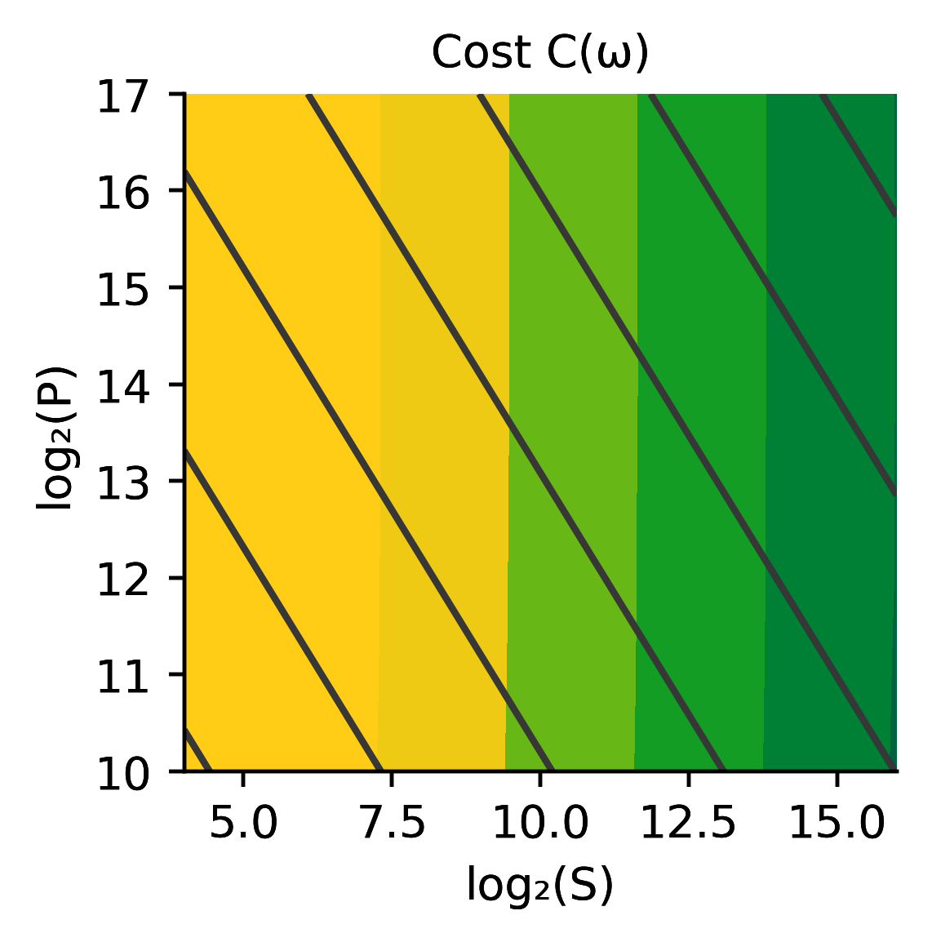
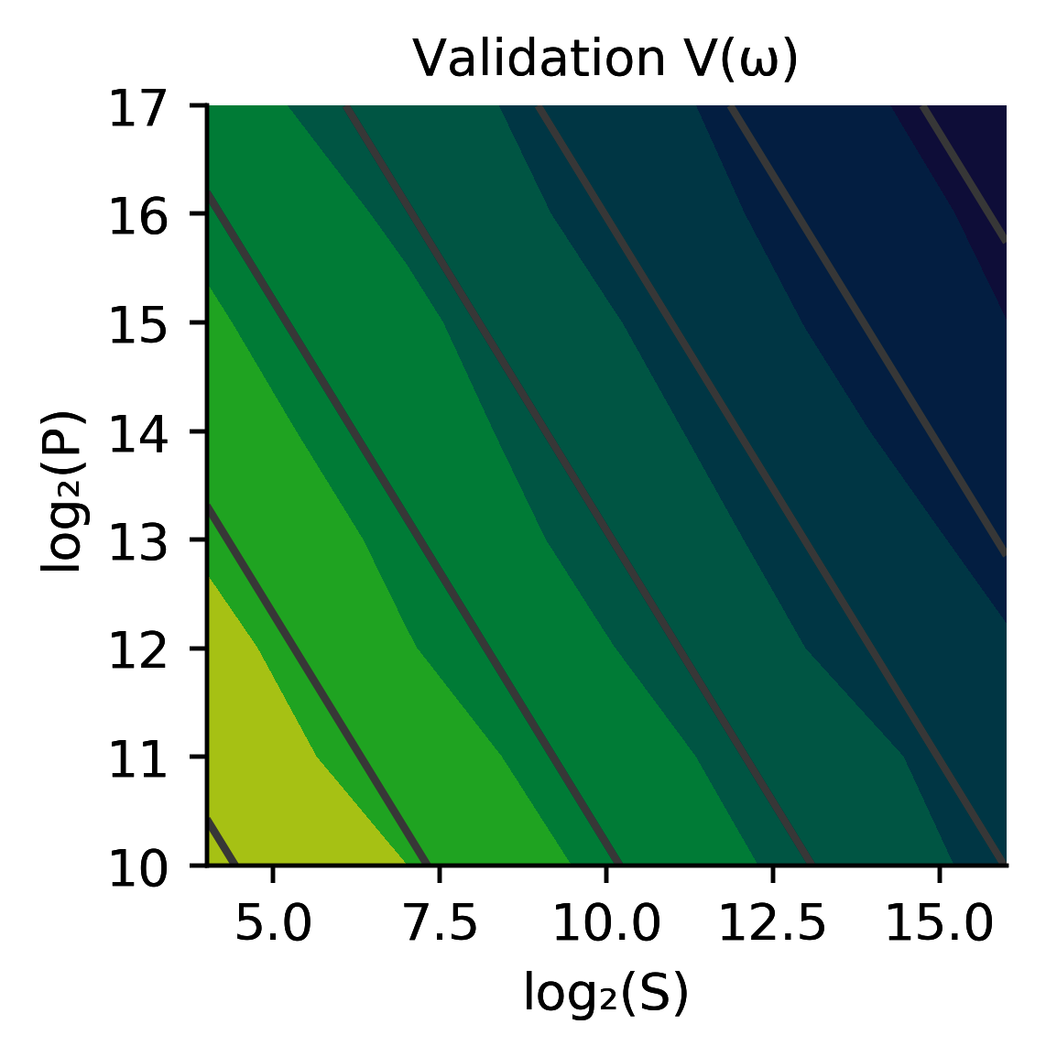
more pulses
The predicted final state given the parameters
P×S=const
Measured estimate of the actual final state
more samples
The actual final state
small error
large error
Optimized Cost (P unique pulses, each ran and sampled S times)
Notes:
Example from how some in-situ methods can reach an error floor of 1/S instead of 1/SP.

Slide 23
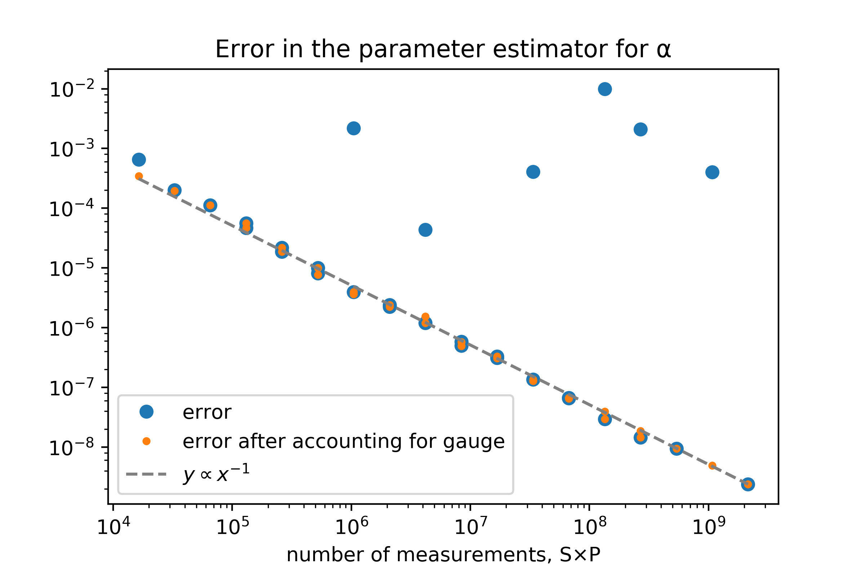
Theoretical Limit of Calibration Fidelity
Fisher Information:
Stuff being directly measured
Parameter we want to know
… is additive
Cramér–Rao bound:
Notes:
Sisi has nice notes on how we do reach this (depending on the choice of distance function).

Slide 24
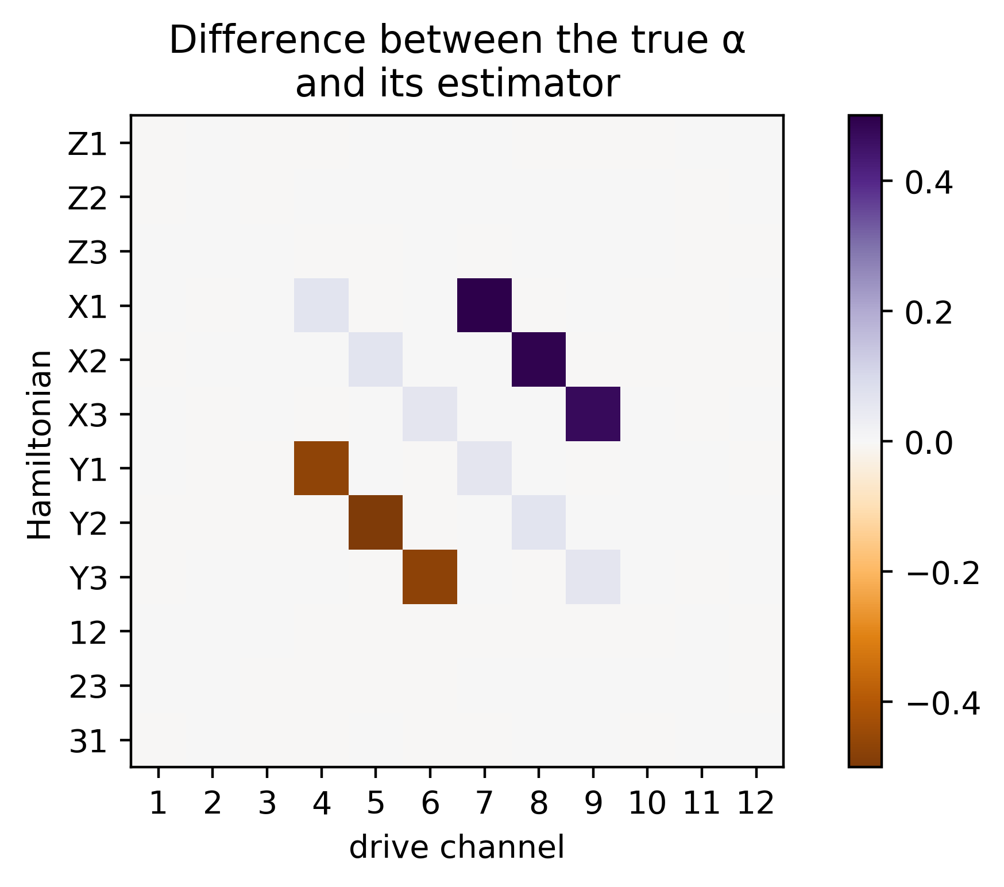
“Gauge” Degrees of Freedom
Permitted Operators (i = 1, 2 or 3):

Slide 25
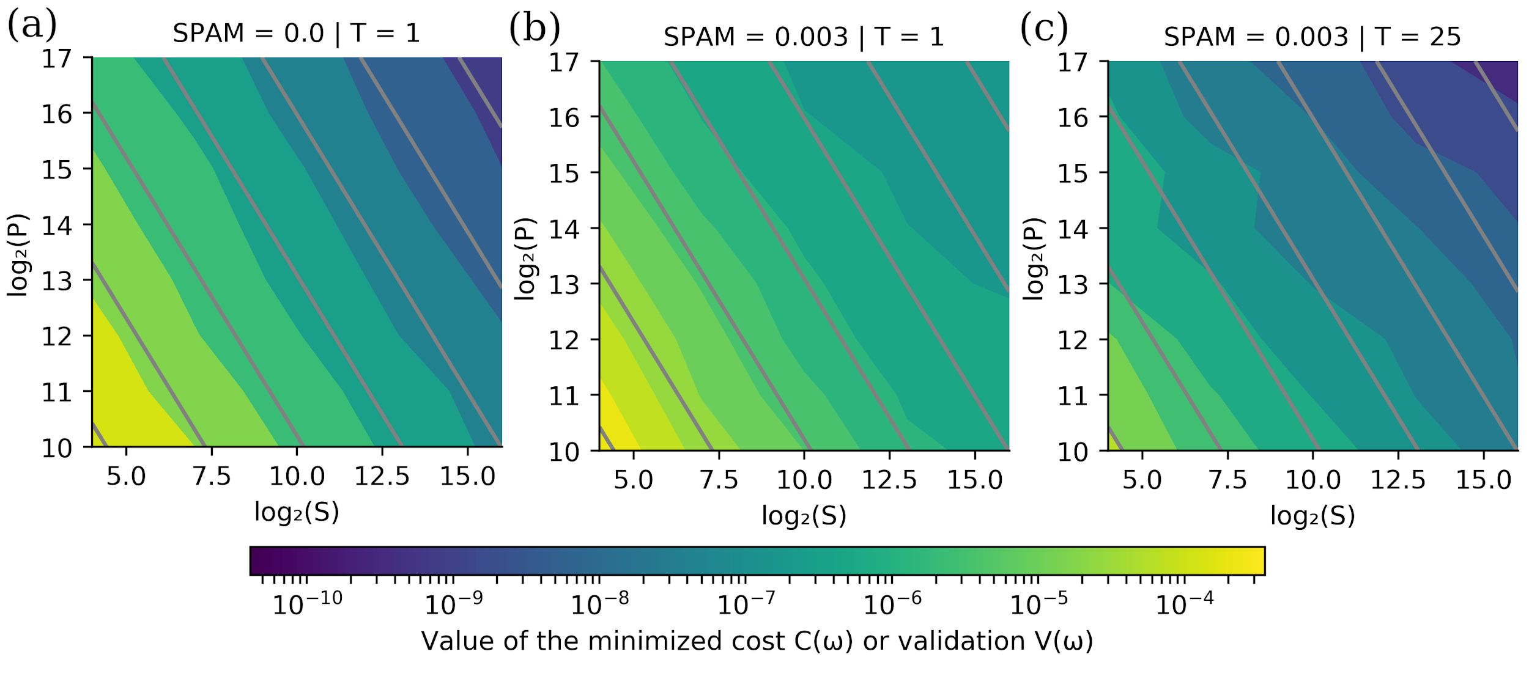
Intrinsic State Preparation and Measurement Errors
Intrinsic SPAM causes a bias in our estimator!

Slide 26
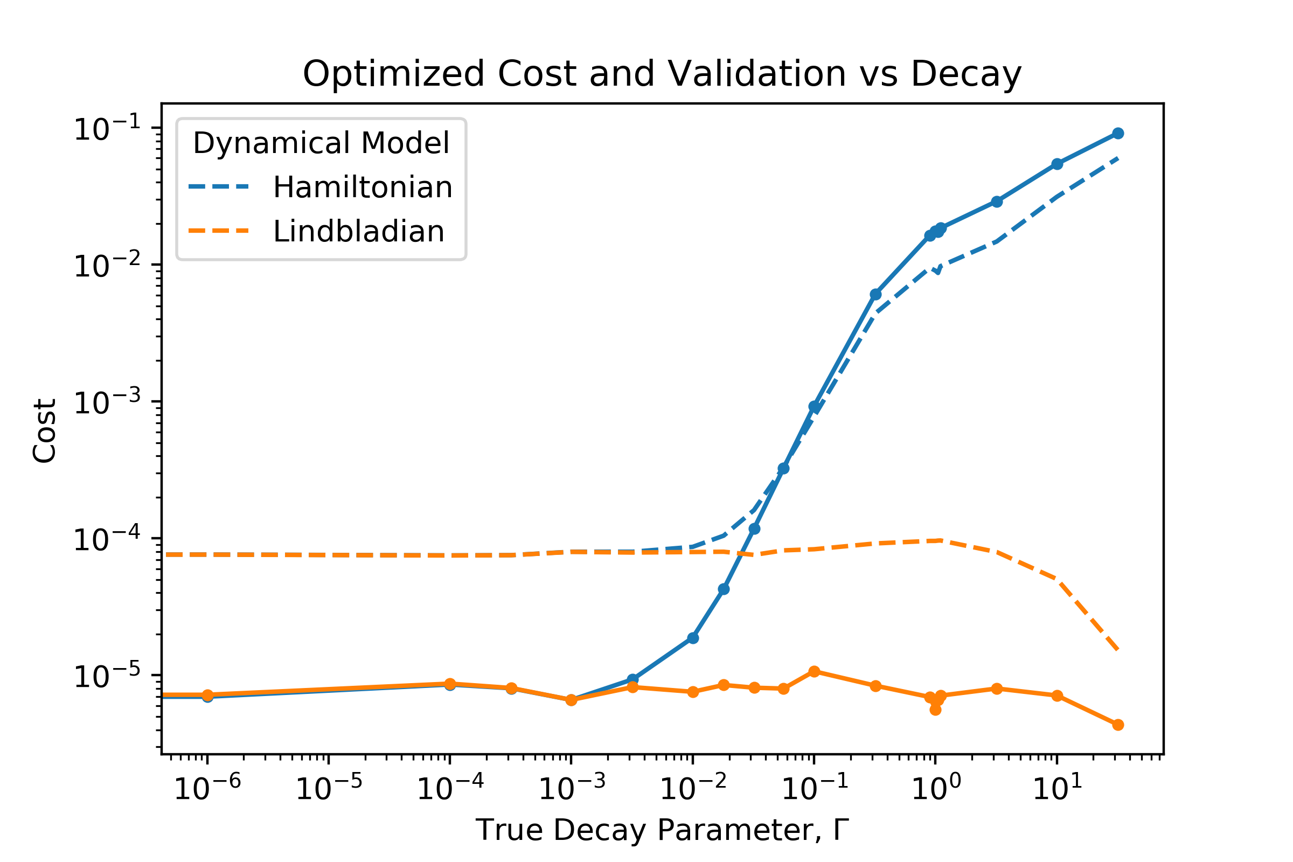
Non-unitary Evolution
A Hamiltonian model is incapable of capturing decoherence.
A Lindbladian model can cover most of the dynamics.

Slide 27
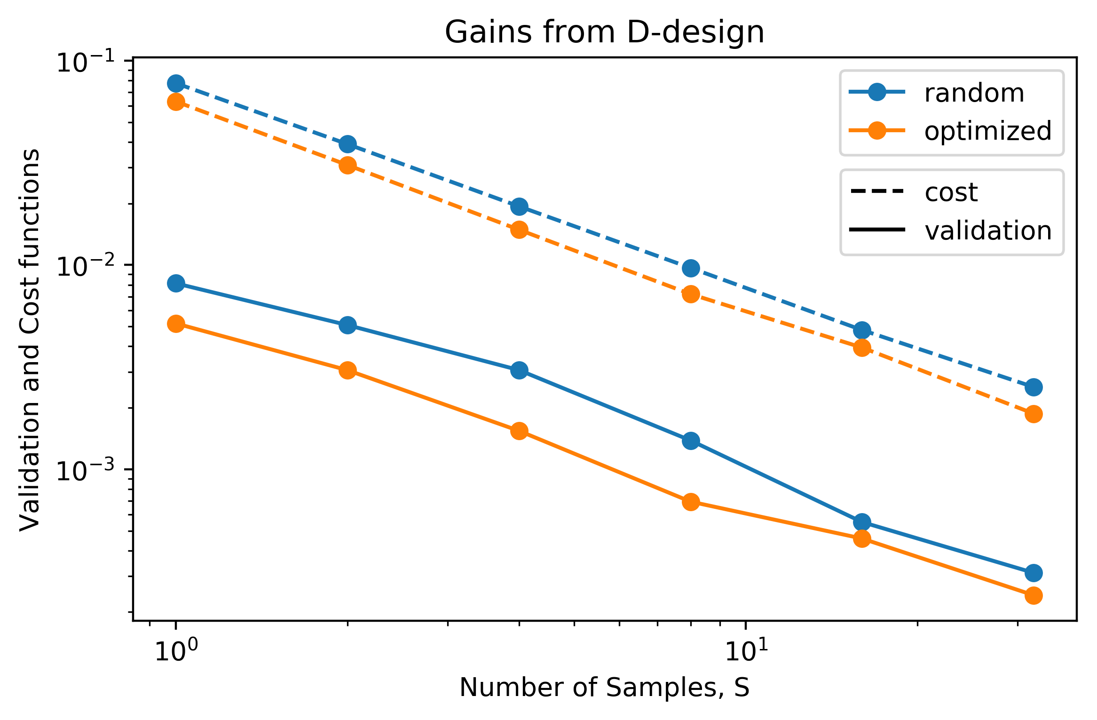
Improving Sensitivity Through Optimal Control
Naturally, the gradient descent procedure can be run in reverse to devise a control pulse for desired final state or another metric.
E.g. Fisher Information can be maximized.

Slide 28
What about Stochastic Master Equations
Alternative blackbox RNN approach in arxiv:1811.12420
Unitary (Hamiltonian) Dissipative (Lindbladian) Weak Measurement (Backaction)
Parameterization
Oscillation frequency
Measurement Record
Dissipation strength
Measurement efficiency

Slide 29
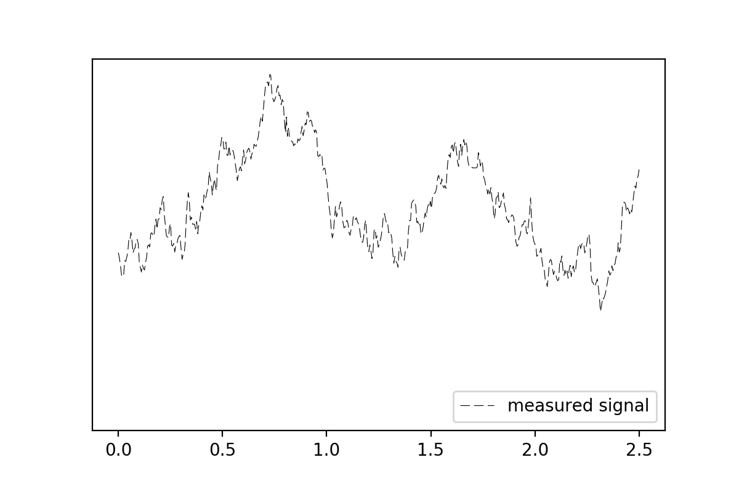
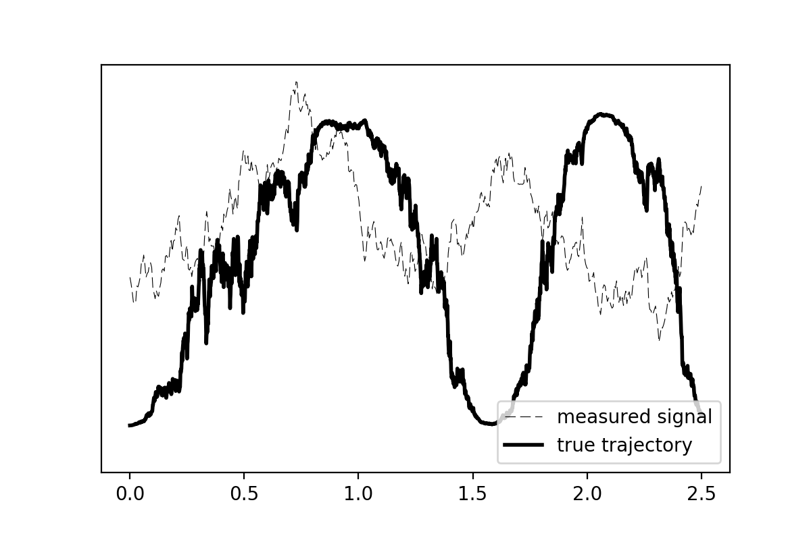
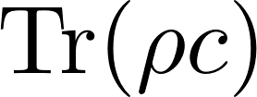
Excited state population
time
Example Trajectory: Weakly measuring the excited state population
Notes:
It is pretty difficult to get the true trajectory out of the measured signal.
Put a Tr(rho c) on the y axis.

Slide 30
The Model to which we fit
Unitary (Hamiltonian)
Dissipative (Lindbladian)
Weak Measurement (Backaction)

Slide 31
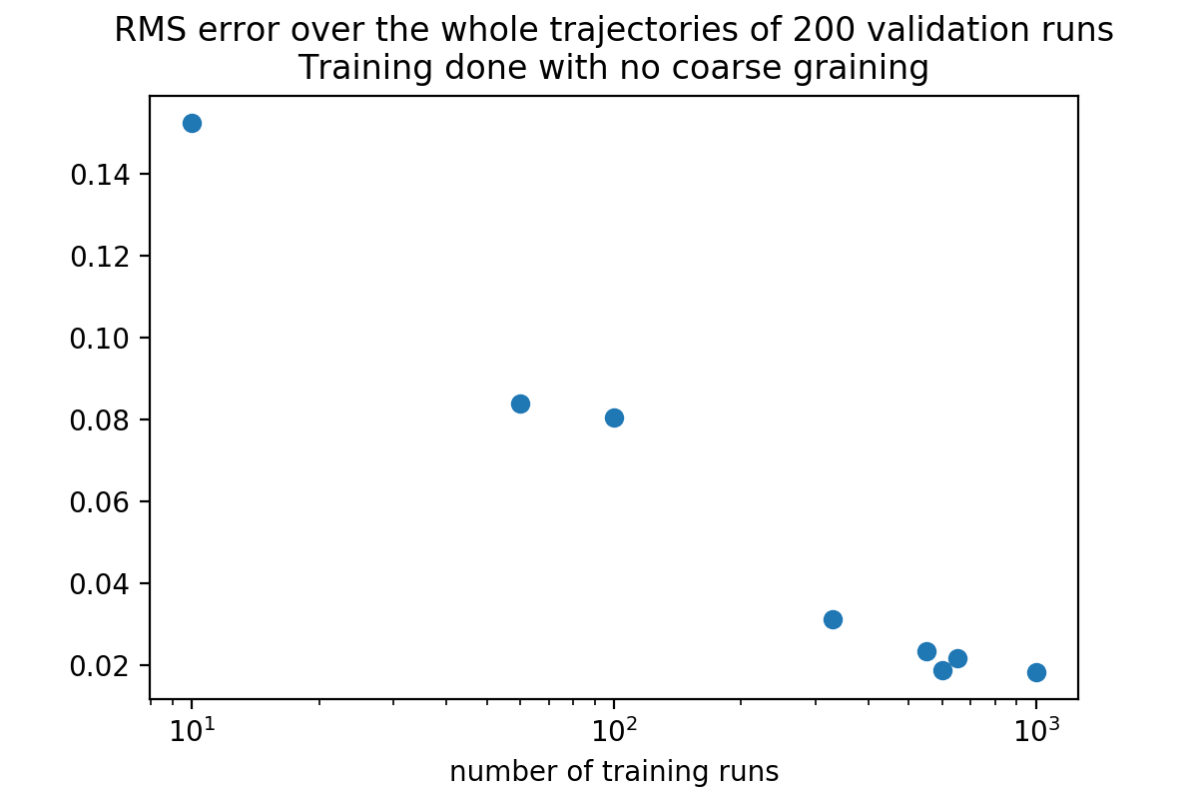
Estimator performance vs Amount of measurement data

Slide 32
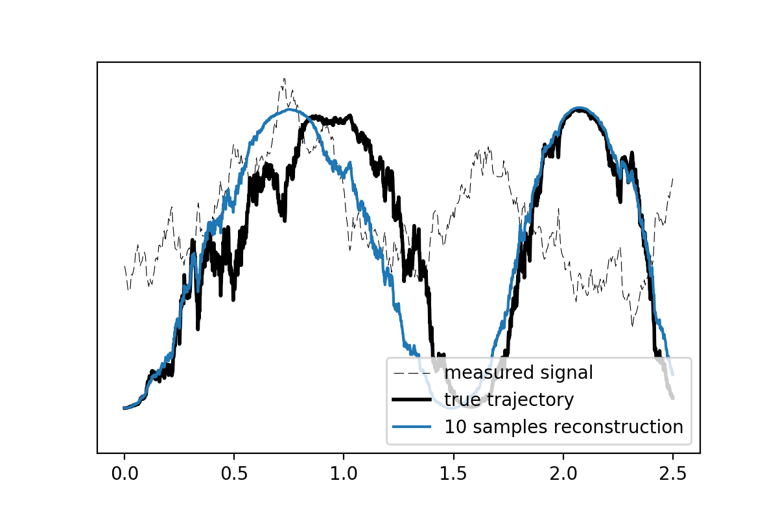
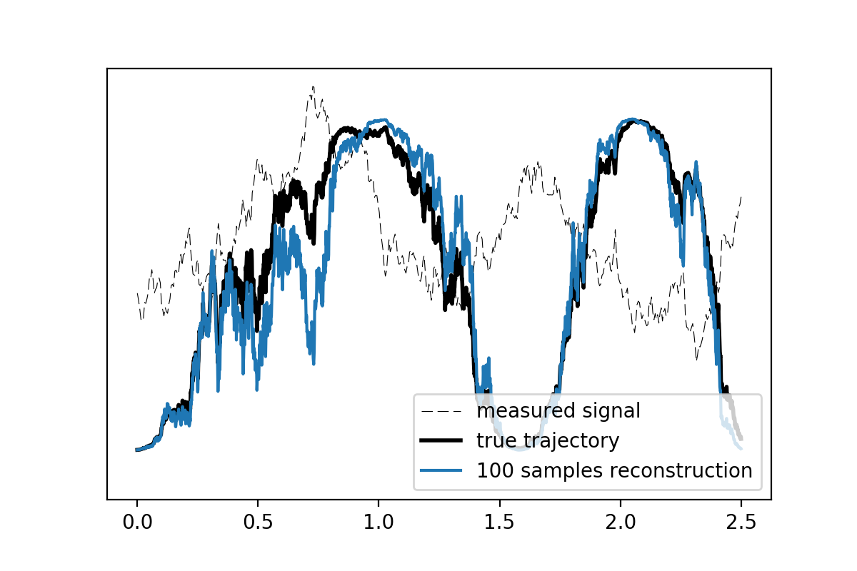
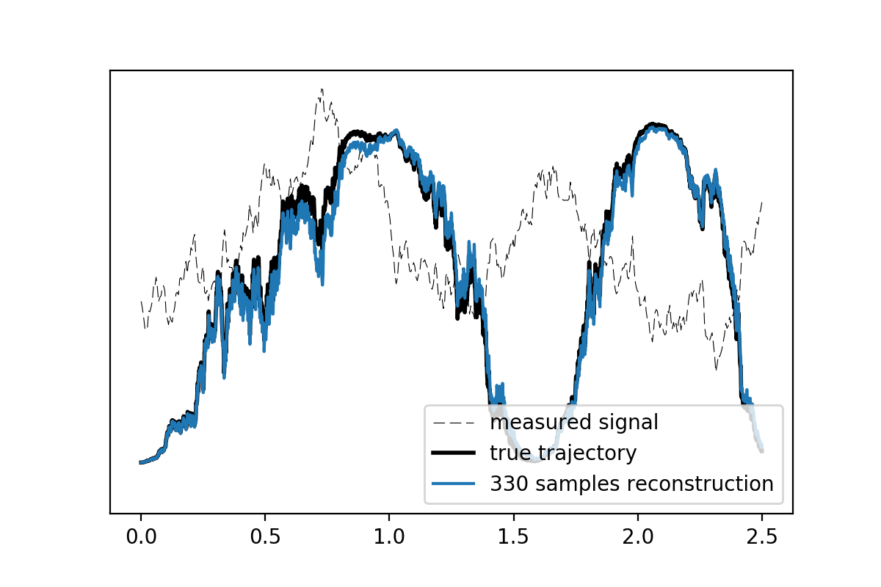
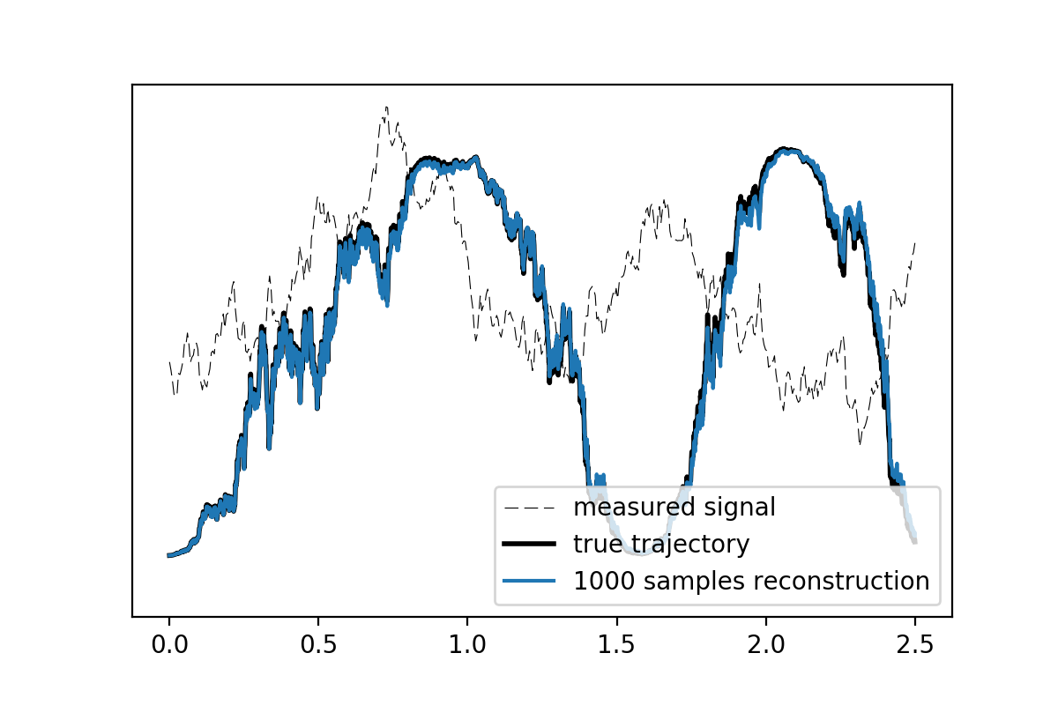
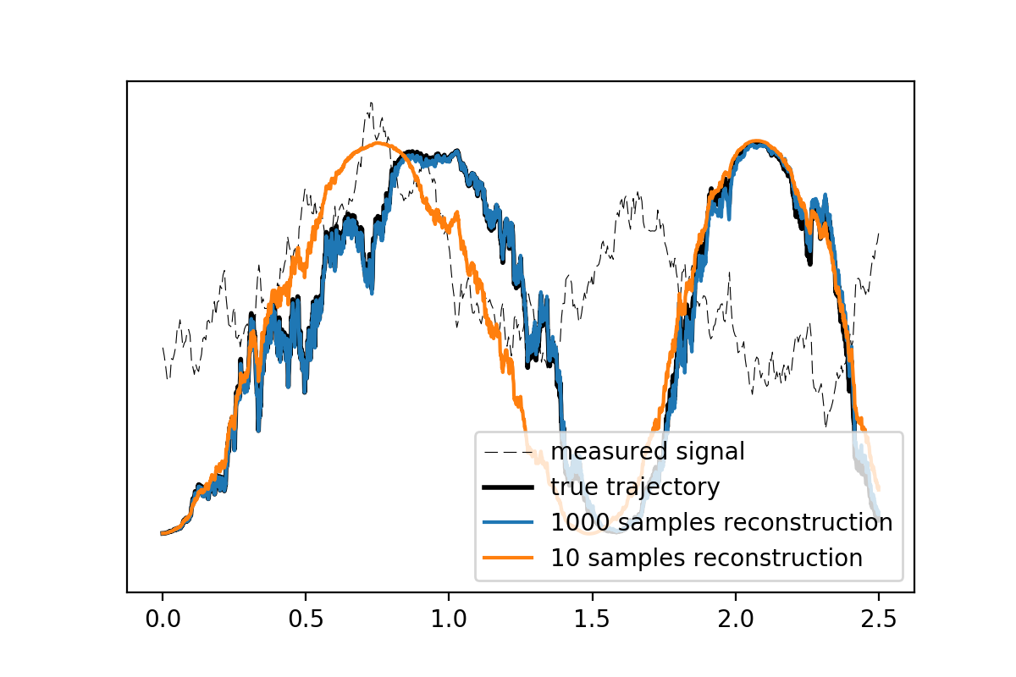
Example Reconstructions
1000× less measurement data required compared to RNN approaches.
Excited state population
time
Notes:
Put a Tr(rho c) on the y axis.

Slide 33
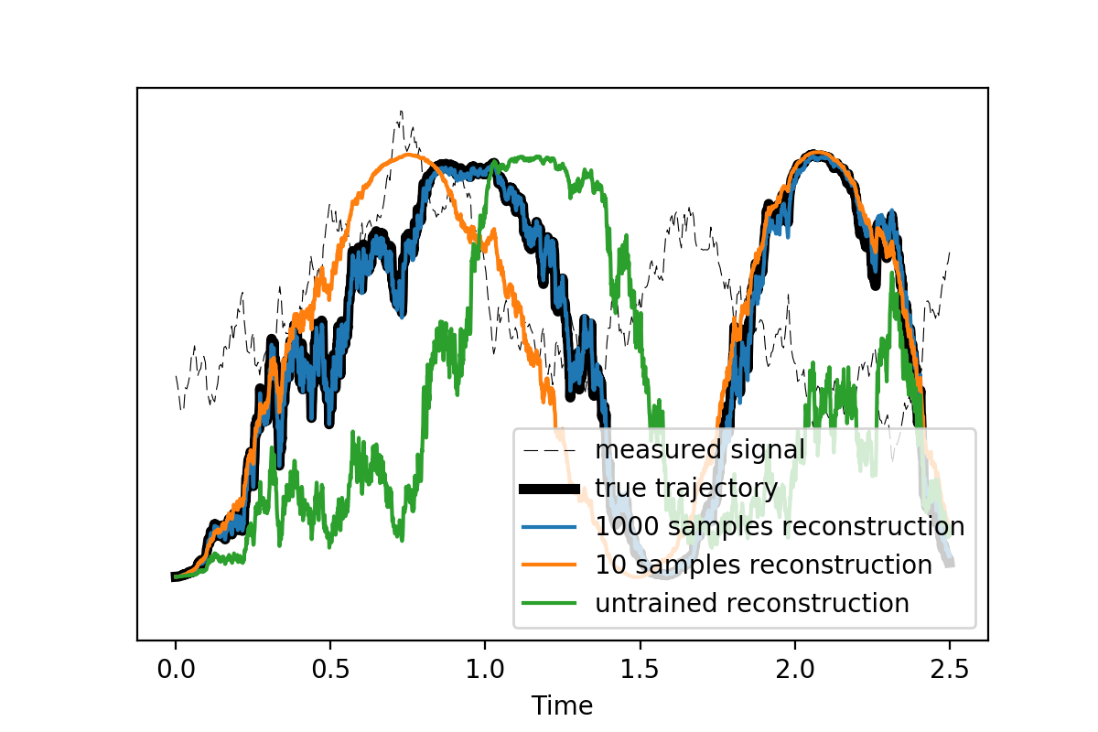
Example Reconstruction (including untrained run)

Slide 34
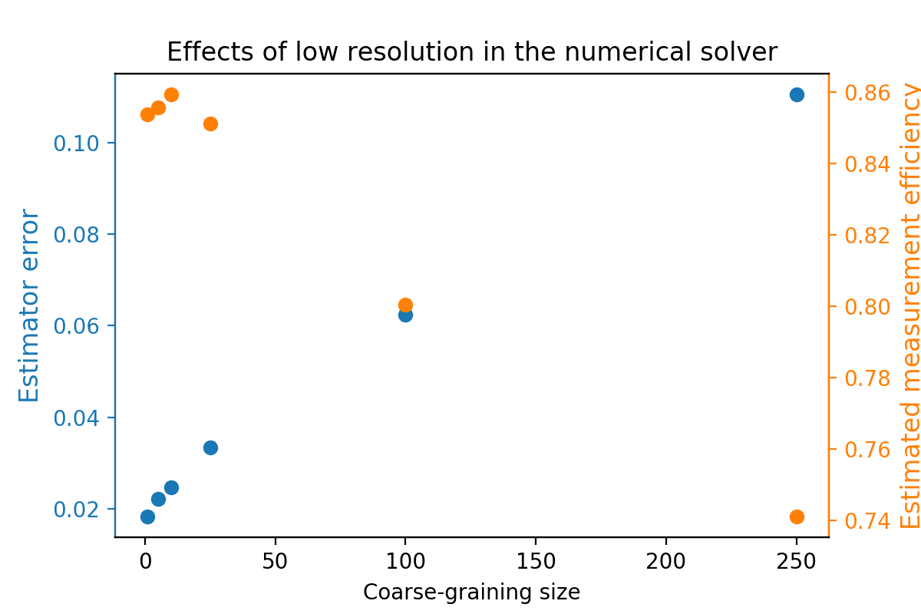
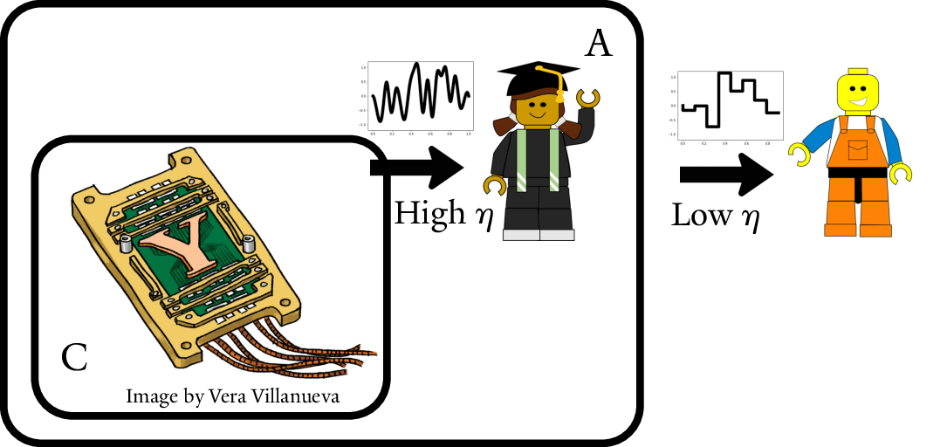
Weak Measurement Sampling Rate vs Numerical Timestep
Perfect measurement efficiency, i.e. η=1, implies infinite sampling rate for V!
Not usually a problem, until we try to integrate stiff systems...

Slide 35
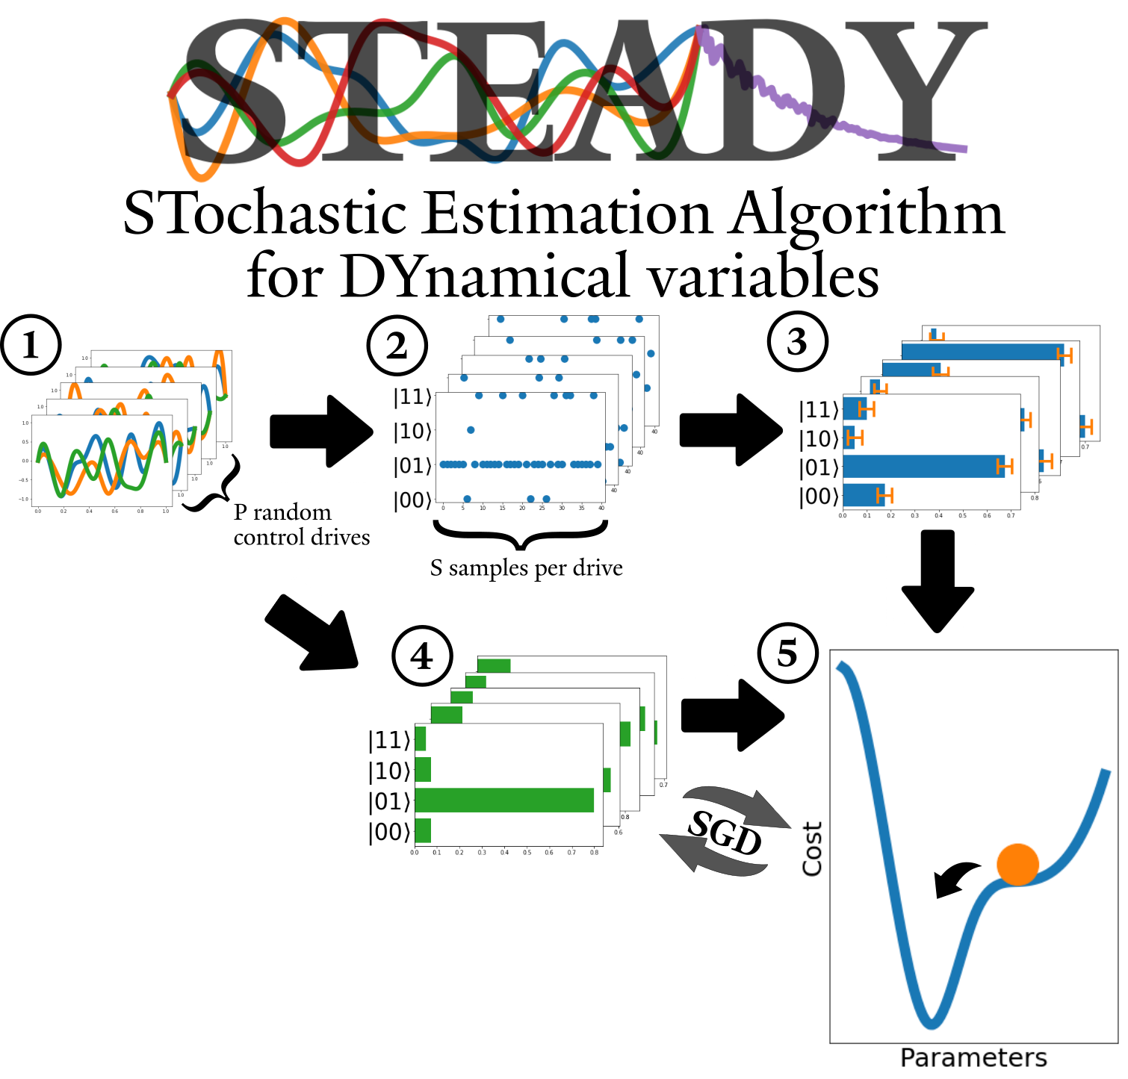
Stochastic Estimation Overview
Reaching for the information theory limit of performance
Learning the whole Hamiltonian/Lindbladian, not just a set of gates
Sparse Efficient Representation
Continuous (for use in optimal control)
“Experimental design” is easy to plug in
Deals with SPAM and non-unitary errors
General while still Interpretable
Embarrassingly simple implementation

Slide 36
Outline
Control and Calibration
Purifying Resources with Imperfect Circuits

Slide 37
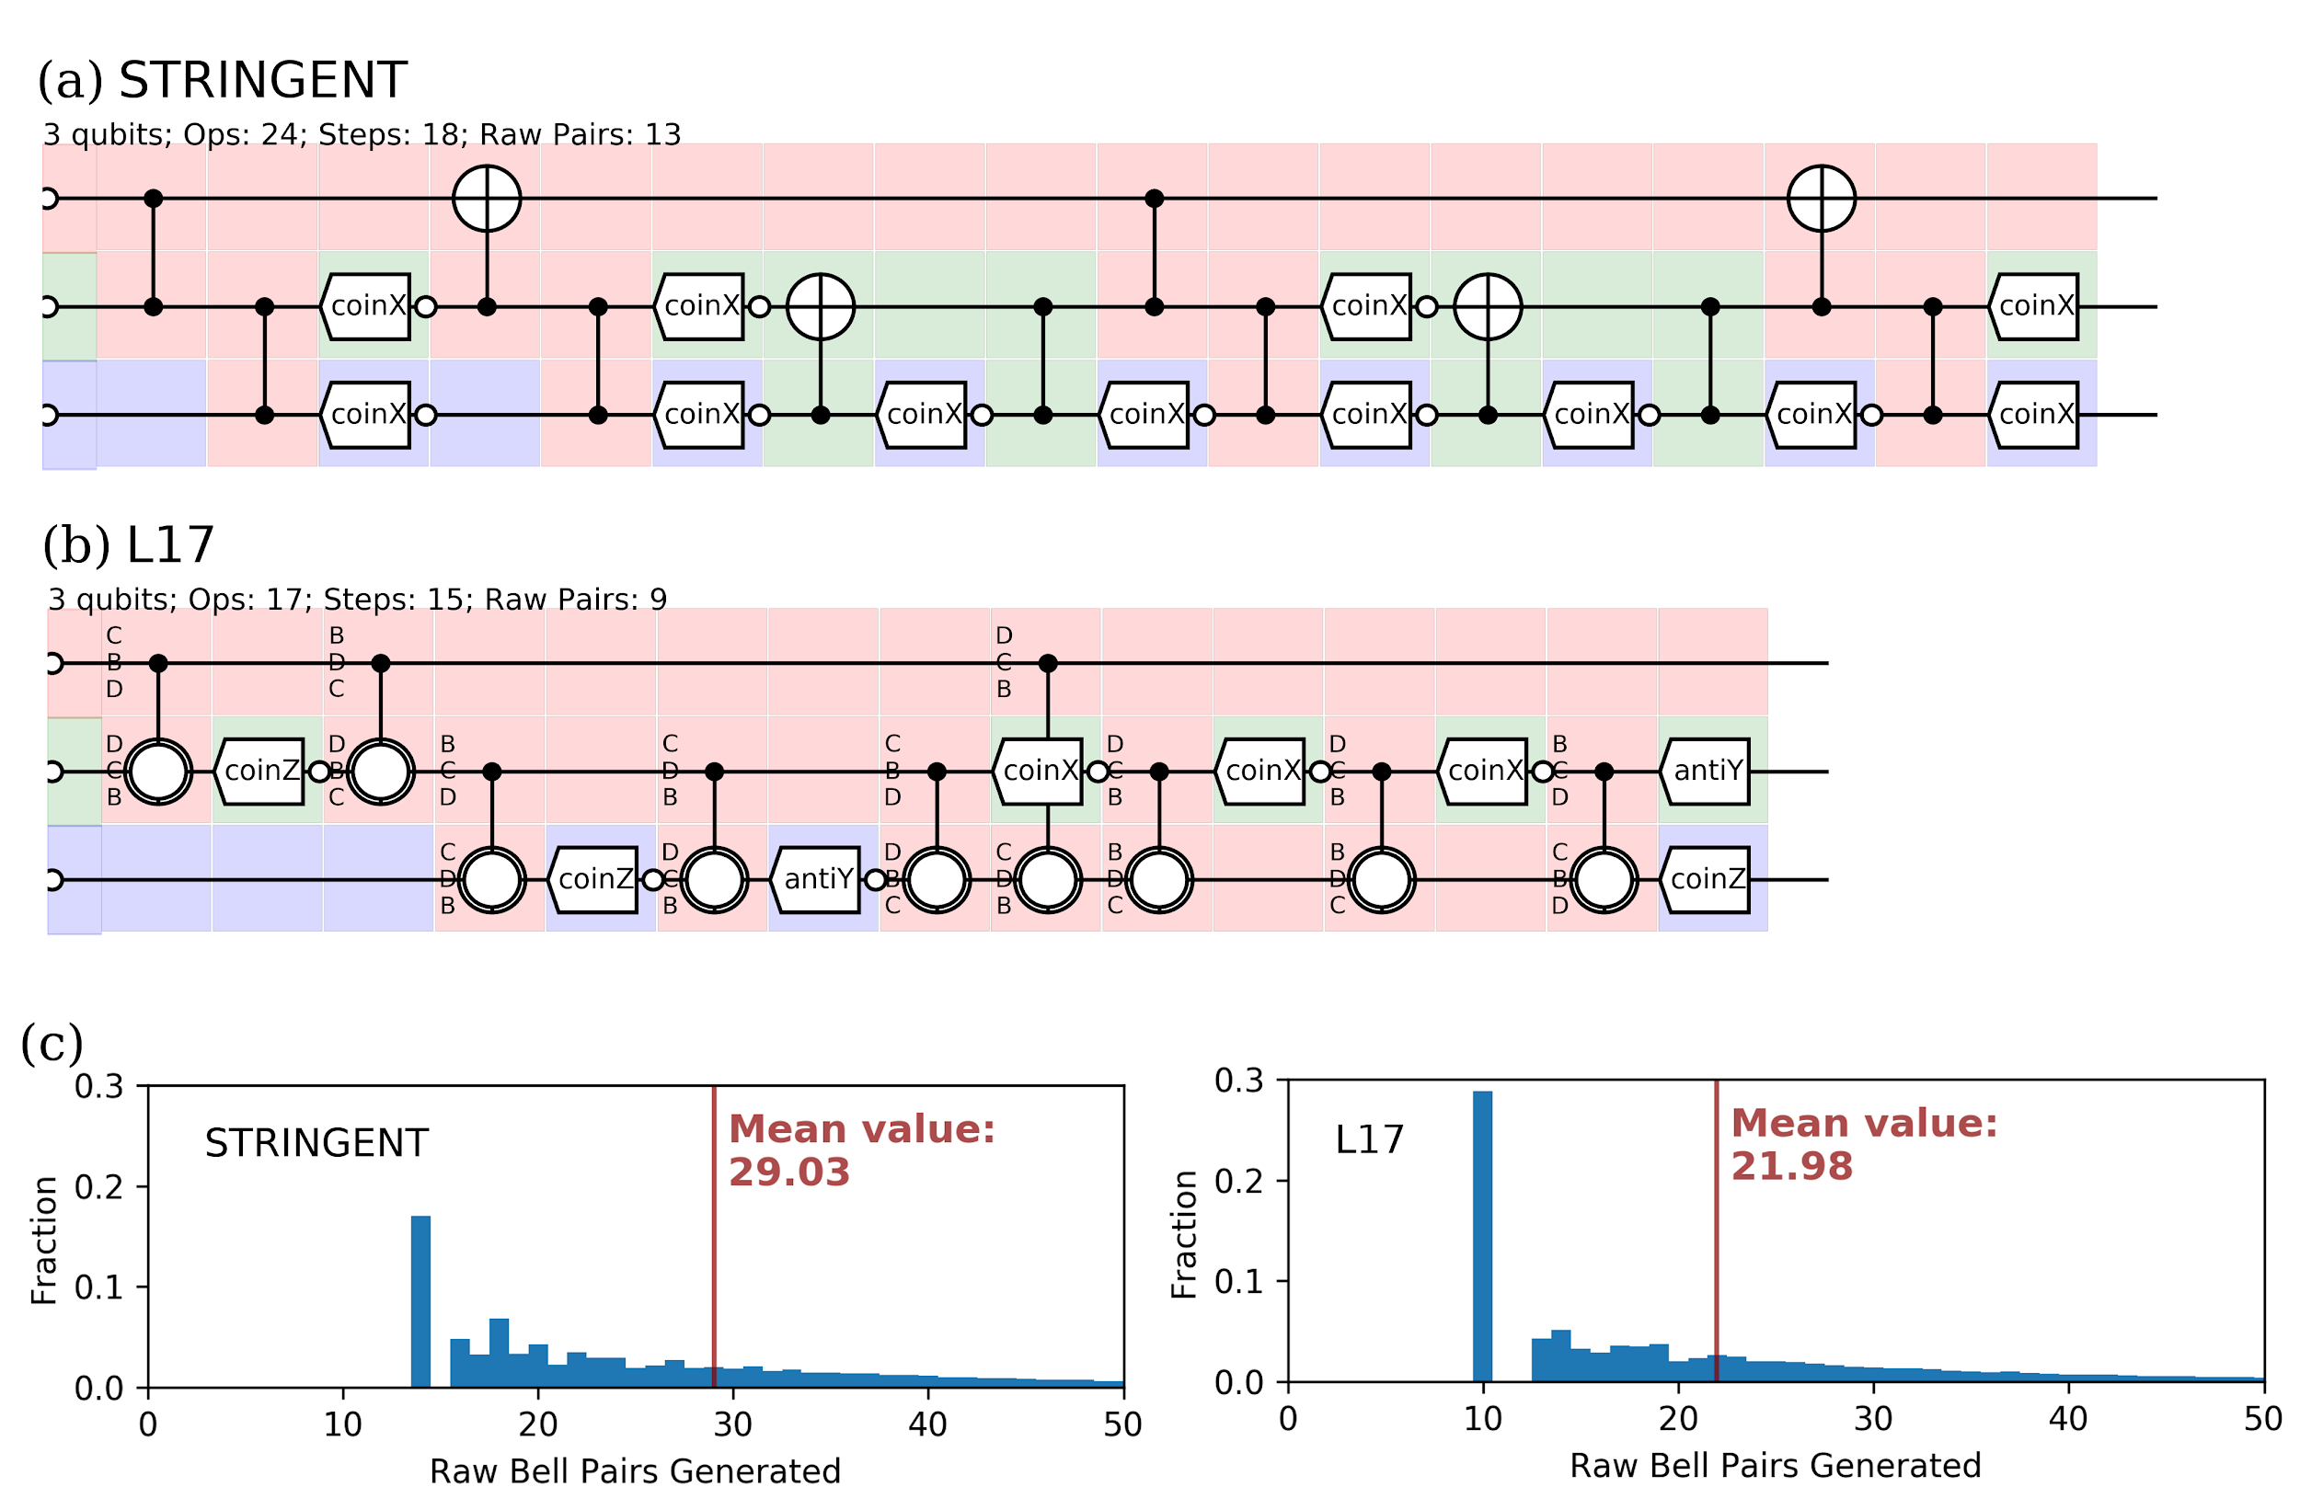
Purifying Resources through Imperfect Circuits
arxiv:1712.09762 / Quantum 2019

Slide 38
Real Bell Pairs are Imperfect
Y error
bit flip error (X)
phase error (Z)

Slide 39
Purification of Imperfect Resources
Four possible Bell states A, B, C, and D.
Typically an entanglement generator would not provide perfect pairs, rather (for instance):
A at 90% B, C, and D at 3.3%
We use two such imperfect Bell pairs to distil one higher quality pair.

Slide 40
Purification
Alice’s side of the circuit.
Sacrificial Bell pair.
Bell pair to be purified.
Bob’s side of the circuit. Alice does the same to her “half pairs”.

Slide 41
Purification
Bob’s side of the circuit. Alice does the same to her “half pairs”.
AA AB AC AD others
81% 3% 3% 3% …
AA remains AA DD becomes AD etc
Trace over the second pair, selecting only A or D.
Result: 93% A in the first pair.
Tracing over the second pair returns the same quality pair as the one we started with.

Slide 42
The Initial State
Single pair:
A - F B - q C - q D - q
e.g. F=90% and q=3.3%
Two pairs:
AA - FF AB - Fq AC - Fq AD - Fq BA - Fq BB - qq BC - qq BD - qq CA - Fq CB - qq CC - qq CD - qq DA - Fq DB - qq DC - qq DD - qq

Slide 43
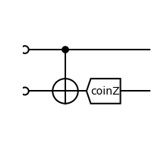
Restating in the form of permutations and selections
CNOT:
AA⇨AA AB⇨DB AC⇨AC AD⇨DD BA⇨BC BB⇨CD BC⇨BA BD⇨CB CA⇨CC CB⇨BD CC⇨CA CD⇨BB DA⇨DA DB⇨AB DC⇨DC DD⇨AD
Coincidence Z:
take A and D
Case study:
CNOT as a permutation on the Bell basis Coincidence Z measurement as selecting half of the set
AA : FF AB : Fq AC : Fq AD : Fq BA : Fq BB : qq BC : qq BD : qq CA : Fq CB : qq CC : qq CD : qq DA : Fq DB : qq DC : qq DD : qq
⇨ ⇨ ⇨ ⇨ ⇨ ⇨ ⇨ ⇨ ⇨ ⇨ ⇨ ⇨ ⇨ ⇨ ⇨ ⇨
FF
qq
Fq
qq
qq
qq
Fq
qq
qq
qq
Fq
qq
Fq
Fq
qq
Fq

Slide 44
Why don’t we pick a better permutation?

Slide 45
Purification-enabling Gates
Unitary Operations
Clifford Operations
648 purifying local permutations (CNOT/SWAP based)
Bell Permutations
Local Operations
Notes:
6*6*6*3=648
648*⅔=144*3=432
144=6*6*4

Slide 46
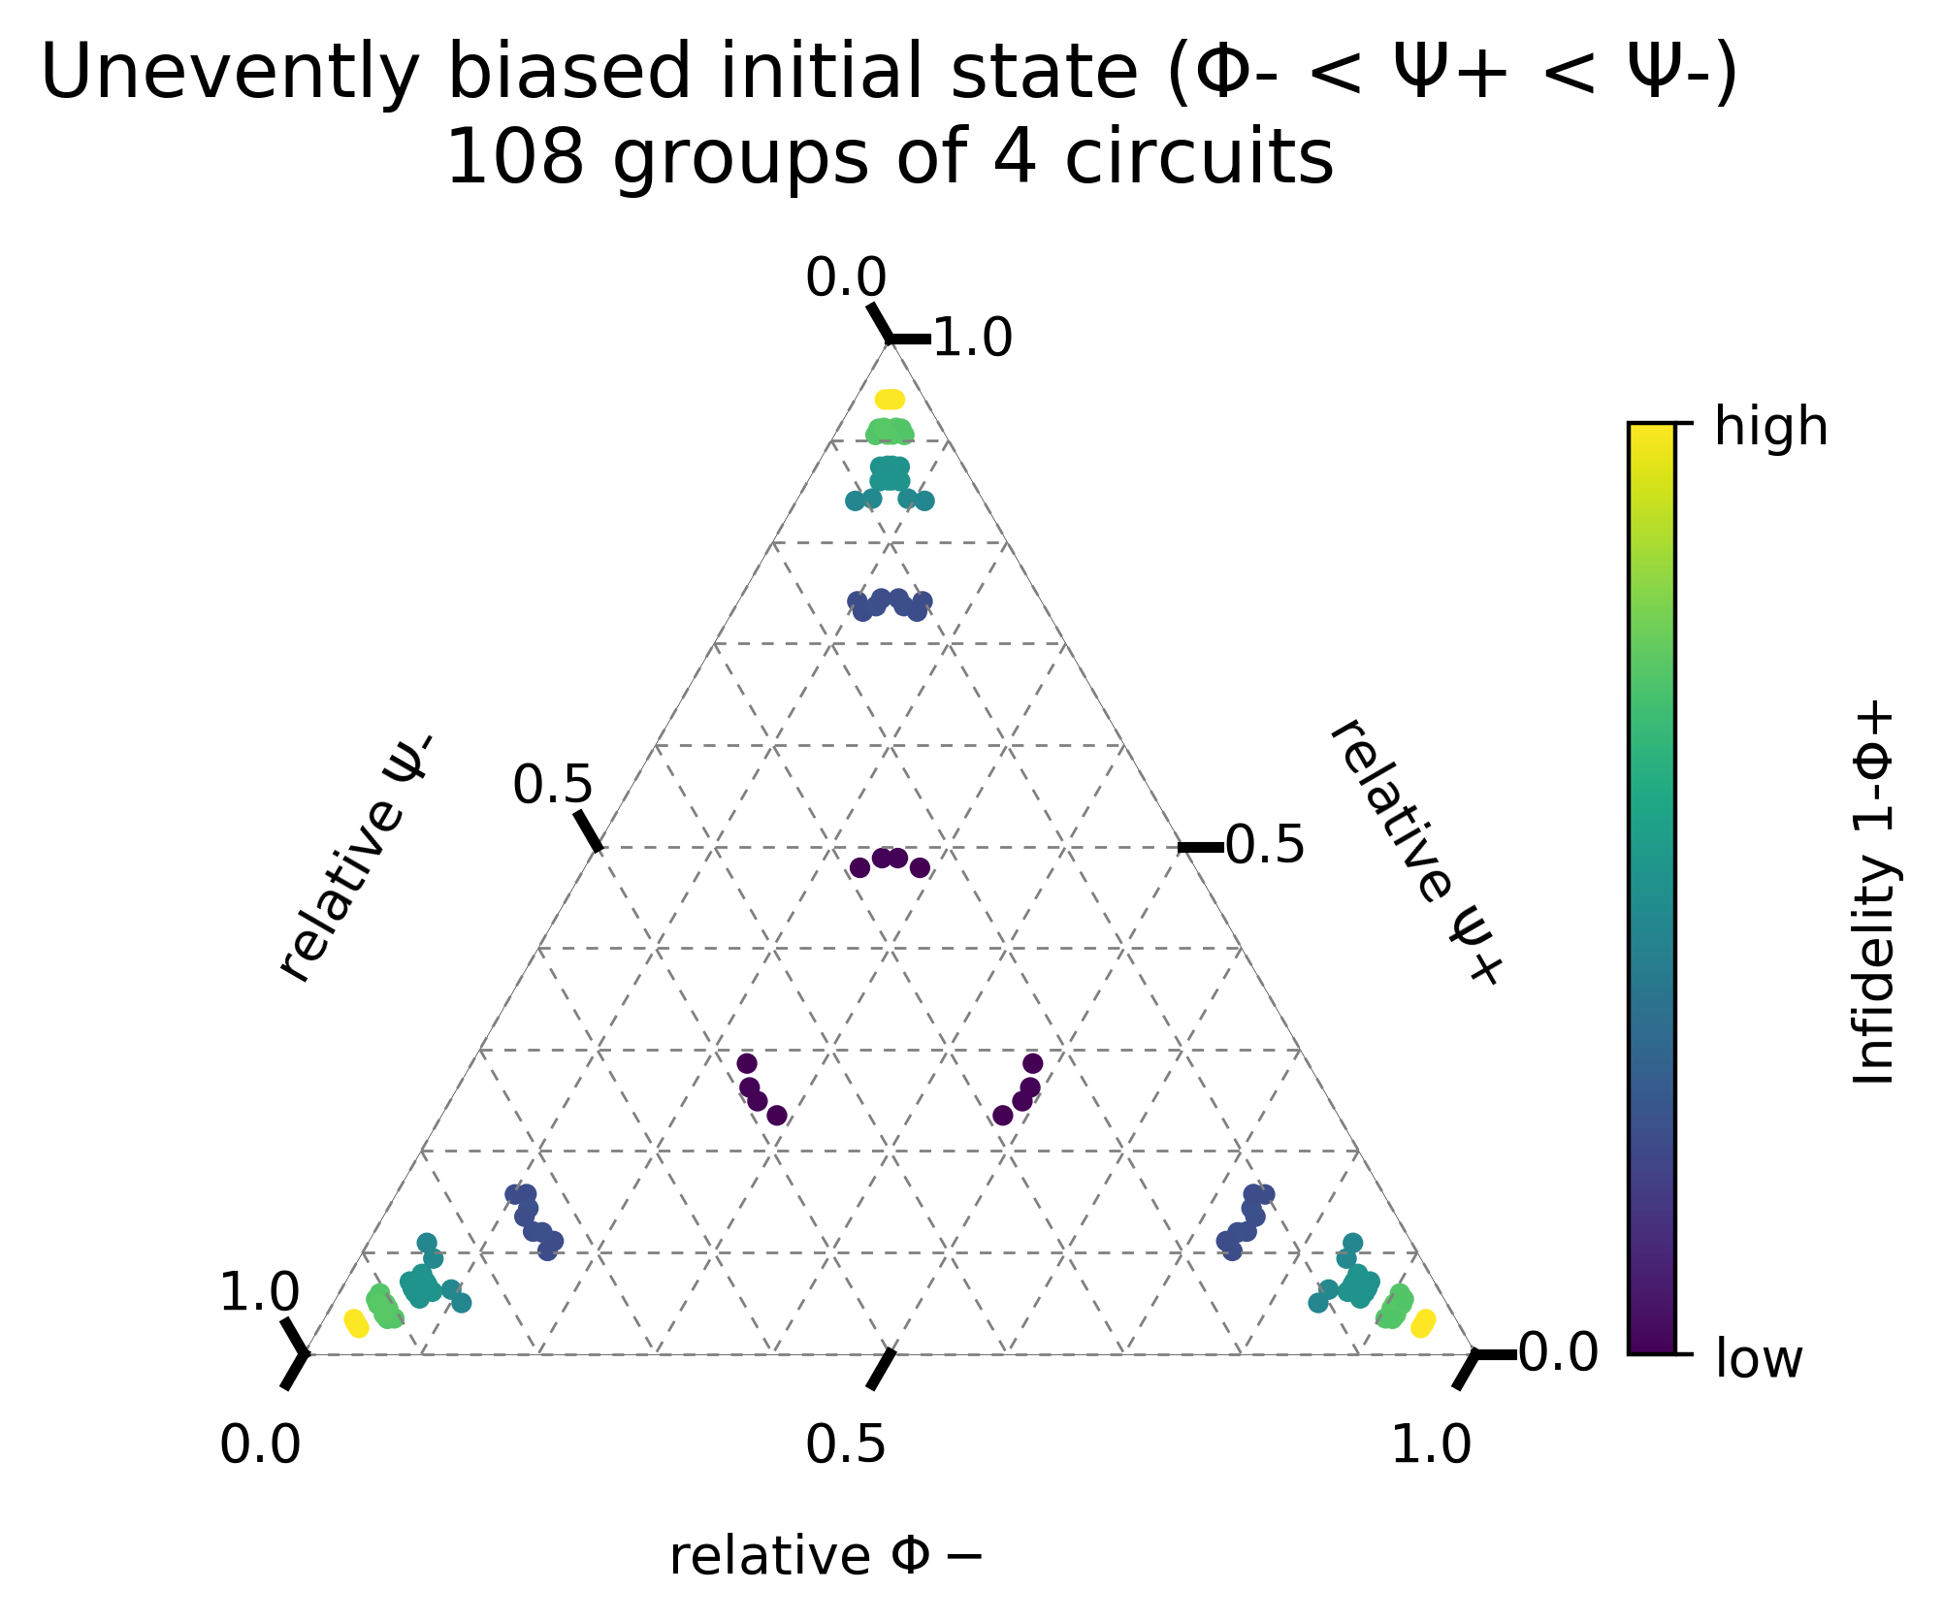
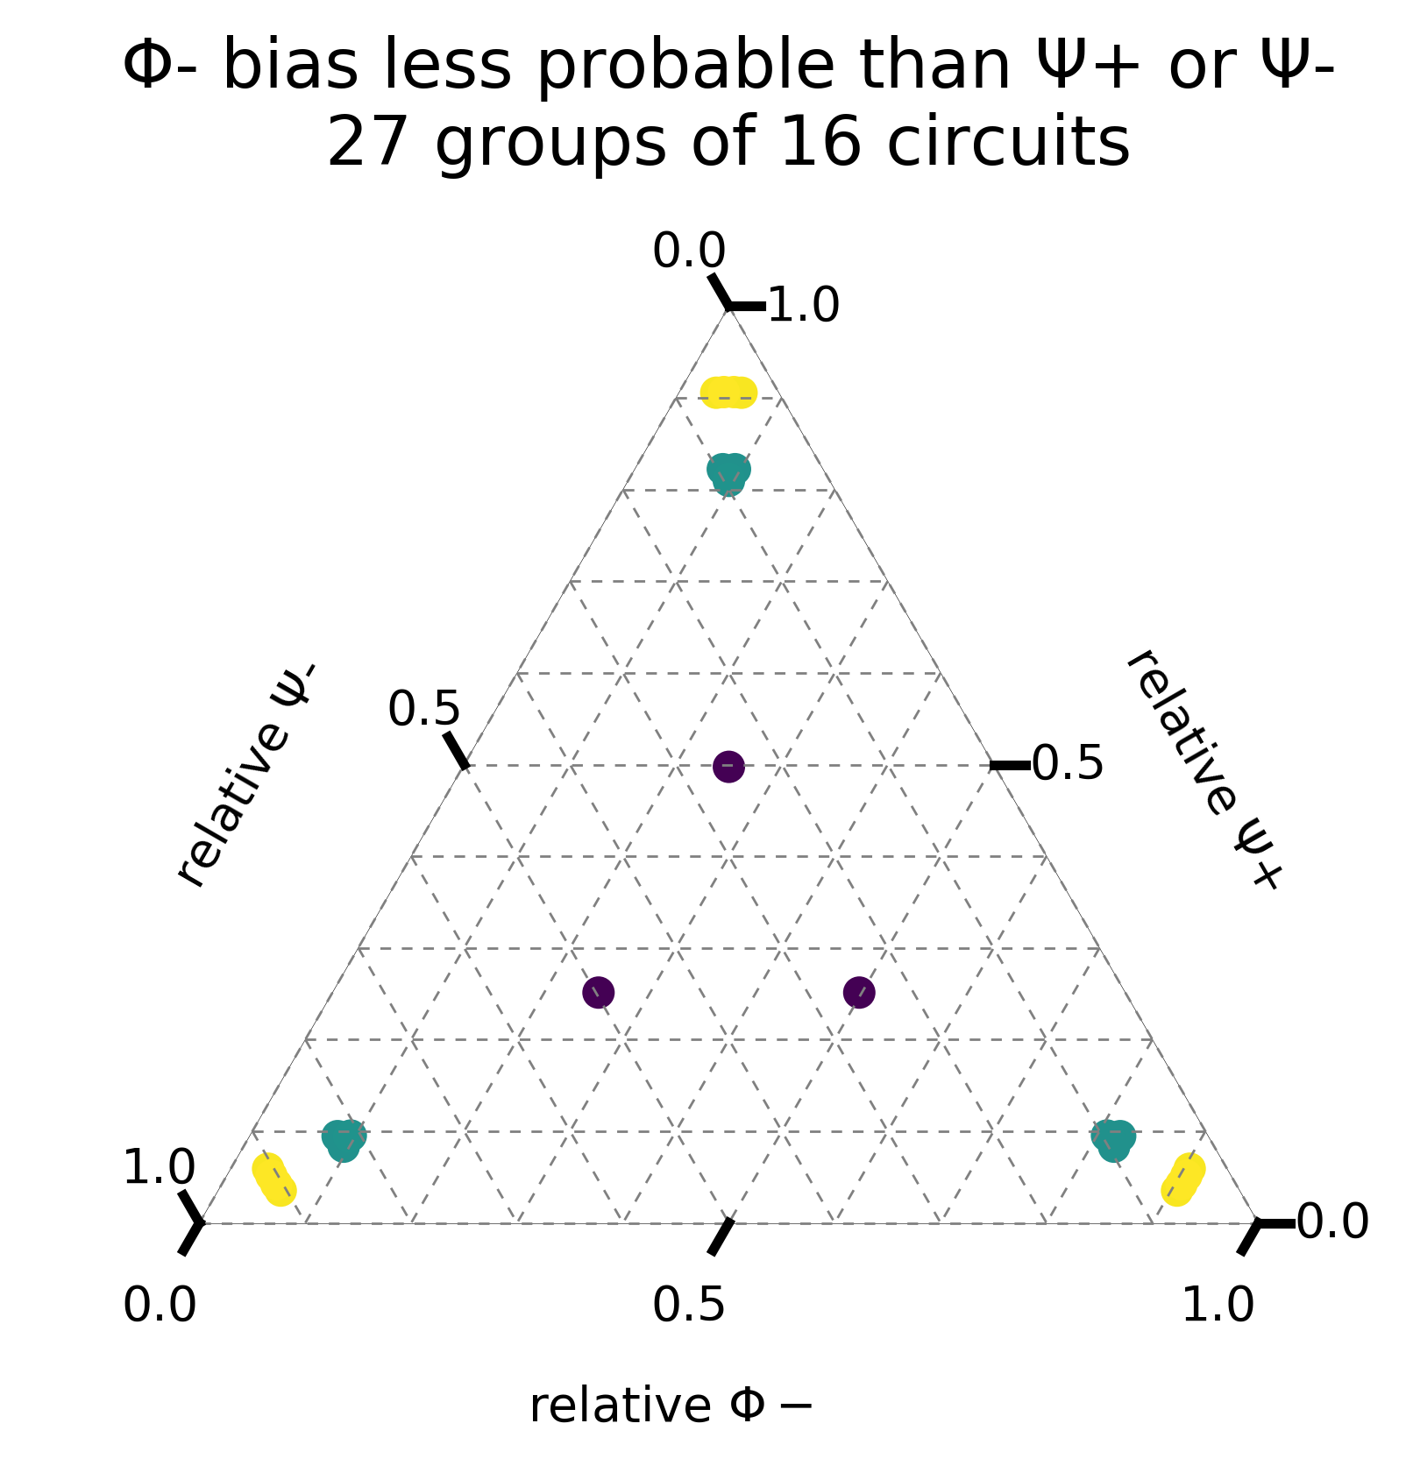
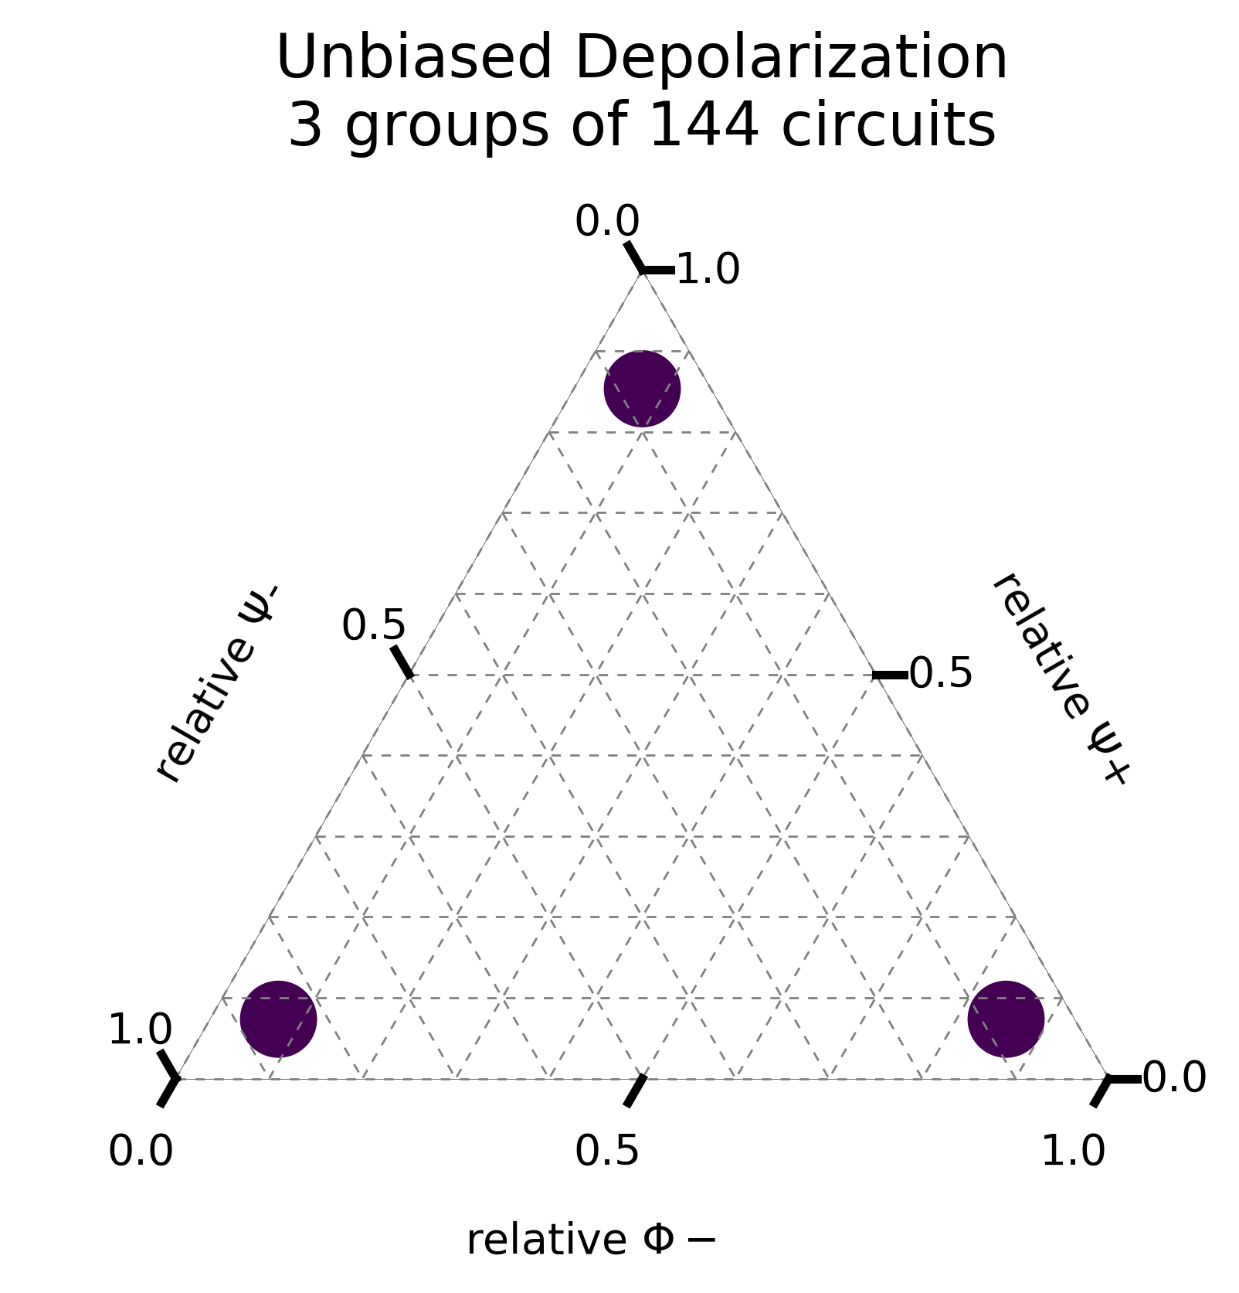
Useful Permutation Subgroups and Cosets

Slide 47
Making Bigger and Better Circuits
Notes:
35 minute mark

Slide 48
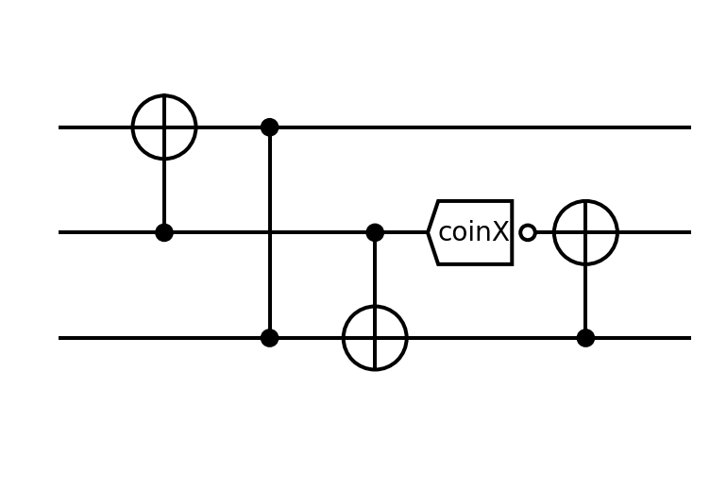
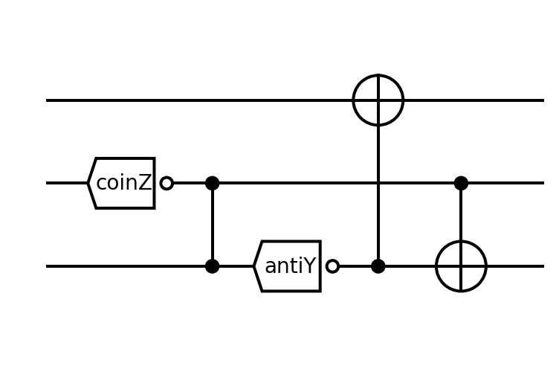
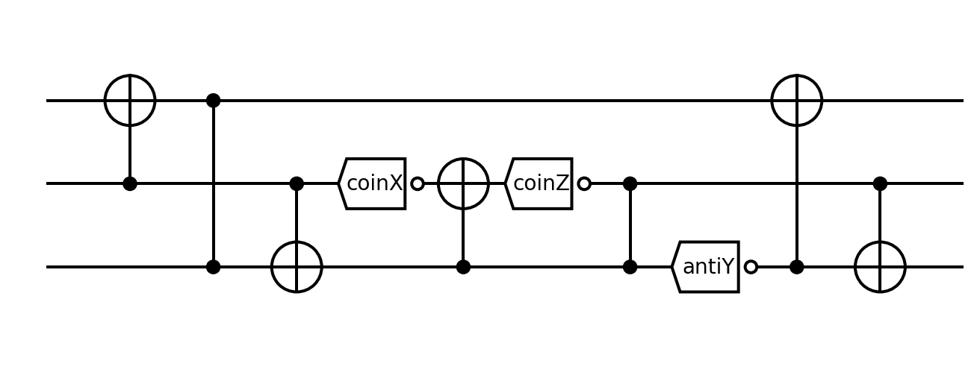
Optimized Purification (Genetic Algorithms)
Mutations
Creating Offspring Circuits

Slide 49
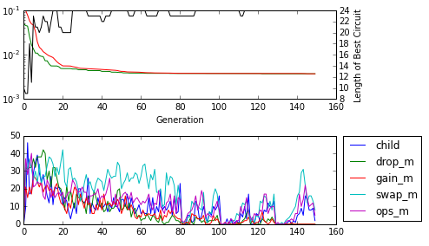
A Hundred Generations Later (5min laptop time)
For a given error model and specified error parameters quickly find near-optimal purification circuits.
Various optimizations related to the structure of the problem were implemented.
Real-time trace of the optimization process.

Slide 50
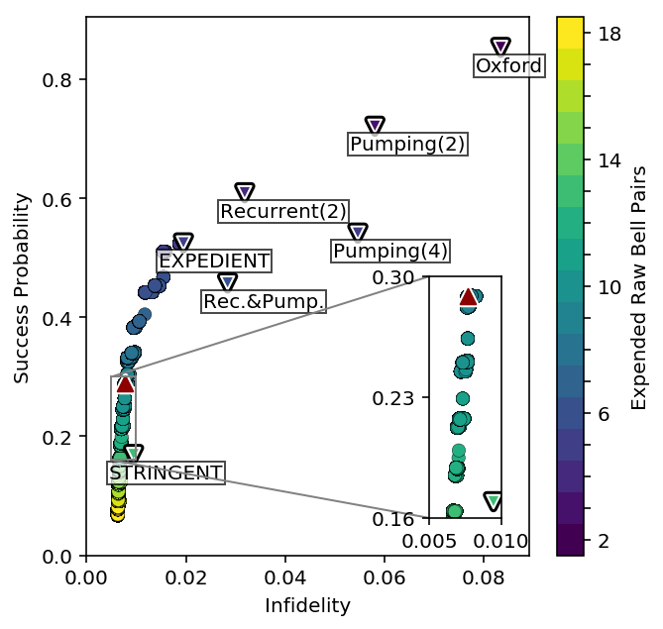
Better Than Prior Art
Breadth 3, simulated for
Initial Bell Pair Fidelity 0.9
Local Operations Fidelity 0.99
Depolarization Error Model
Available at qevo.krastanov.org
Circuits From: - Nickerson, Nature Comm. 4, 1756 (2014) - Deutsch, PRL 77, 2818 (1996) - Dür, PRA, 59, 169 (1999)

Slide 51
A Particular Example
One of the Best Competitors (STRINGENT)
Competitor
One of Our Circults
Ours

Slide 52
Example with a Communication Qubit
Nigmatulin et al: - 6 raw Bell pairs - 2.46% infidelity
Our optimized circuit: - 5 raw Bell pairs - 1.77% infidelity

Slide 53
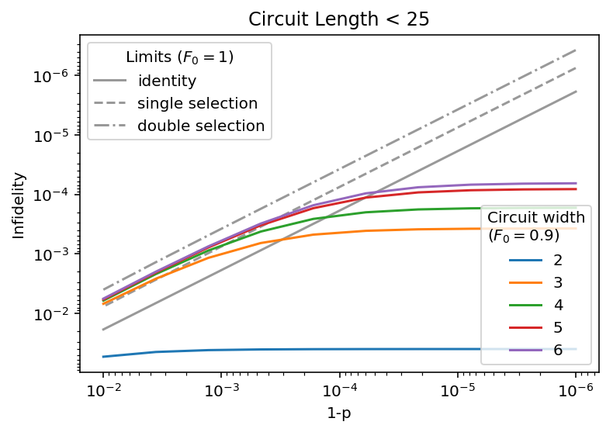
Initialization vs Operations’ Infidelity

Slide 54
Diminishing Returns

Slide 55
Optimized Circuits Overview
The optimizer is giving the best known circuits
They are customized to your hardware’s error model
The software also provides:
Monte Carlo resource estimates
Exact symbolic evaluation for the infidelities
code and examples at qevo.krastanov.org

Slide 56
Speculative Outlook
Bringing the two toolkits together:
The circuit optimization required working efficiently with noisy Clifford circuits
The parameter estimation is not yet scalable, as it requires quantum simulations
However, with some finite effort we can:
Design Clifford gates through optimal control over the estimated model
Run a random circuit of such imperfect Clifford gates
Perform infidelity estimation across this entire pipeline
Thus the parameter estimation would run efficiently even for larger systems
Notes:
What is the guaranteed convergence speed for stochastic gradient descent.

Slide 57
Thanks to Collaborators, Classmates, and Friends!
And thank you, Liang, for mentoring me and for enabling my teaching and outreach interests!
To colleagues and collaborators for working together, expanding our knowledge of the world.
And to friends and classmates, for supporting each other, and making life at Yale so much better.
High schoolers building motion-sensing LED bracelets (Eng. Day 2017) and learning the math and CS behind drawing fractals (Math Art 2018).

Slide 58
Questions?

