Slide 1
Quantum Information on Nonlinearly Coupled Optical Modes
Optimal Control and Hardware Prospects (arXiv:2002.07193)
May 12th, 2020
Stefan Krastanov, Mikkel Heuck, Jeffrey Shapiro, Prineha Narang, Dirk R. Englund, and Kurt Jacobs

Slide 2
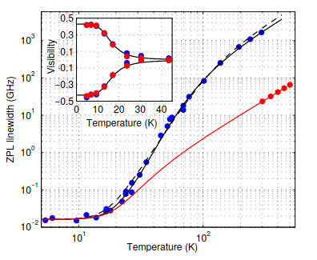
Room Temperature Nonlinear Photonics?
Small things get jittery when heated (thermal broadening)!
Plot of Linewidth vs Temperature for NVs More than GHz linewidth at room temperature.
Plakhotnik et al. Physical Review B 92.8 (2015): 081203

Slide 3
Quantum Control of Bulk Nonlinear Optics
Quantum Second-Harmonic Generation
Three-wave mixing with a controllable classical pump

Slide 4
These are
Compact
Versatile
Re-Programmable
Room Temperature
Quantum Processing Units

Slide 5
Programmable by an Optimal Control Approach

Slide 6
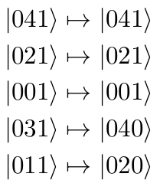
Programmable by an Optimal Control Approach
Example realization:
Example target operation:
Pumping mode b conditioned on parity

Slide 7
Exciting Examples of Room Temperature Control

Slide 8
Room Temperature Compiled Toffoli Gate
Others: At least 6 multi-qubit gates.
Our approach: A single application of our triply-resonant cavity gate.

Slide 9
Compact Measurement-Free Error Correction (did I mention it is room temperature)
First correction step (with the use of some ancillas):
Second correction step:

Slide 10
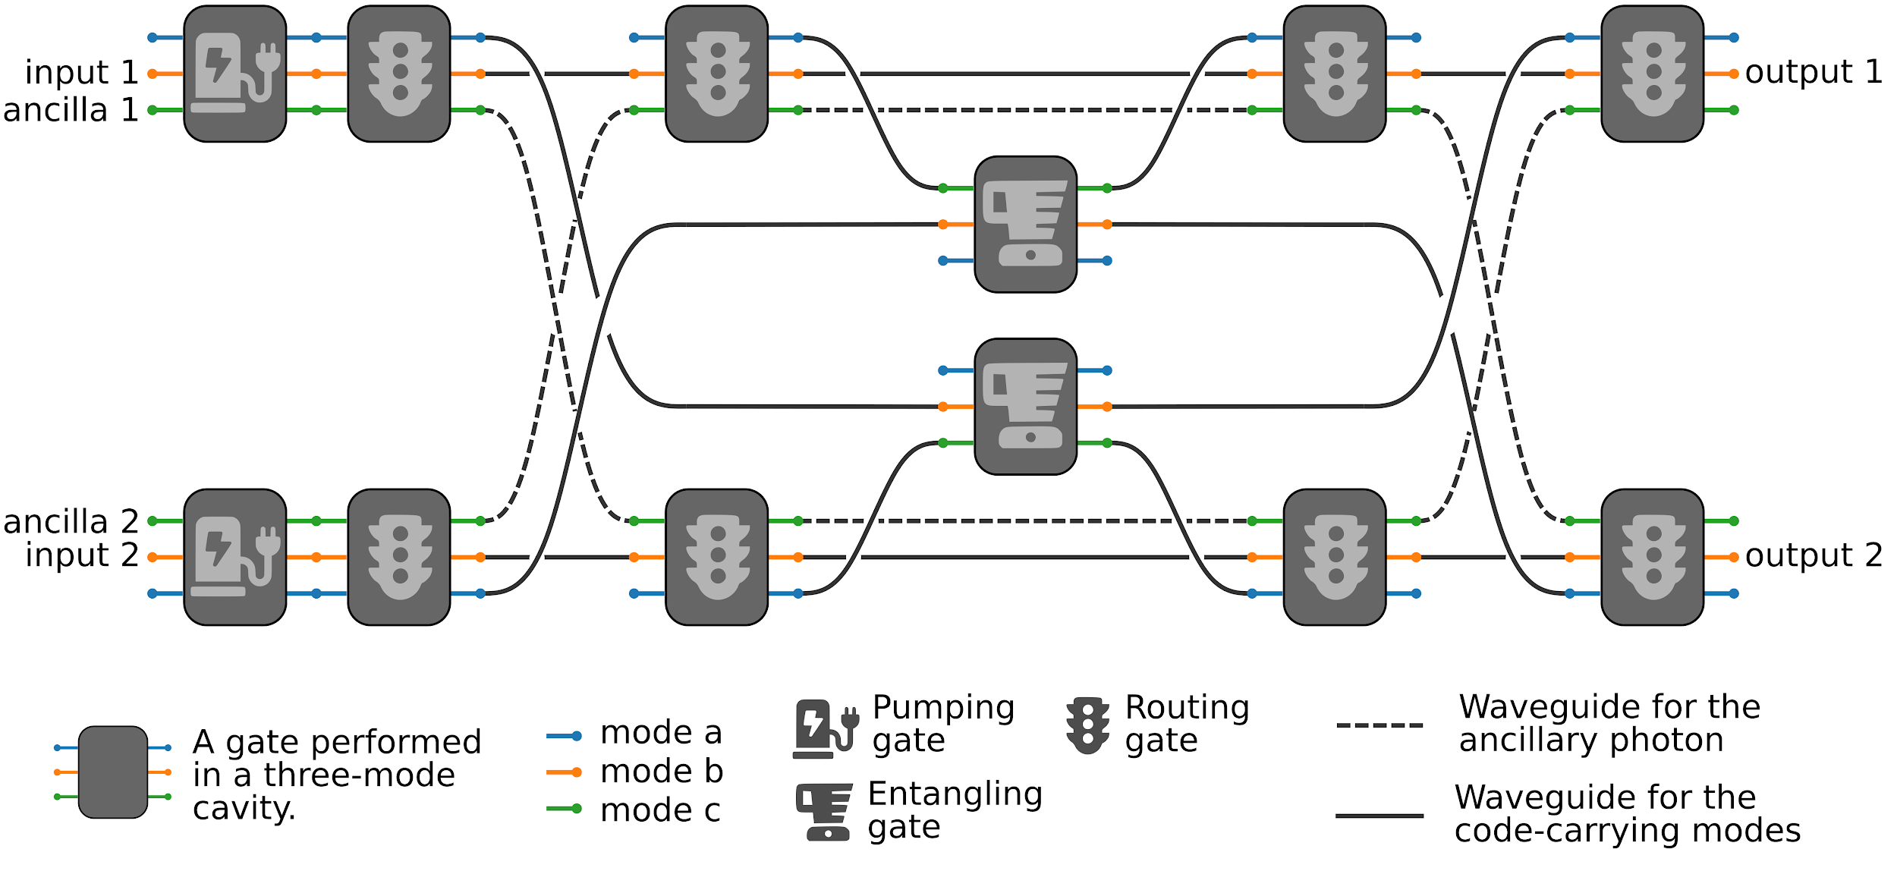
Compact Measurement-Free Error Correction (did I mention it is room temperature)

Slide 11
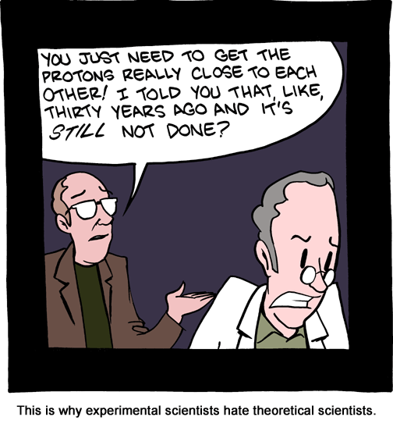
How feasible is practical nonlinear interaction?
Photons are great for quantum computing, because they do not have mass and do not interact with all the terrible things around them.
Photons offer exciting challenges for quantum computing because they do not readily interact with each other.
© SMBC

Slide 12
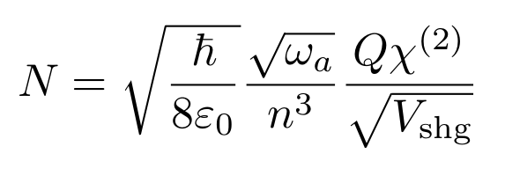
Photon-Photon Interactions are Weak (but getting stronger thanks to heroic experimental efforts)
“N” is the number of “elementary operations” we can perform in a single cavity lifetime. Currently it is at ~0.03. A value of 1000 is within reach this decade.
Lifetime Might improve by an order of magnitude or two
Interaction Strength Difficult to improve but colleagues in other fields are working on it
Mode Overlap Potential for many orders of magnitude improvement

Slide 13
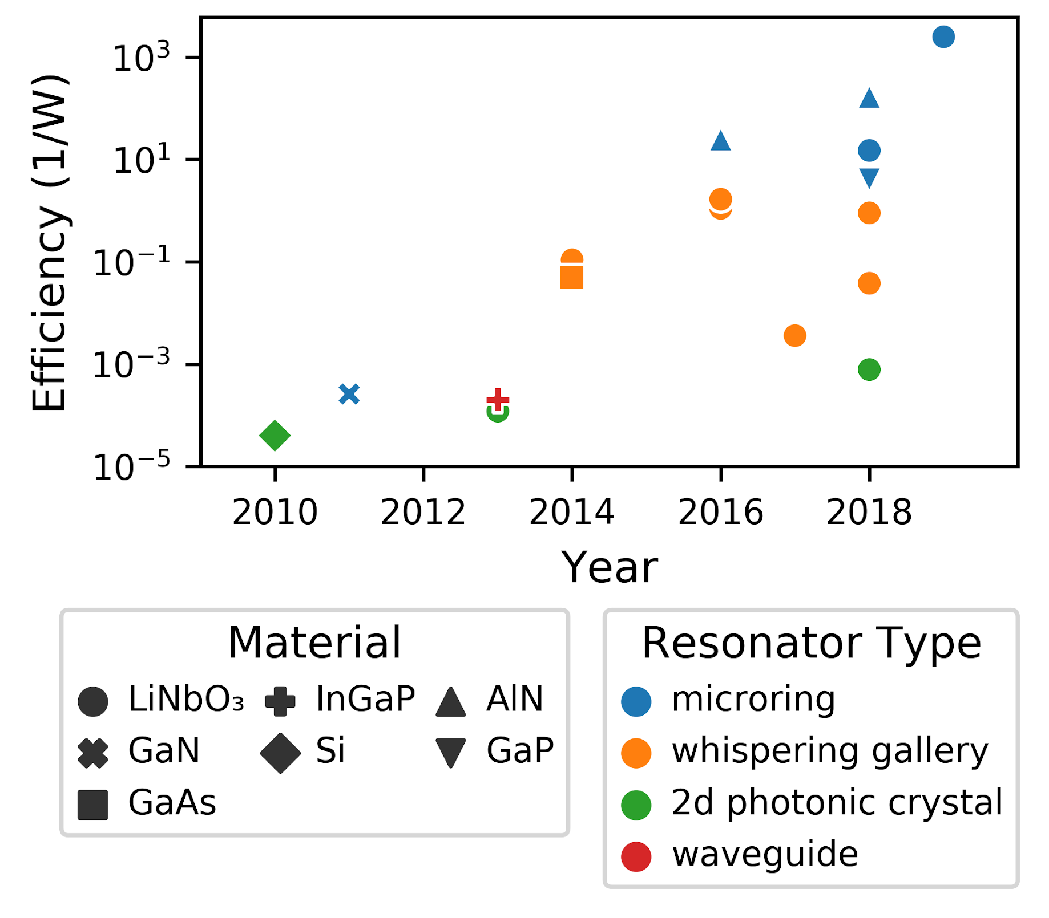
Second Harmonic Generation Experiments
Photon-Photon Interactions are Weak
but getting stronger thanks to heroic experimental efforts

Slide 14
If we extrapolate, in the next decade we will have hardware with N on the order of 1000,
That would enable “engineeringly useful” operations, not just interesting physics experiments.
Thank you for your attention! See arXiv:2002.07193 for more details.
This work was partially funded by the Mitre Quantum Moonshot initiative. And thanks to Christopher Panuski and Ryan Hamerly for numerous helpful conversations.

Slide 15
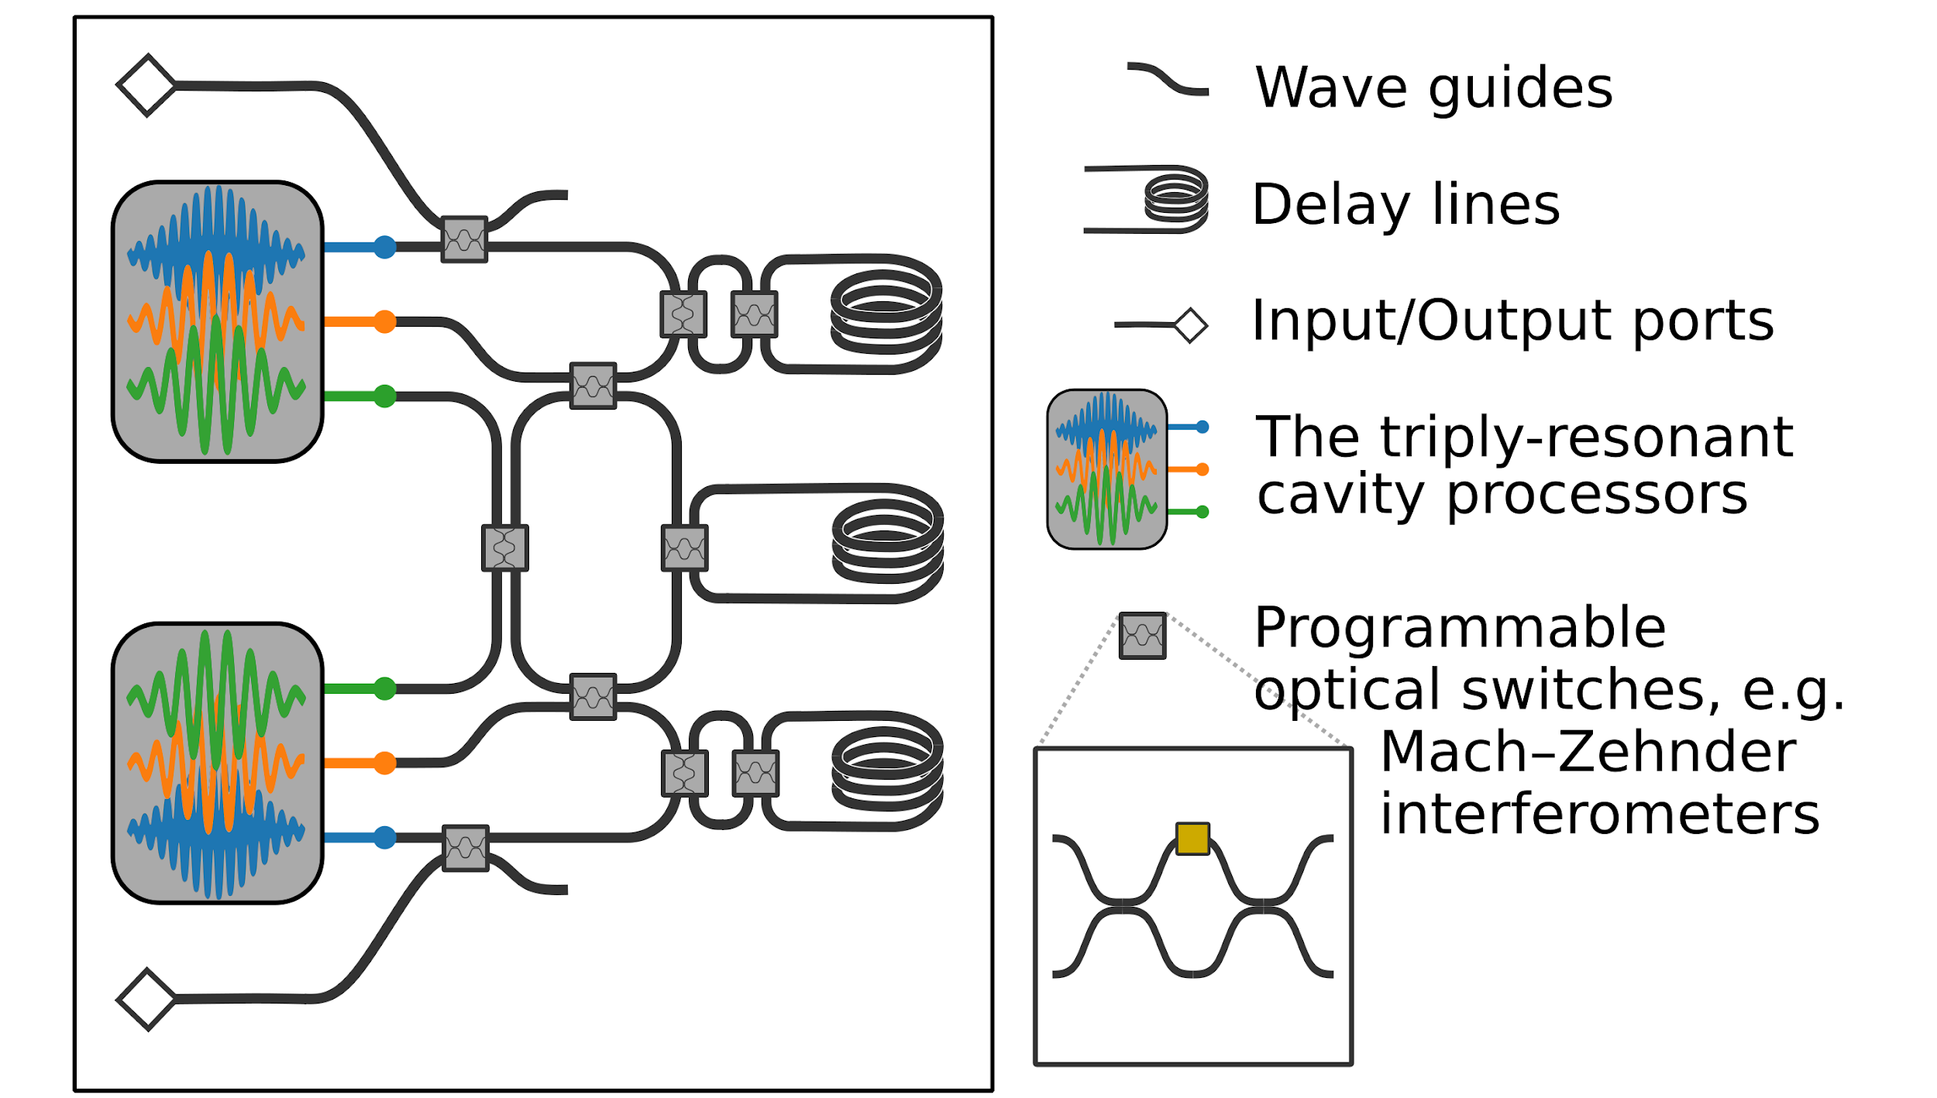
Compact Measurement-Free Error Correction (did I mention it is room temperature)

