Slide 1
Hobby Electronics for Outreach and Research
Stefan Krastanov Engineering Day at Yale (under the patronage of Yale SWE)

Slide 2
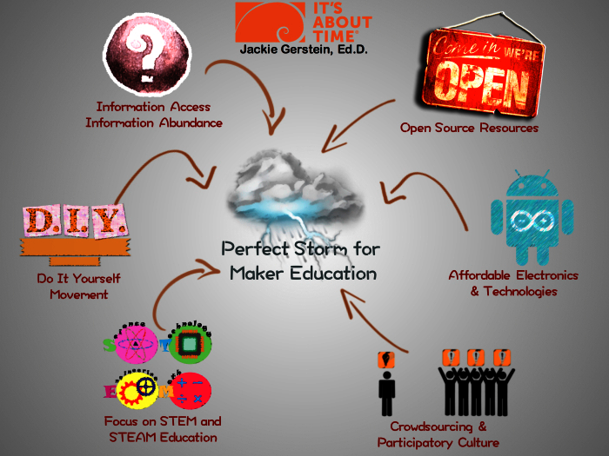
The Maker Movement

Slide 3
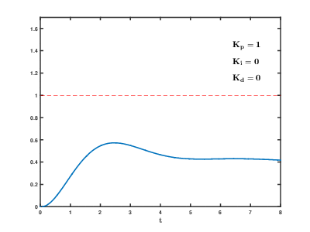
Theory
With examples from Engineering Day outreach events!

Slide 4
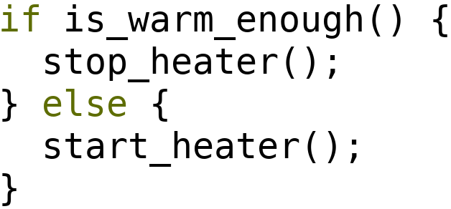
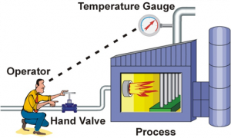
A Bit of Theory (Control Theory)
Quick and dirty: (on-off control)
Feedback loop:
A bit more advanced and precise: PID loops, transfer functions, Laplace transforms, and other fun stuff

Slide 5
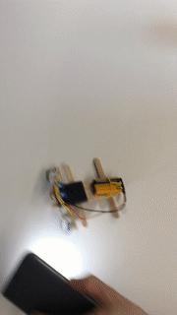
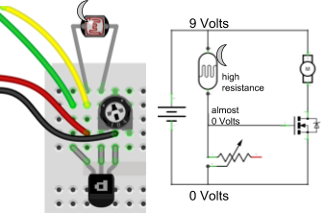
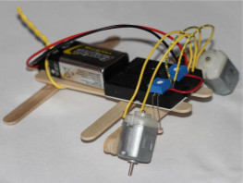
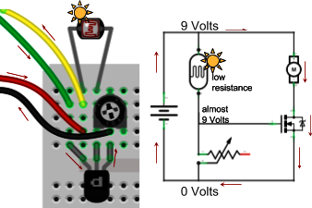
Control Theory Example Light Tracking Automaton (on-off control)

Slide 6
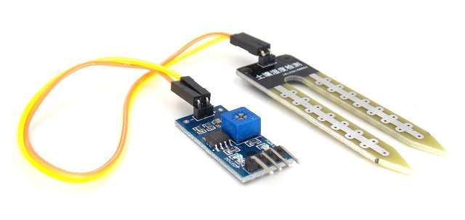
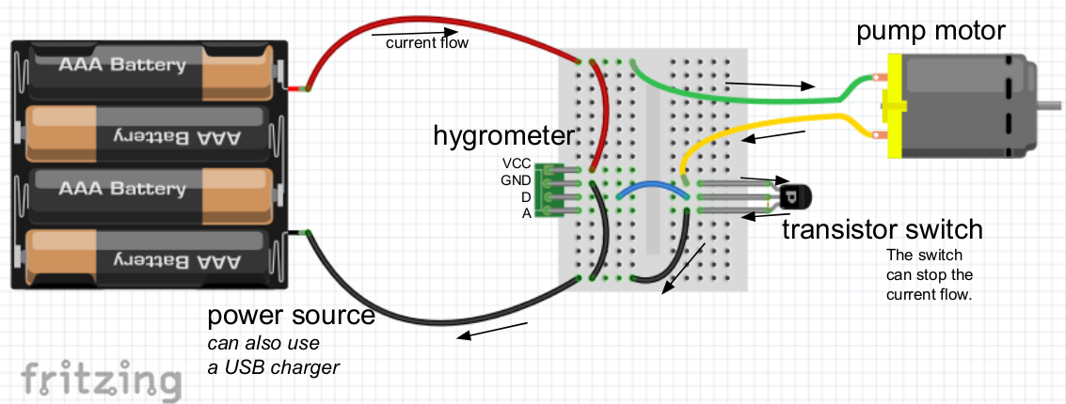
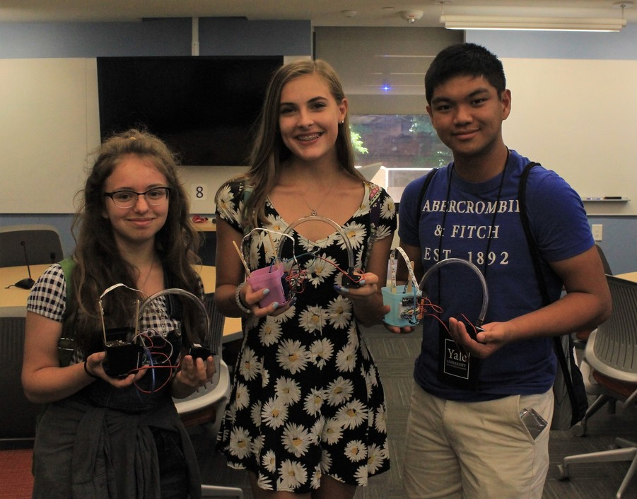
Control Theory Example Automated Garden (on-off control)

Slide 7
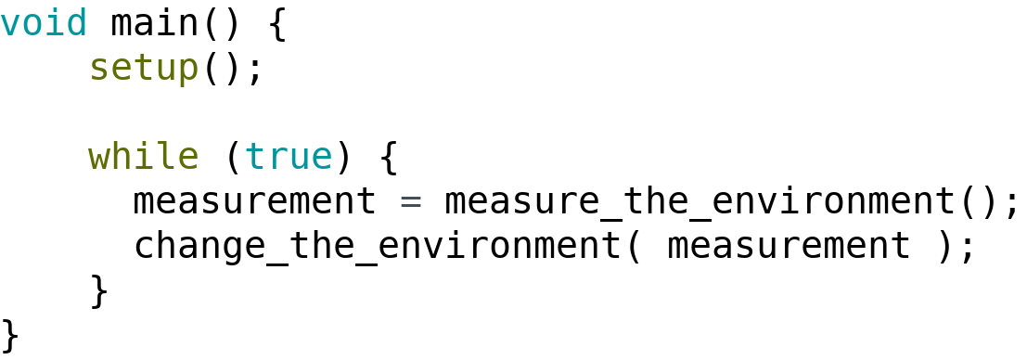
A Bit of Programming (The Event Loop)
Not covered, but interesting: threads, concurrent programming, timers, interrupts...

Slide 8
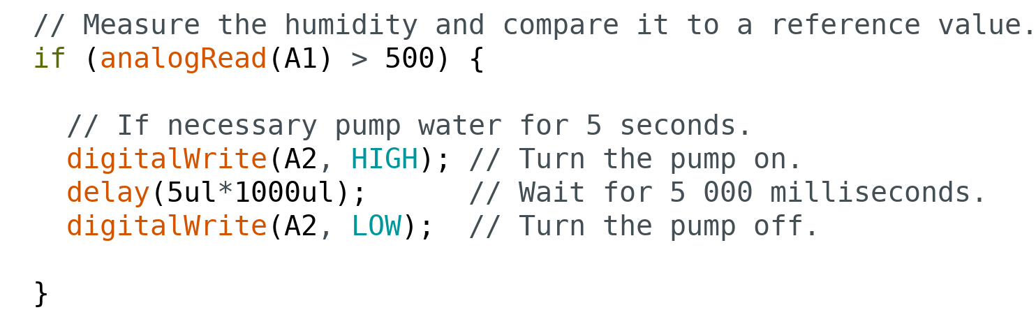
Event Loop Example Automated Garden (a programmable version)

Slide 9
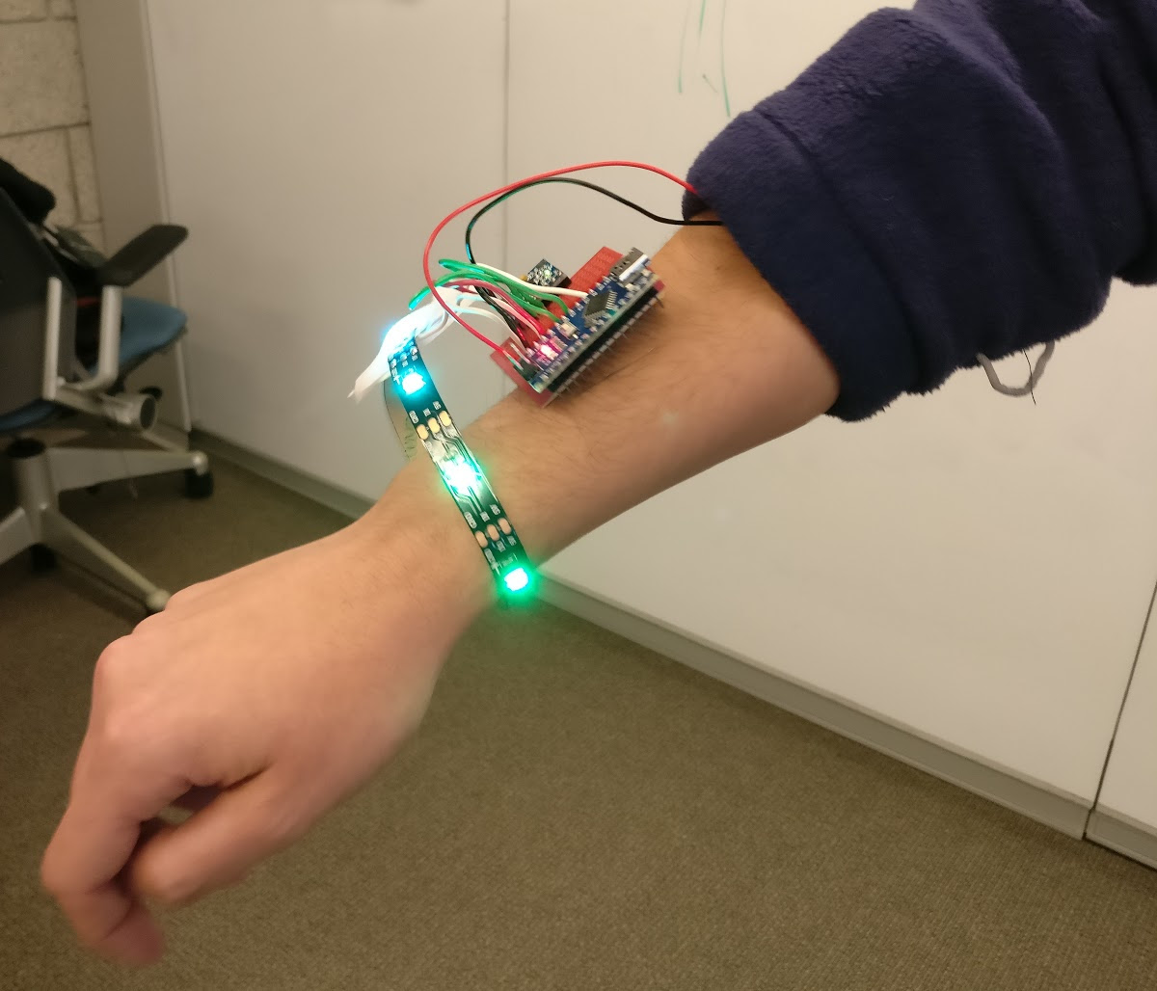
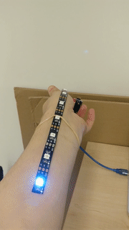
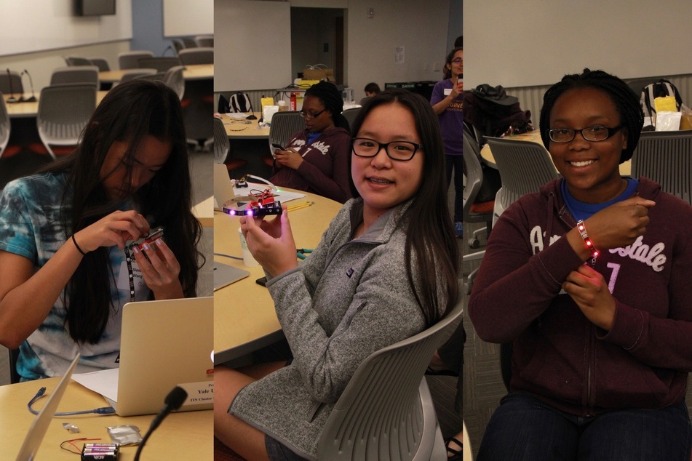
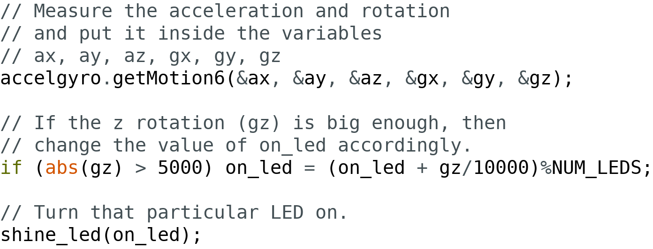
Event Loop Example Motion Sensing LED Bracelet

Slide 10
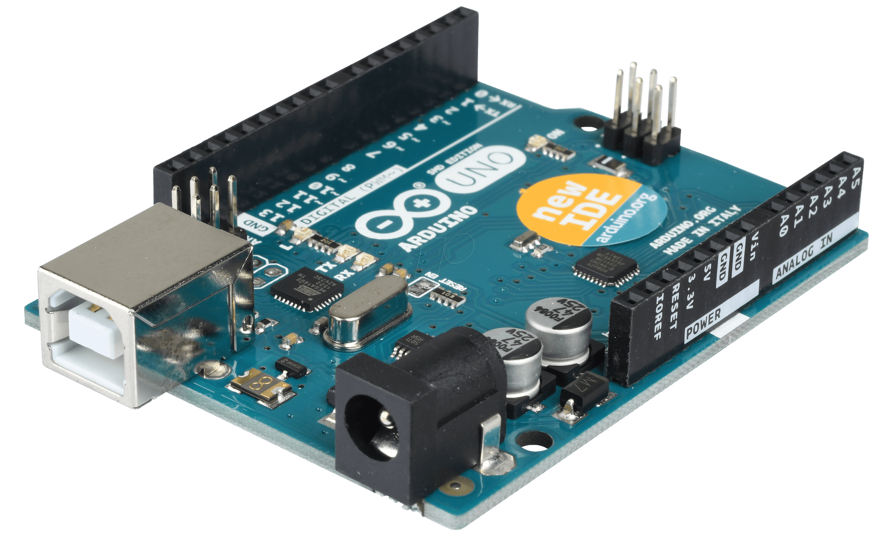
Arduino
The Rock Star of Hobby Electronics

Slide 11
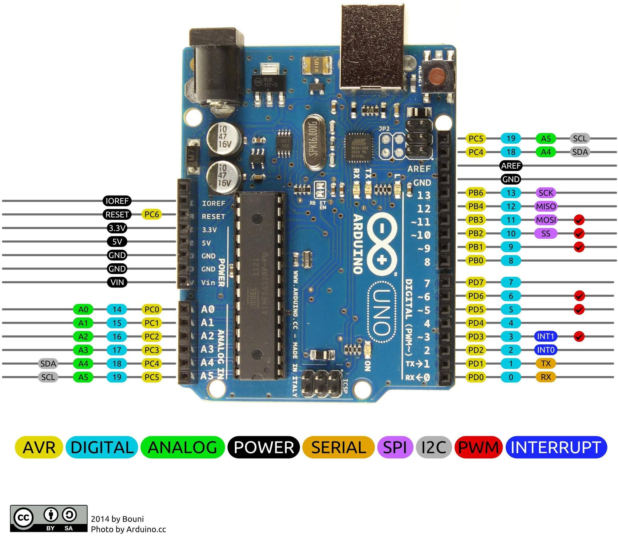
Arduino

Slide 12
Where to Get Materials?
And support!

Slide 13
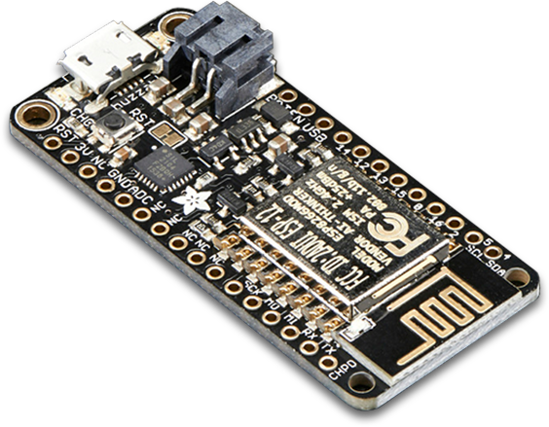
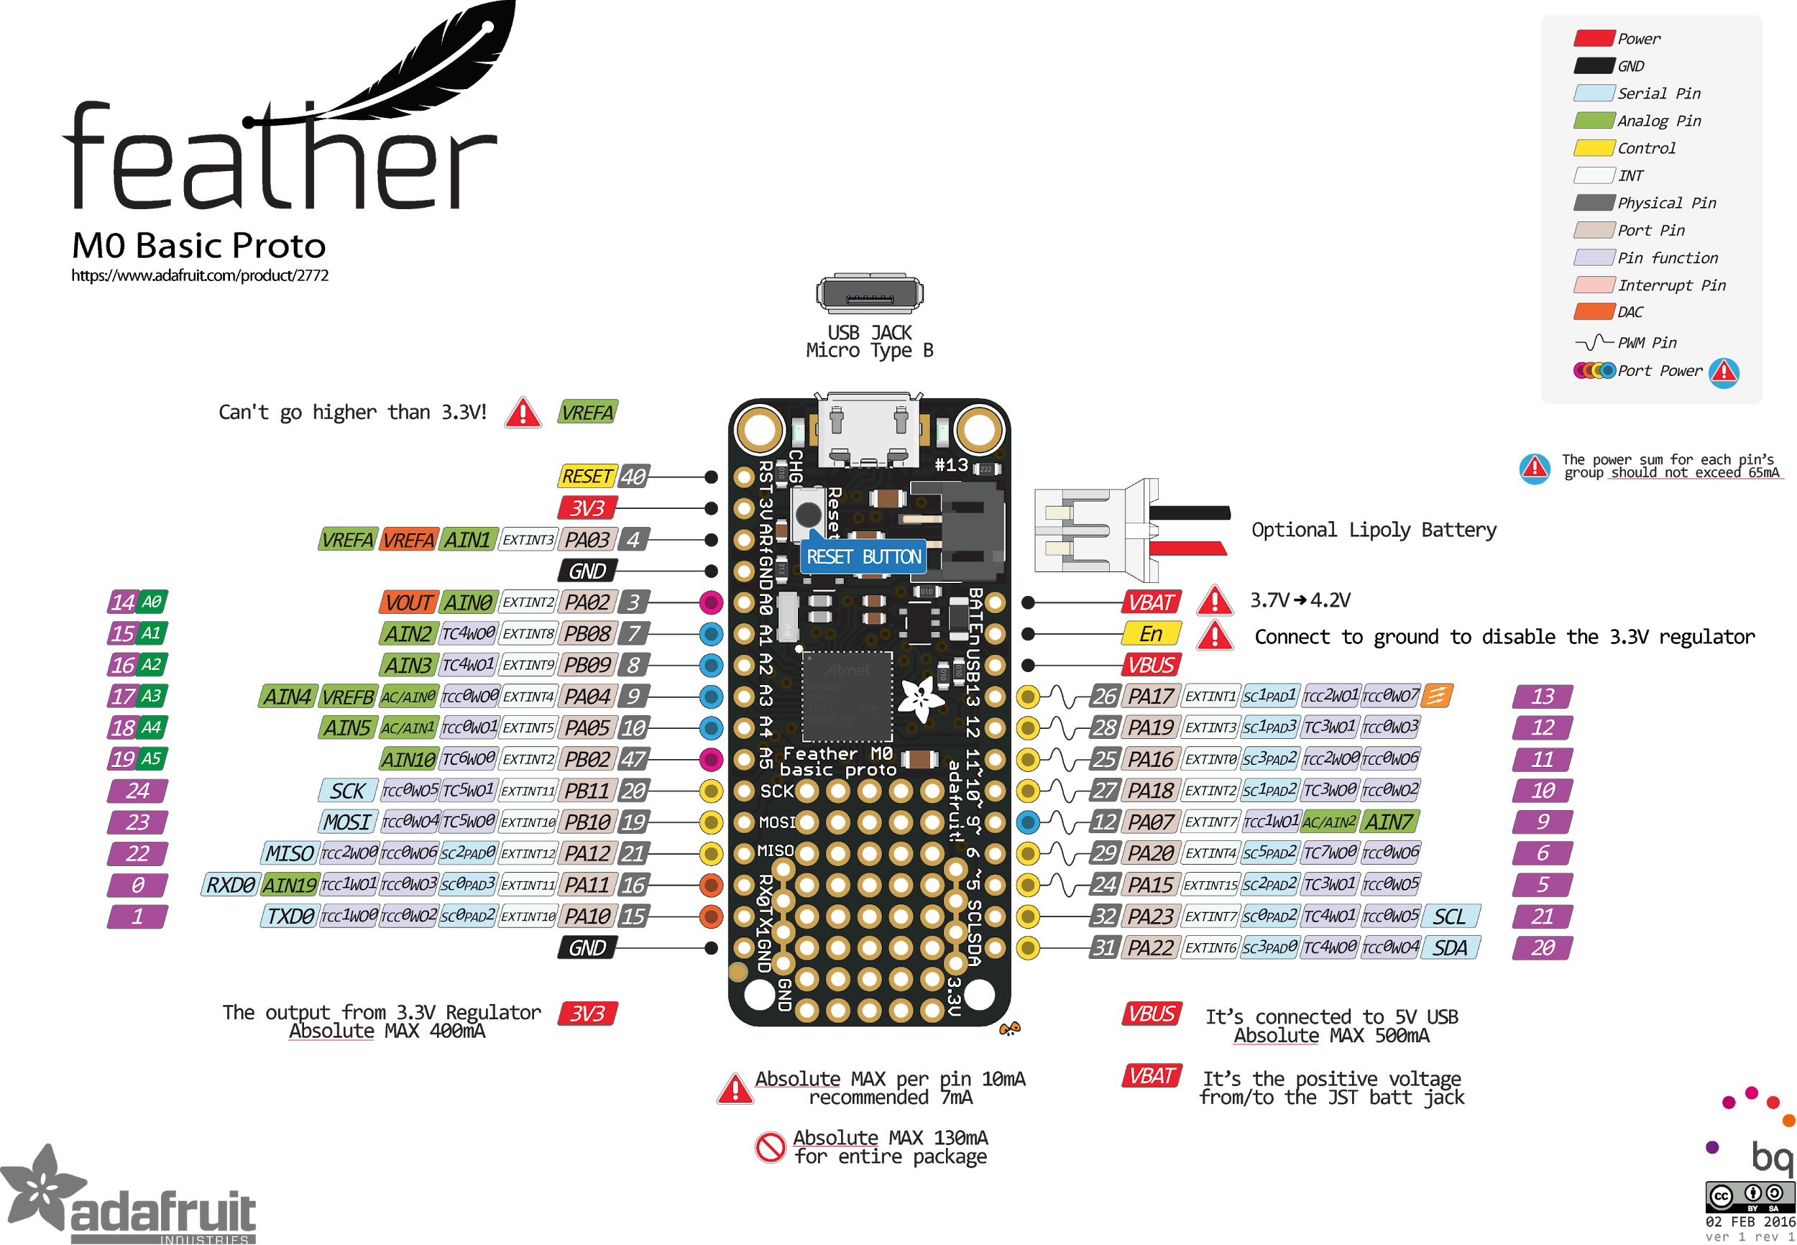
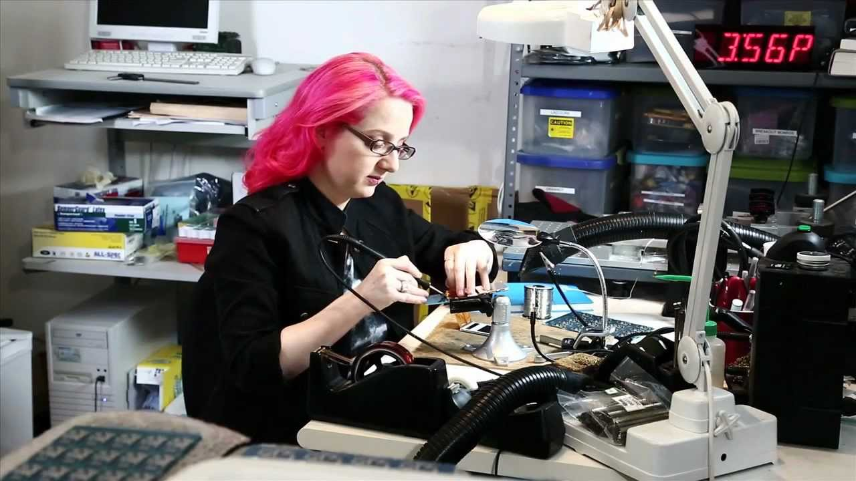
Adafruit

Slide 14
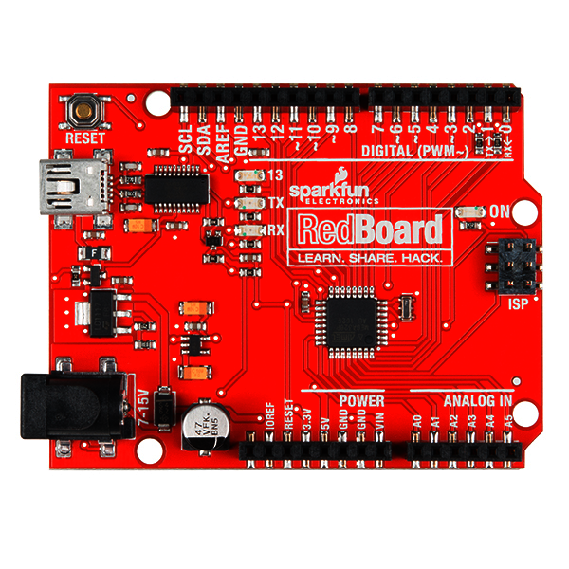
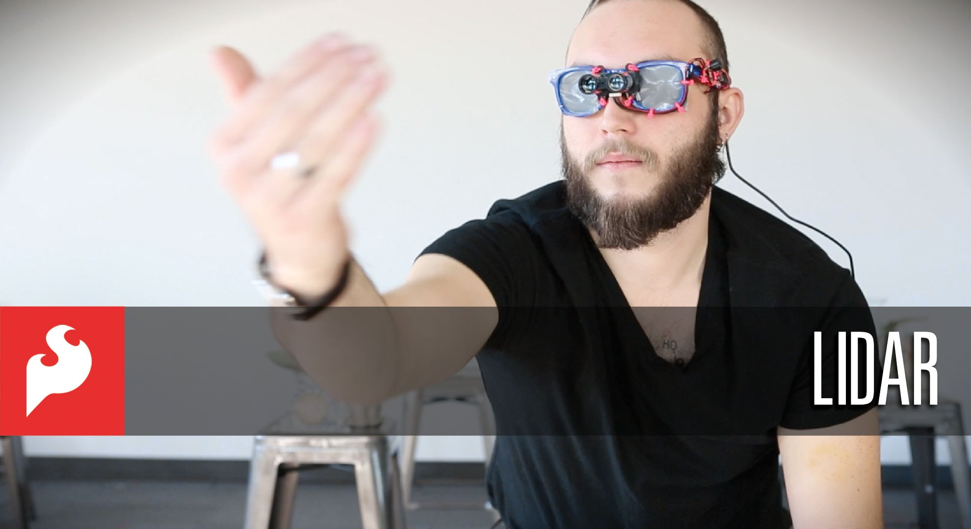
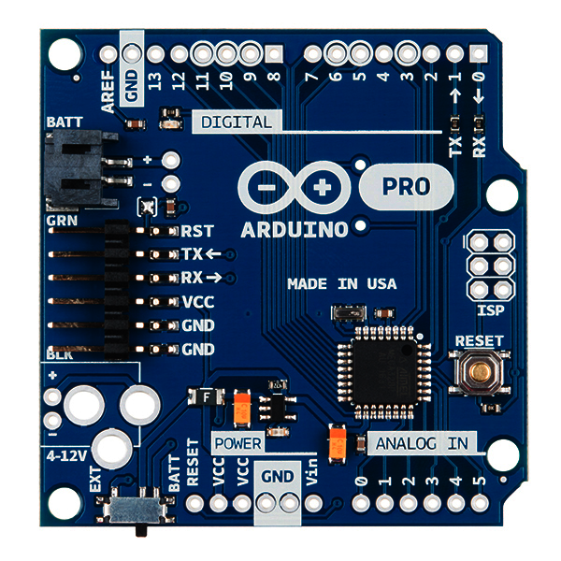
Sparkfun

Slide 15
Others (not exhaustive (please do not be angry))
Electronics
(quality and documentation, but requires some expertise) Digikey, Mouser
(a ton of weird gadgets for any project) Seeed Studio, Pololu
(cheap, bulk, but you do not know what you will get) Aliexpress, Amazon
Fabrication
(circuitry, electronics) Seeed Studio Fusion, PCBWay
(laser cutting, 3D printing) Ponoko, Sculpteo, Shapeways

Slide 16
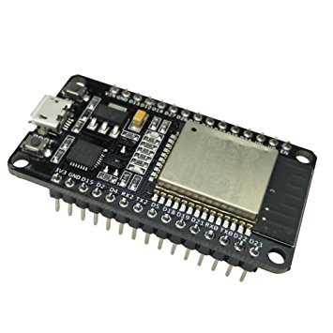
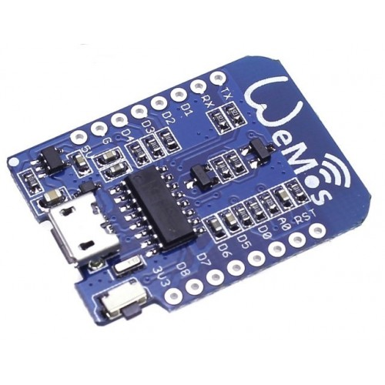
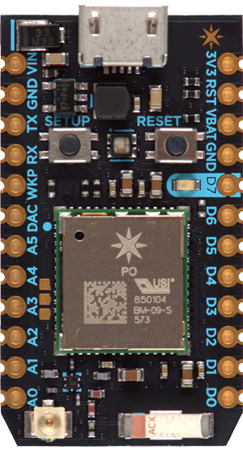
Other “Hobby” Microcontrollers
(not exhaustive)
Particle Photon $20 WiFi Cloud Services
Feather (family) $25-$35 WiFi Bluetooth Radio SD card logger
ESP8266 $3 (not a typo) WiFi
ESP32 $5 (yup) WiFi Bluetooth LiPo charger
Puck.js $40 Bluetooth NFC (i.e. RFID) Javascript Extreme battery life

Slide 17
“Professional” Microcontrollers (comparatively recent and known among hobbyists)
Extremely low power consumption, high performance, and a plethora of special built-in hardware for measurements and communication (all for <$10)
Texas Instruments
Simple Link CC26XX with Bluetooth capabilities
Simple Link CC32XX with WiFi capabilities
Nordic Semiconductor
NRF52 with Bluetooth capabilities
Other families
Atmel’s AVR
Microchip’s PIC
Texas Instruments’ MSP430

Slide 18
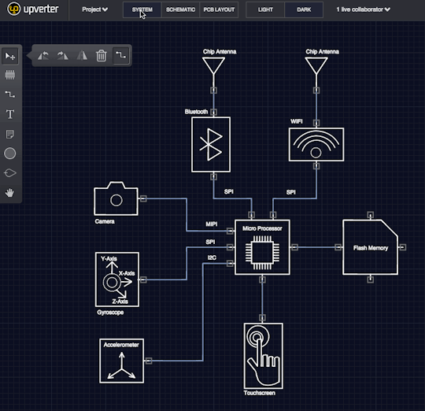
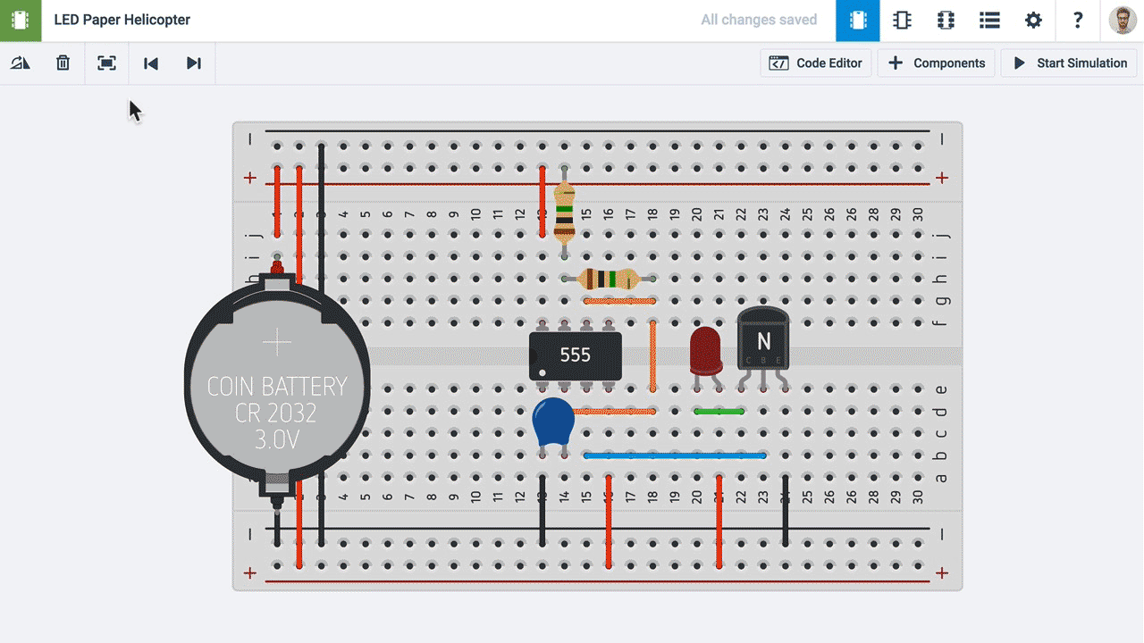
Design Software
Autodesk Circuits
Upverter

Slide 19
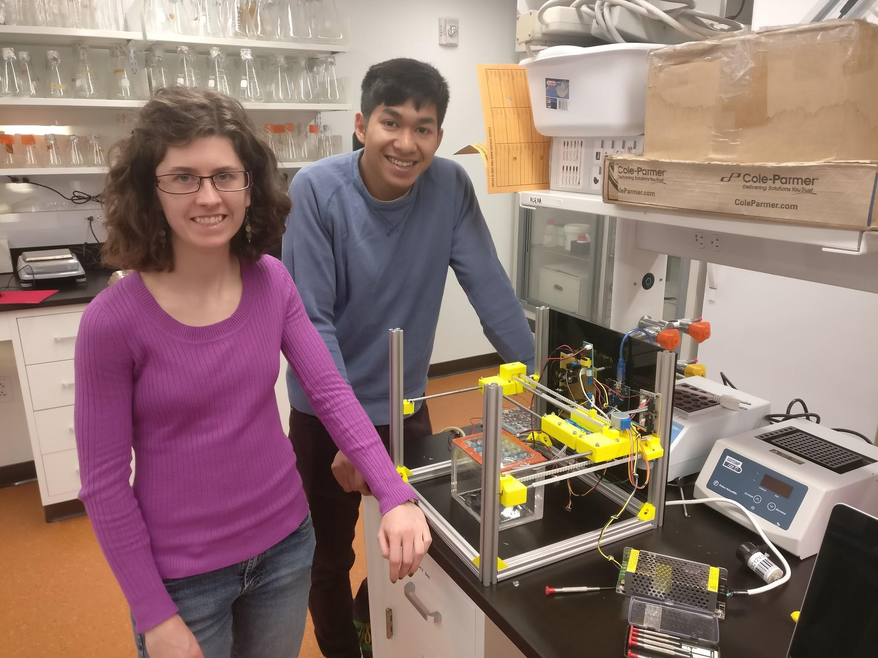
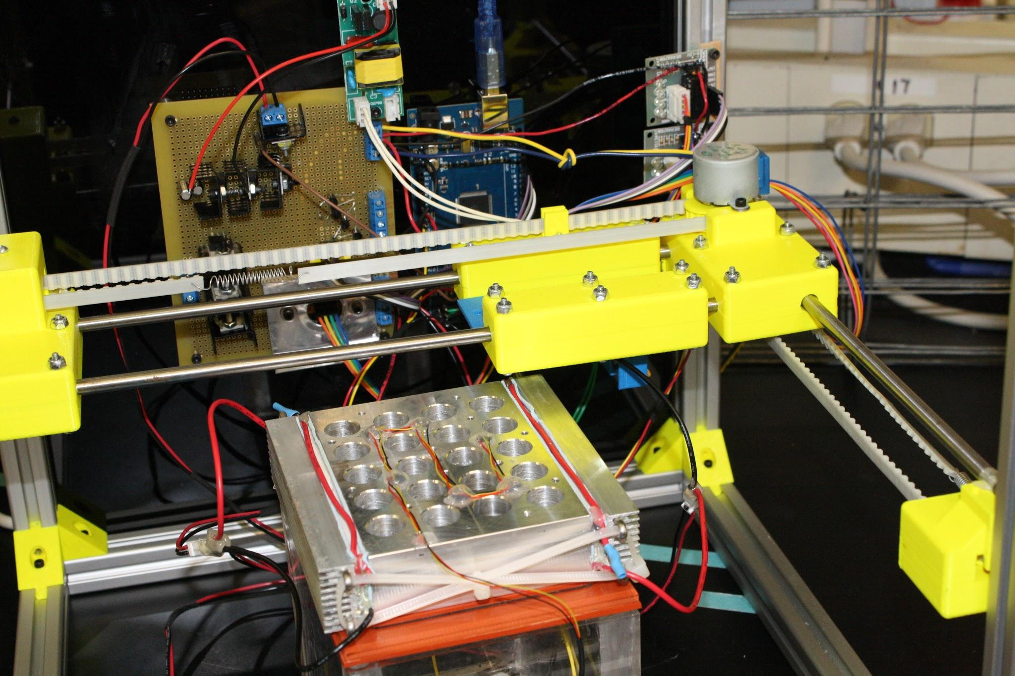
Fabrication Example Automated Bioreactor, Peccia Lab, Yale (Research)
A straightforward Arduino program that measures/controls
Stepper motors
Temperature/Heat pumps
UV radiation lamps
Airflow
All done with 3D printing and simple circuits on hand-soldered proto boards.

Slide 20
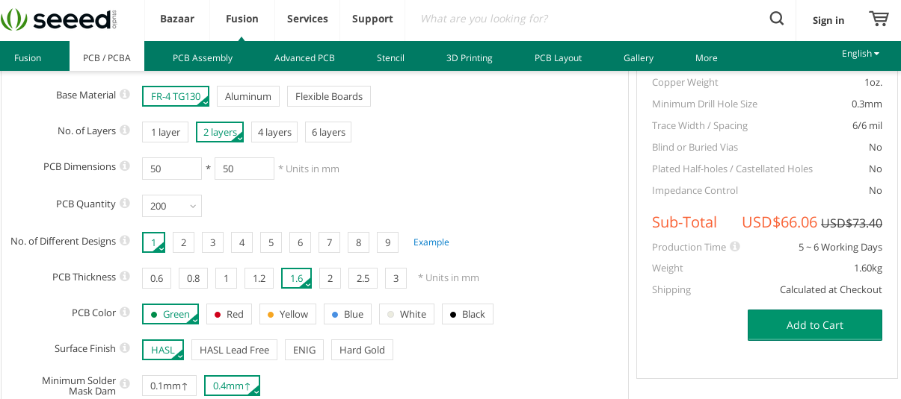
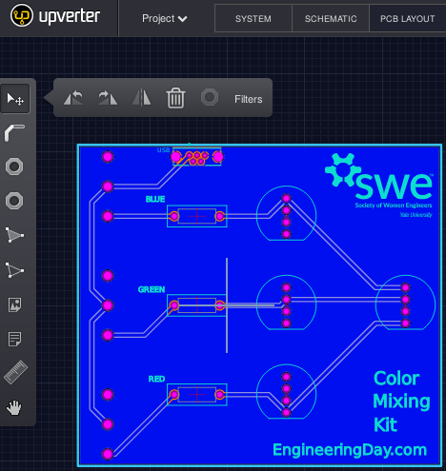
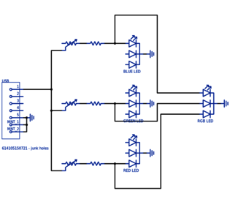
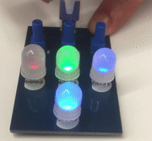
Fabrication Example
Color Mixing with LEDs, Yale Engineering Day (Outreach)
Order 200 boards for $60
Design a printed circuit board
Make up an LED circuit
Have the kids learn soldering while making a color-mixing gadget

Slide 21
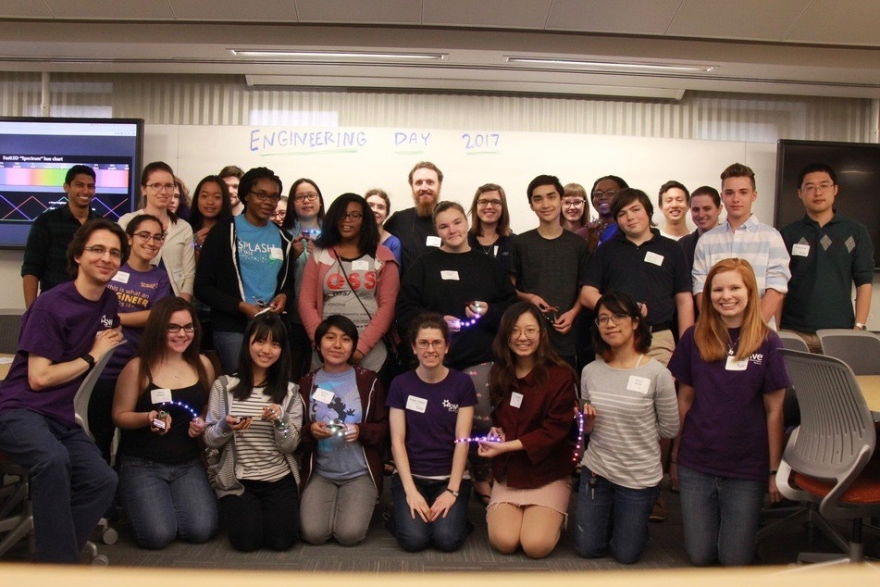
If You Can Think It, You Can Build It
Be aware that great tools exist, use them!
Help us teach kids that these tools exist!
GSI The Chemical World is happening on Apr. 14th
Engineering Days will be happening over the next few months
Depending on interest, hands-on workshops on microcontrollers might be happening over the next few months
I brought a bunch of samples to play with after the talk
All of the example projects are available at engineeringday.com

