Slide 1
Stochastic Hamiltonian and Lindbladian Estimation
June 14th ‘18 Group Meeting
Stefan Krastanov (work done with Sisi Zhou, Steven Flammia, Liang Jiang)

Slide 2
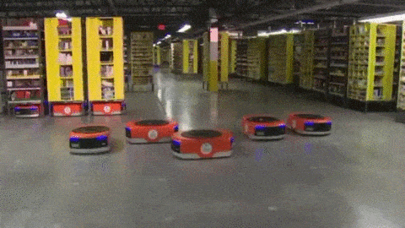
Calibration as Prerequisite for Control
Nothing is built exactly to specifications!

Slide 3
Prerequisite for (Open Loop) Control
Model of the dynamics
State of the system
Control drives

Slide 4
Calibrating the Model describing our Quantum Hardware
The “Easy” Case: Calibrating in absence of noise
Model
Experimental Measurements
Calibration Procedure
Information Theory Limits
All the Annoying Impediments
State Preparation and Measurement Noise
Non-unitary behavior
Drift and others

Slide 5
Model Hamiltonian
Model Hamiltonian Parameters Control Drives
“True” Hamiltonian “True” Parameters

Slide 6
Model Hamiltonian A Particular Parameterization
Model Hamiltonian Parameters Control Drives (for Q qubits) (D-dimensional vector)
Predetermined permitted operators (M different operators, not spanning the entire space of operators)
M⨉(D+1) real parameters to be estimated

Slide 7
Model Hamiltonian
General Linear Control Drives
Model Hamiltonian Parameters Control Drives
2^{2Q}⨉(D+1) real parameters to be estimated

Slide 8
Calibration
Run a bunch of random control drives. Compare the result to the prediction. Fudge the parameters so that the prediction becomes better.

Slide 9
Run a Bunch of Control Drives
Generate P random control pulses and measure the resulting states.

Slide 10
Compare the Result to Prediction
Fundamentally, you can not exactly measure a quantum state. You can estimate its population in a given basis with repeated projective measurements. (or a bit more generally—and more expensively—do tomography on the state)
run control drive
phases are lost in projective measurement
sample from this distribution
0
1
0
0
Finally, compare the estimate of the truth to the prediction:

Slide 11
Calibrating the Model with Gradient Descent
Sum over a bunch of random control pulses
Measured estimate of the actual final state
Prediction given the parameters

Slide 12
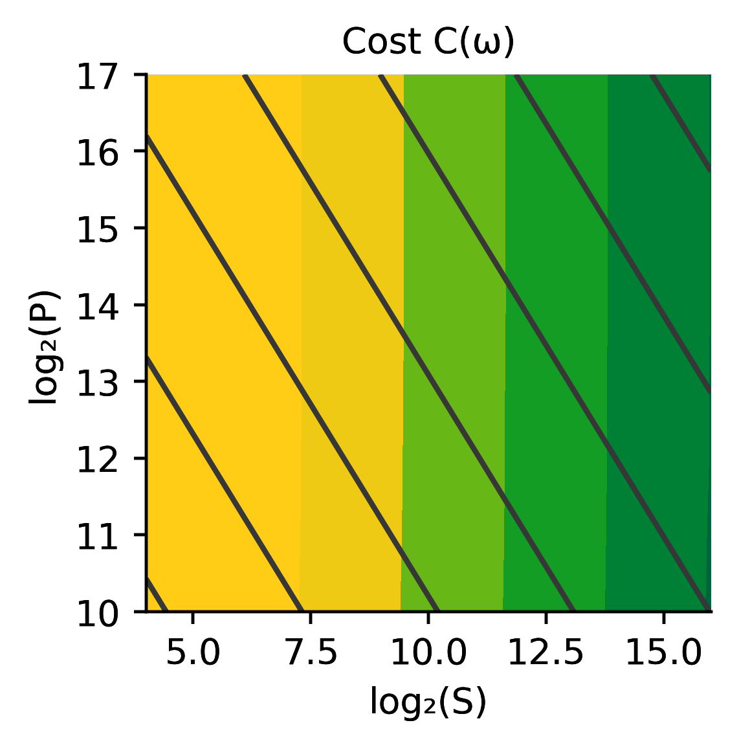
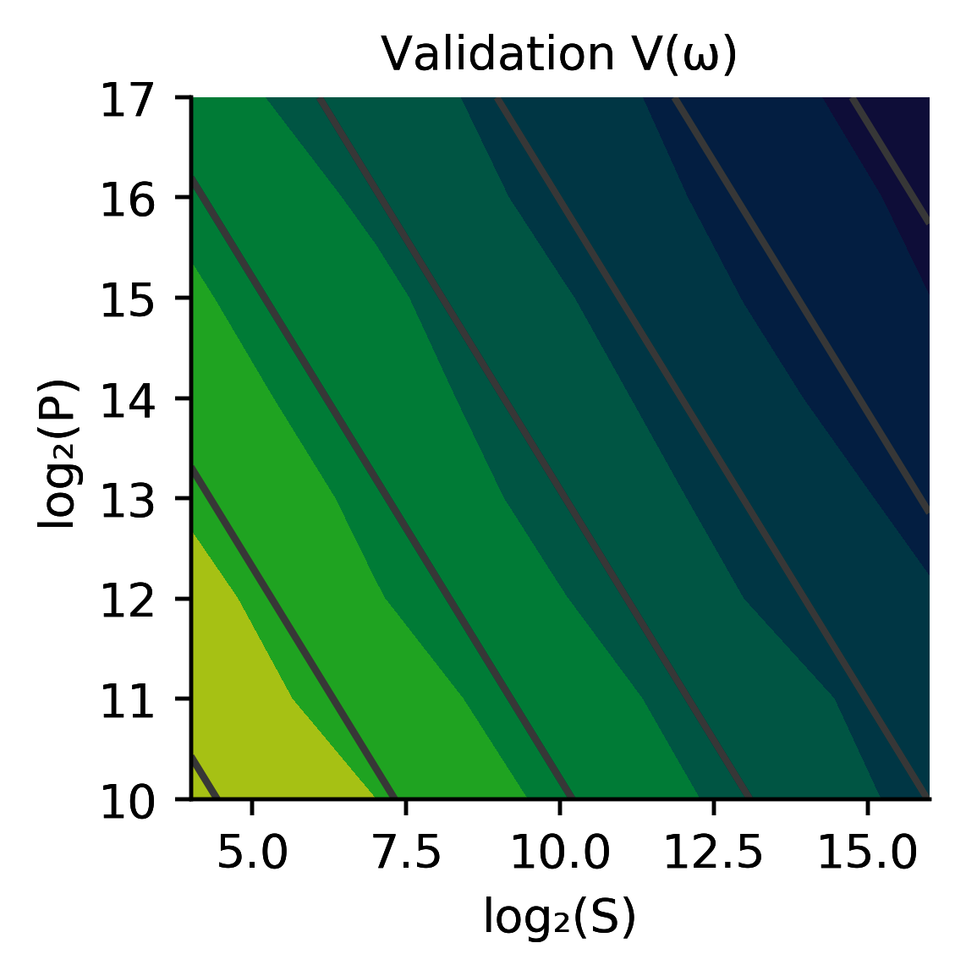
The actual final state
Measured estimate of the actual final state
The predicted final state given the parameters
Optimized Cost (P different pulses, each ran and sampled S times)

Slide 13
Theoretical Limit of Calibration Fidelity
Fisher Information:
… is additive
Cramér–Rao bound:

Slide 14
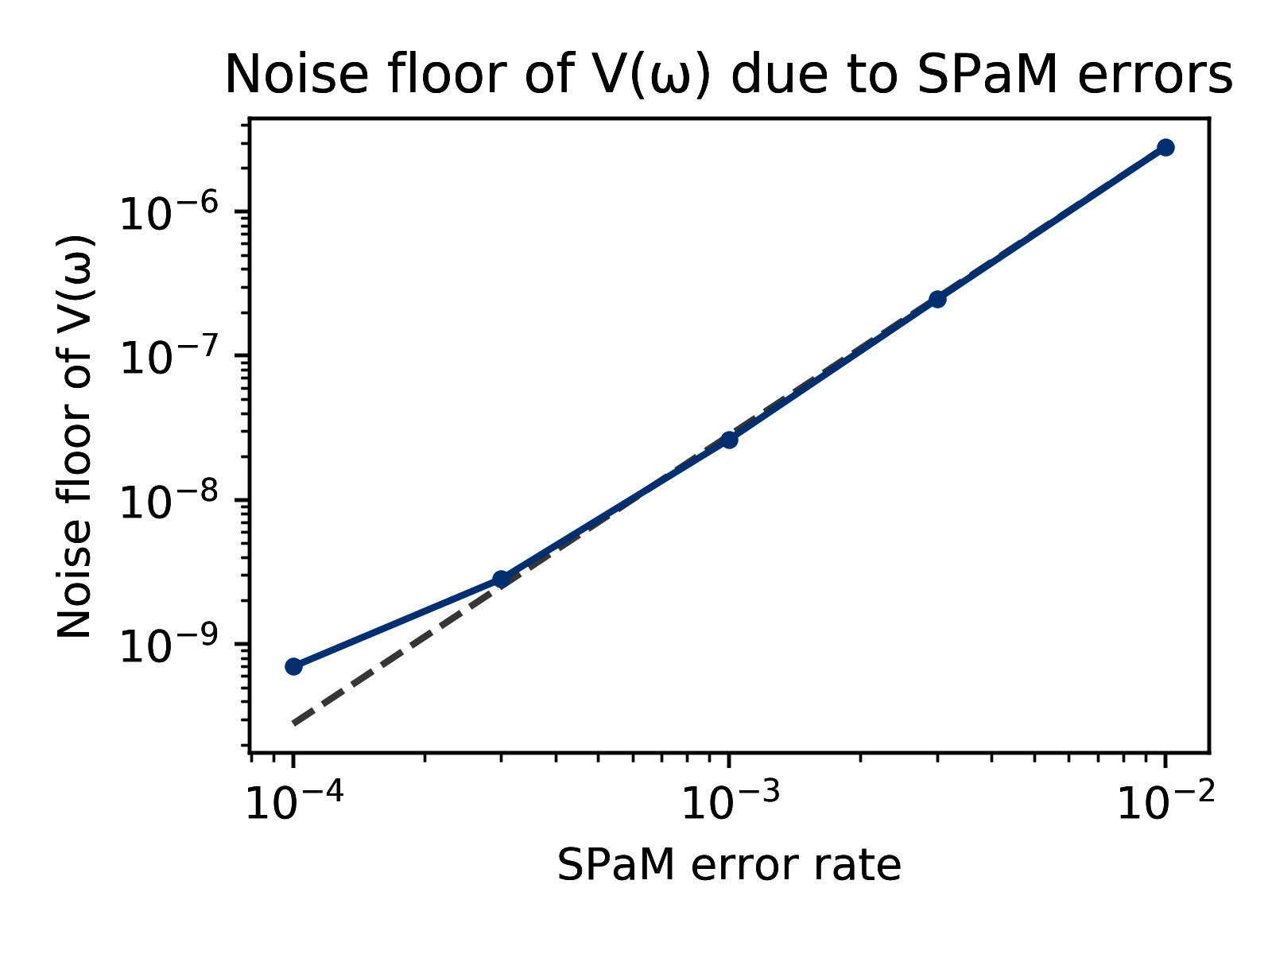
State Preparation and Measurement Errors
SPAM causes a bias in our estimator!

Slide 15
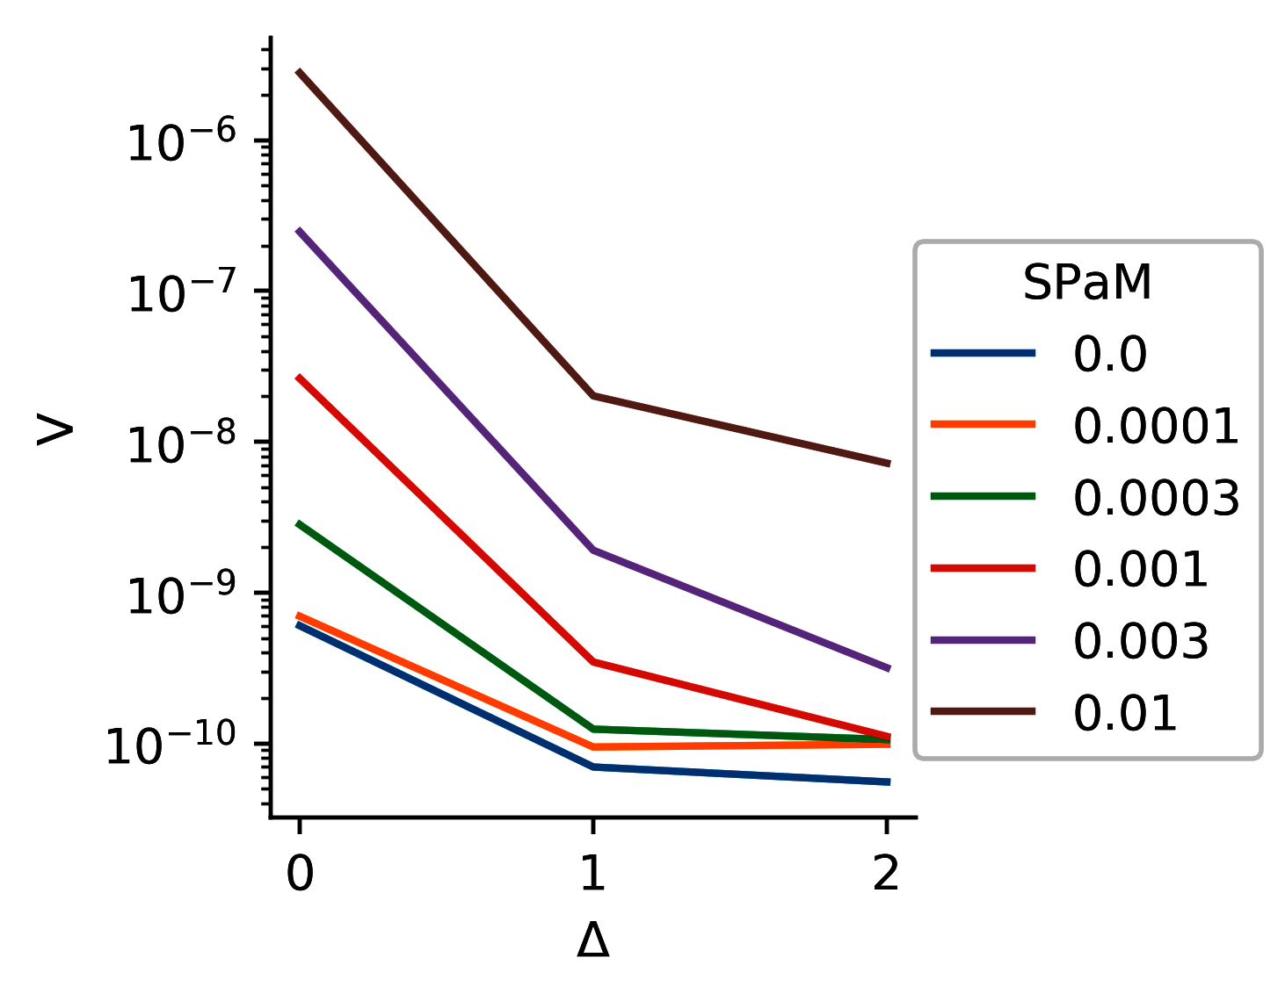
State Preparation and Measurement Errors
stat. error + bias error ~ error in population prediction ~ error in params. ⨉ T

Slide 16
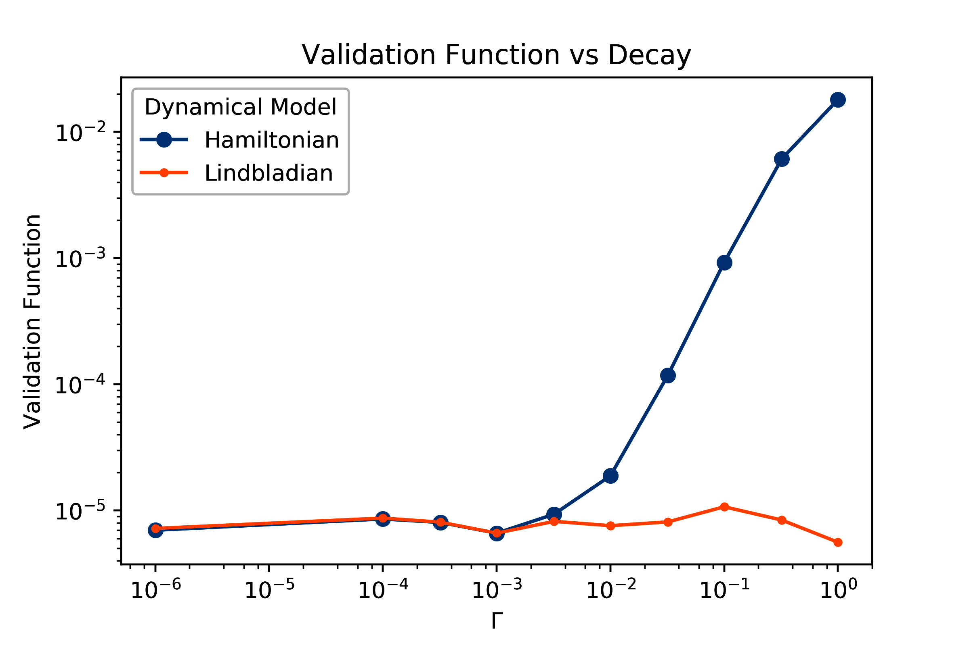
Non-unitary Evolution
A Hamiltonian model is incapable of capturing decoherence.
A Lindbladian model can cover most of the dynamics.

Slide 17
Other Caveats (Drift, Nonlinearities, Convergence)
Hamiltonians might have drift or other low-frequency noise
just add it to the model
The drives might be slightly non-linear (or even strongly non-linear)
just add it to the model
Convergence might be difficult
kitchen sink approach
annealing the learning rate
regularization
Bayesian learning and annealing the regularization
“hyperparameter” search, trying different cost functions

Slide 18
Cost Function Choice

Slide 19
Validation Function Choice

Slide 20
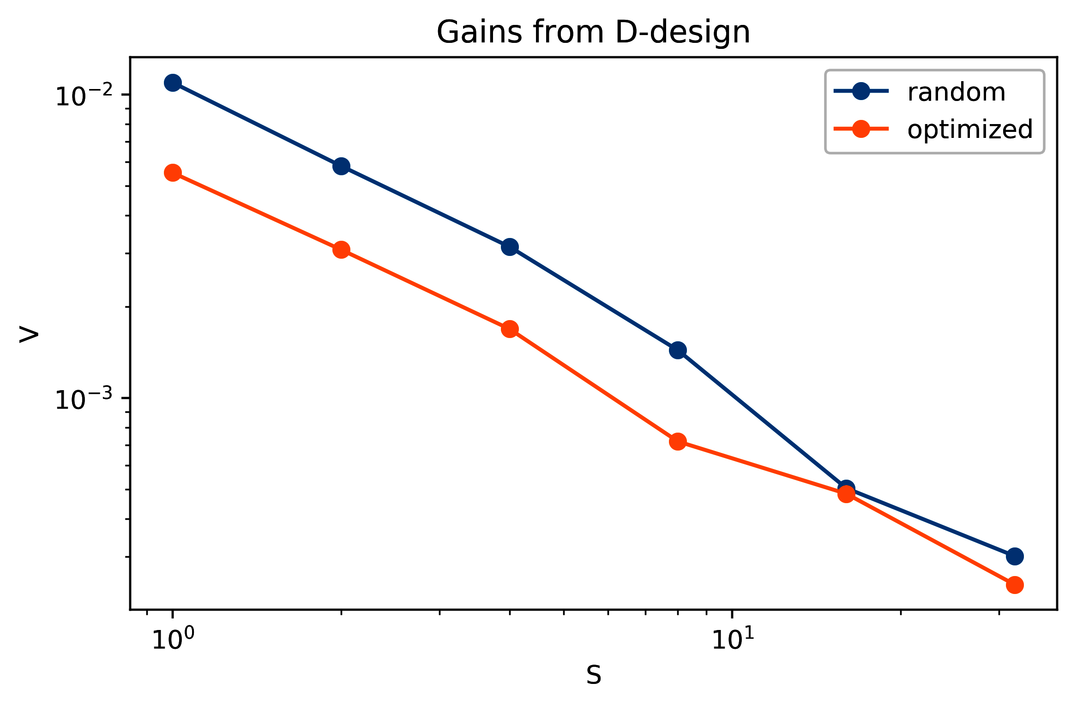
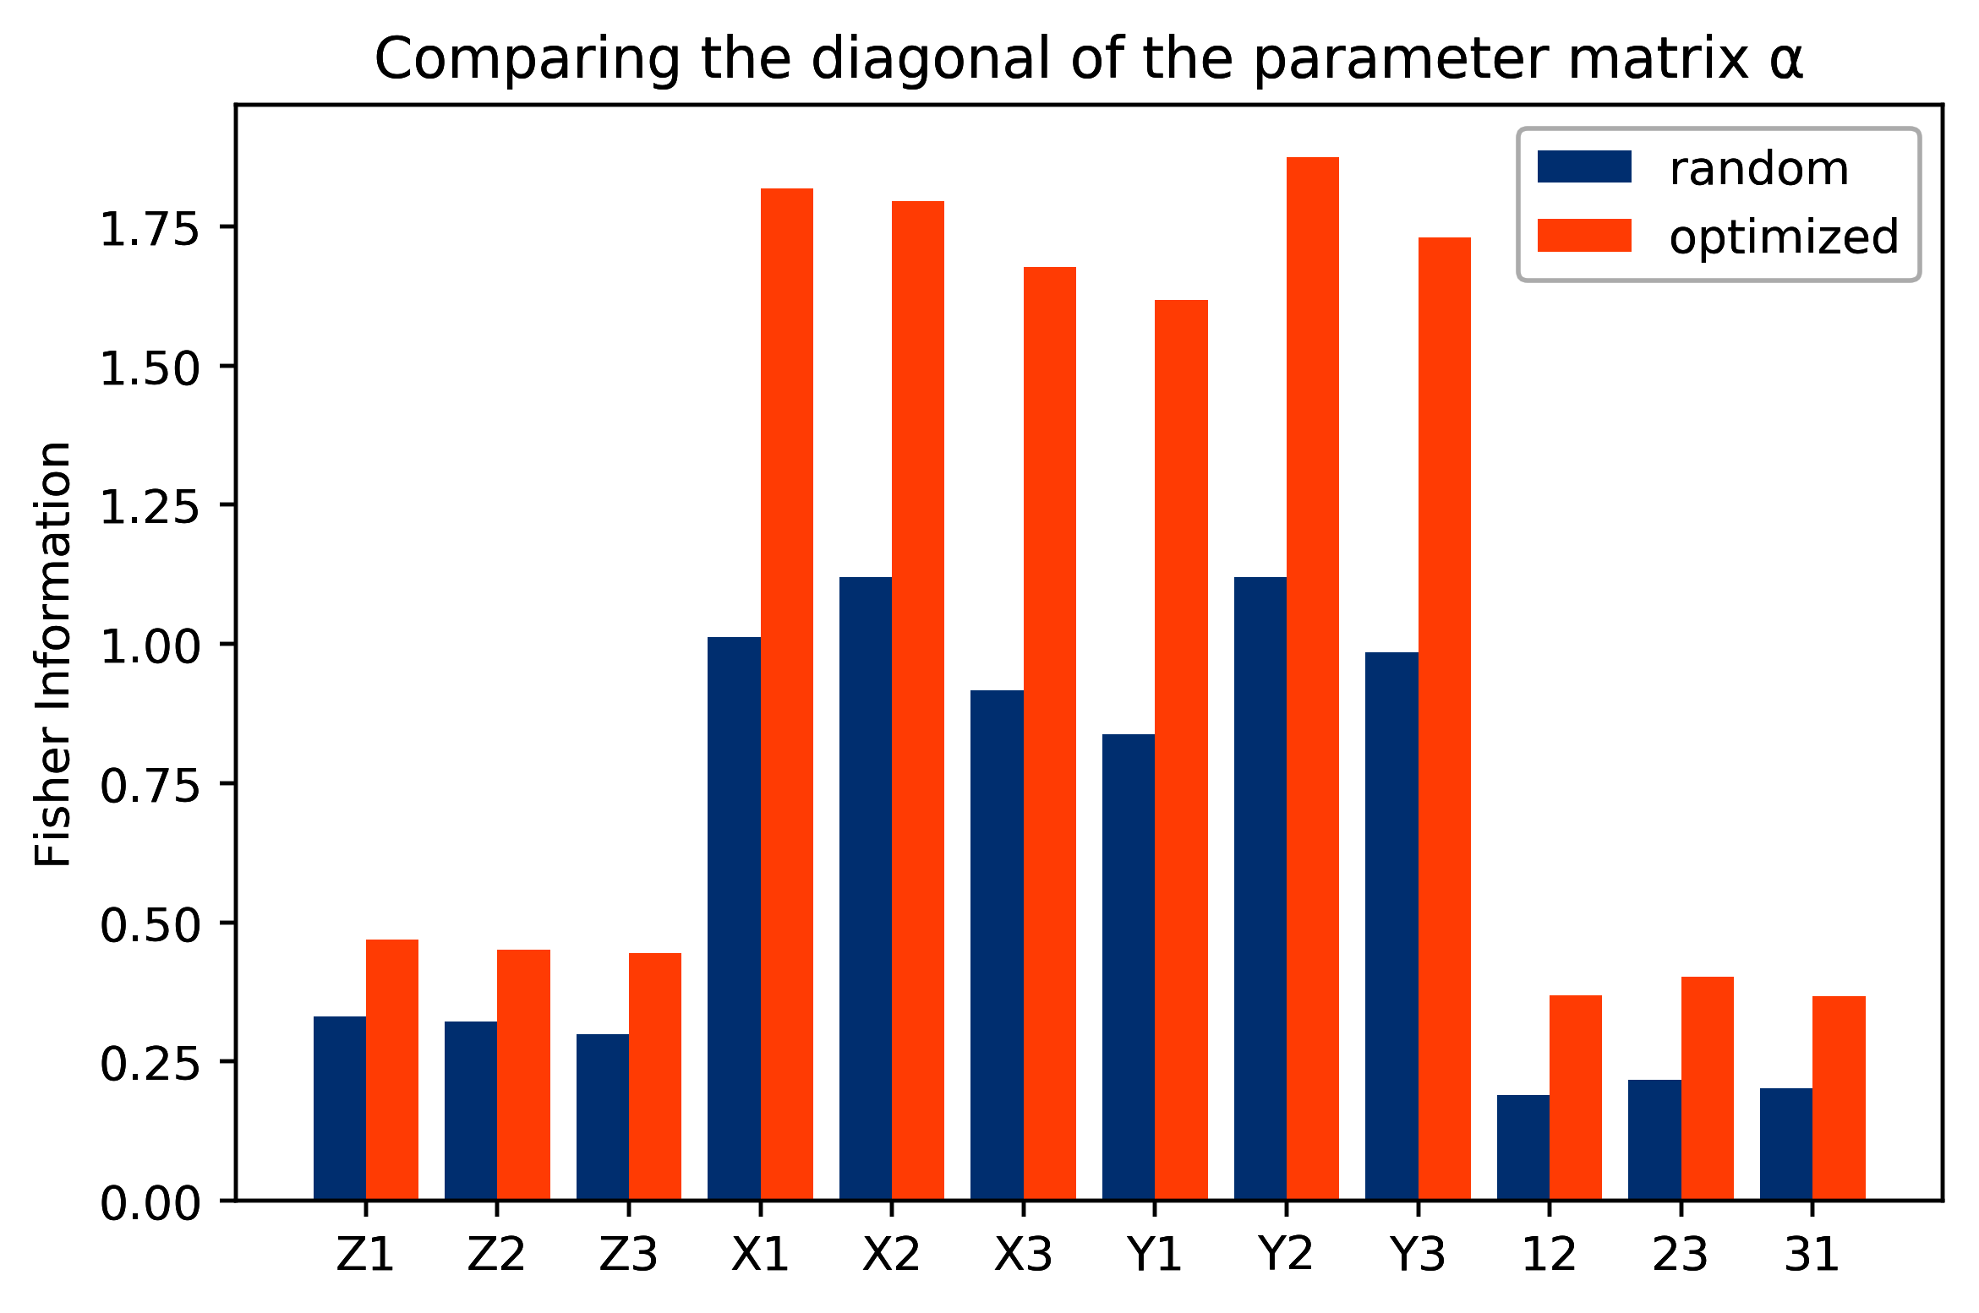
Improving Sensitivity
Instead of using random control pulses, we can modify them, such that the available Fisher Information is maximized.

Slide 21
Control
Naturally, the gradient descent procedure can be ran in reverse to devise a control pulse for desired final state.

Slide 22
Other Approaches
Process Tomography
Gate Set Tomography
Randomized Benchmarking
ACRONYM and other in-situ tricks

Slide 23
The End!
Reaching the information theory limit of performance
Learning the whole Hamiltonian/Lindbladian, not just a set of gates
Embarrassingly simple implementation
Deals with SPAM and non-unitary errors
“Experimental design” is easy to plug in
“Optimal control” is easy to plug in

