Slide 1
Highly Efficient Bell State Purification Through Genetic Algorithms
Stefan Krastanov, Liang Jiang and many others at

Slide 2
The Problem:
Designing an Efficient (Quantum) Circuit
A Solution: Discrete Optimization

Slide 3
Outline: Quantum Circuits for Bell State Purification
Why do we need Bell states?
A primer on modular architecture for quantum computers
Purification
Optimized Purification
Some Applications (if you ask)
GHZ states
Stabilizer measurements

Slide 4
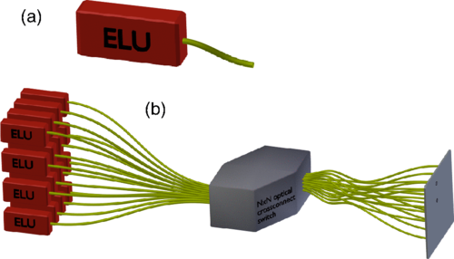
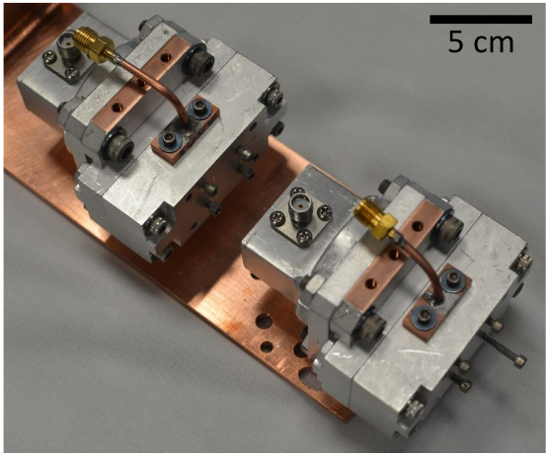
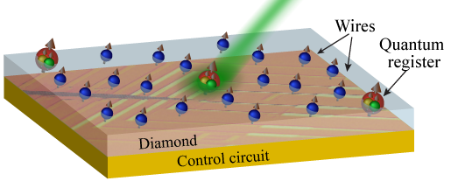
Why Do We Need Bell States?
Quantum Teleportation
Quantum Key Distribution
Modular architecture for quantum computers (Trapped Ions, Superconducting Circuits, NV centers, etc.)
Monroe, PRA 89, 022317 (2014) Shankar, Narla, YQI, Yale Prof. Cappellaro, MIT (first two talks in our session - H48)

Slide 5
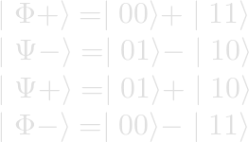
Purification
The four possible Bell states are Φ+, Ψ-, Ψ+, and Φ-:
Φ+ at 90% Ψ-, Ψ+, and Φ- at 3.3%
Start with two Bell pairs and obtain one higher quality pair.

Slide 6
Purification
Alice’s side of the circuit.
Sacrificial Bell pair.
Bell pair to be purified.
Bob’s side of the circuit. Alice does the same to her “half pairs”.

Slide 7
Purification
Bob’s side of the circuit. Alice does the same to her “half pairs”.
Φ+Φ+ Φ+Ψ- Φ+Ψ+ Φ+Φ- others
81% 3% 3% 3% 10%
Tracing over the second pair returns the same quality pair as the one we started with.

Slide 8
Purification
Bob’s side of the circuit. Alice does the same to her “half pairs”.
Φ+Φ+ remains Φ+Φ+ Φ-Φ- becomes Φ+Φ- other permutations happen

Slide 9
Purification
Bob’s side of the circuit. Alice does the same to her “half pairs”.
Trace over the second pair, selecting only Φ+ or Φ-.
Result: 93% Φ+ in the first pair.

Slide 10
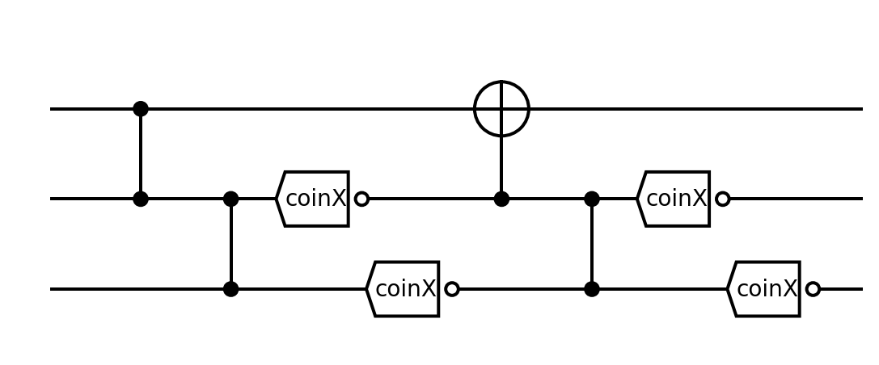
More Advanced Purification Example
The EXPEDIENT purification circuit, Nickerson, Nature Comm. 4, 1756 (2014)

Slide 11
Combinatorial Explosion of Possible Circuits
Circuits of length L (number of operations) and depth N (number of resettable Bell pairs):

Slide 12
Optimized Purification (Genetic Algorithms)
Represent the circuit as a “DNA string” where each gene is a gate/measurement.
Get many random circuits and subject them to merciless simulated evolution.
nearingzero.net

Slide 13
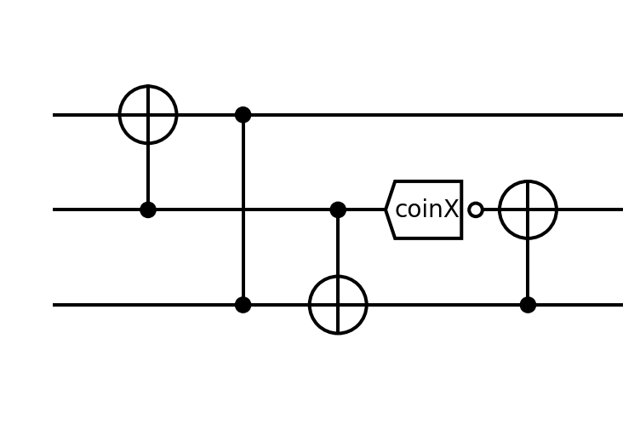
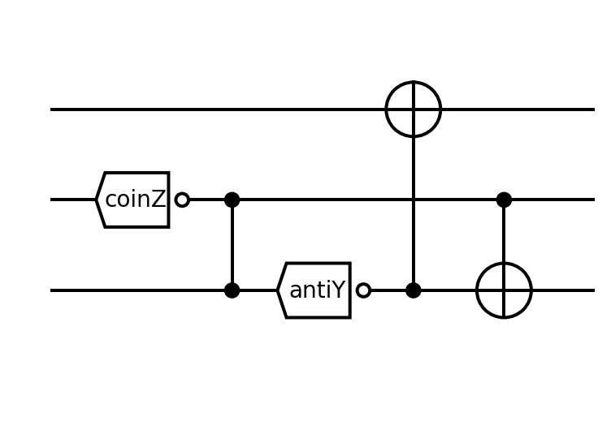
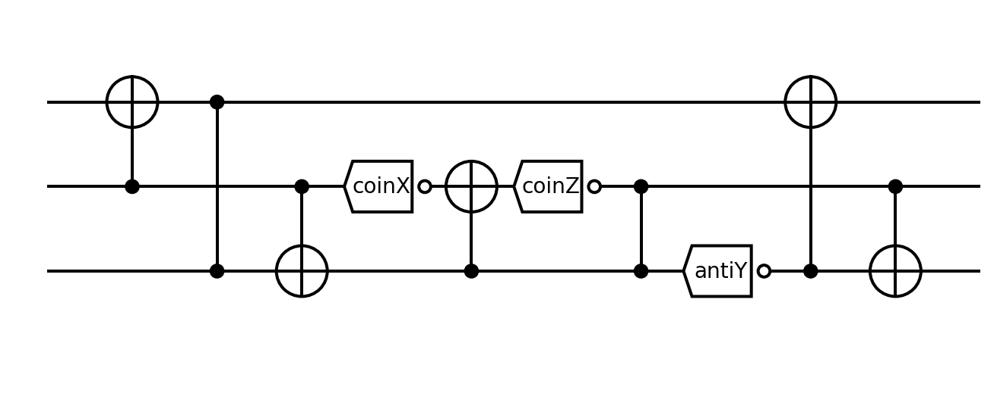
Two “Modes” of Evolution
Mutations
Sexual reproduction

Slide 14
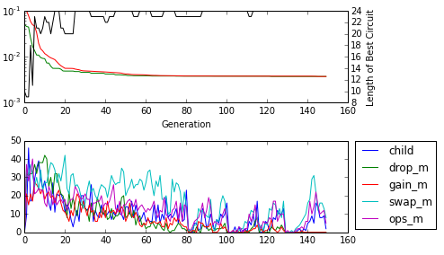
A Hundred Generations Later (5min laptop time)
For a given error model and specified error parameters quickly find near-optimal purification circuits.
Various optimizations related to the structure of the problem were implemented.
Real-time trace of the optimization process. (it is pretty, this is all about it)

Slide 15
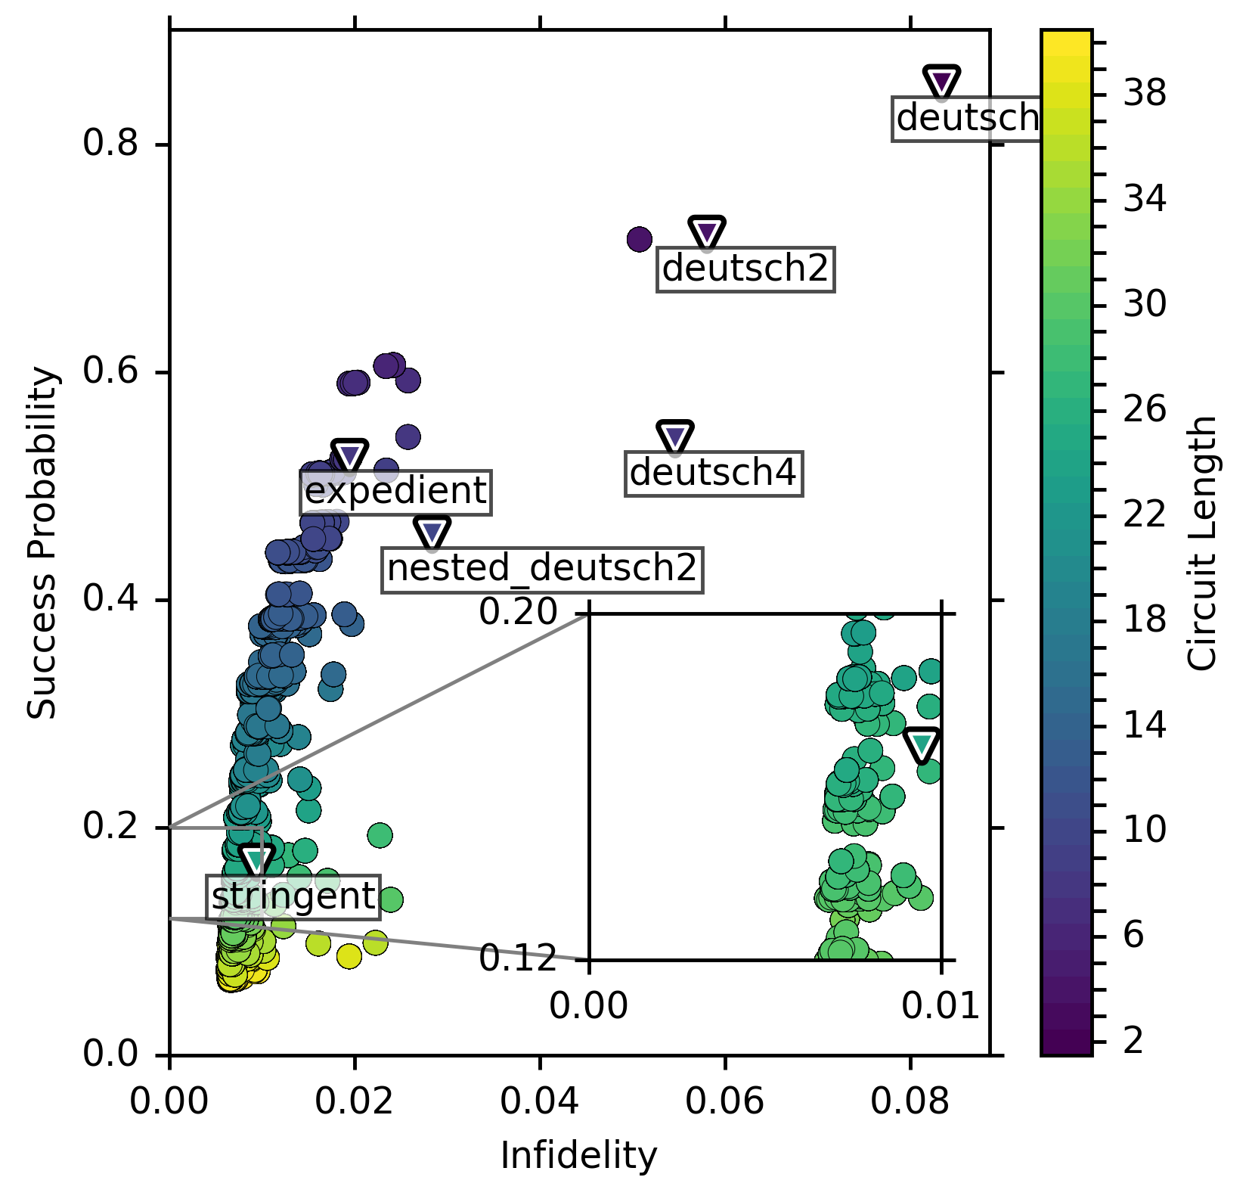
Better Than Prior Art
Simulated for
Initial Bell Pair Fidelity 0.9
Local Operations Fidelity 0.99
Depolarization Error Model
Available at qevo.krastanov.org
Circuits From: - Nickerson, Nature Comm. 4, 1756 (2014) - Deutsch, PRL 77, 2818 (1996) - Dür, PRA, 59, 169 (1999)

Slide 16
A Particular Example
L23 is one of the many circuits we designed. STRINGENT is from Nickerson, Nature Comm. 4, 1756 (2014)

Slide 17
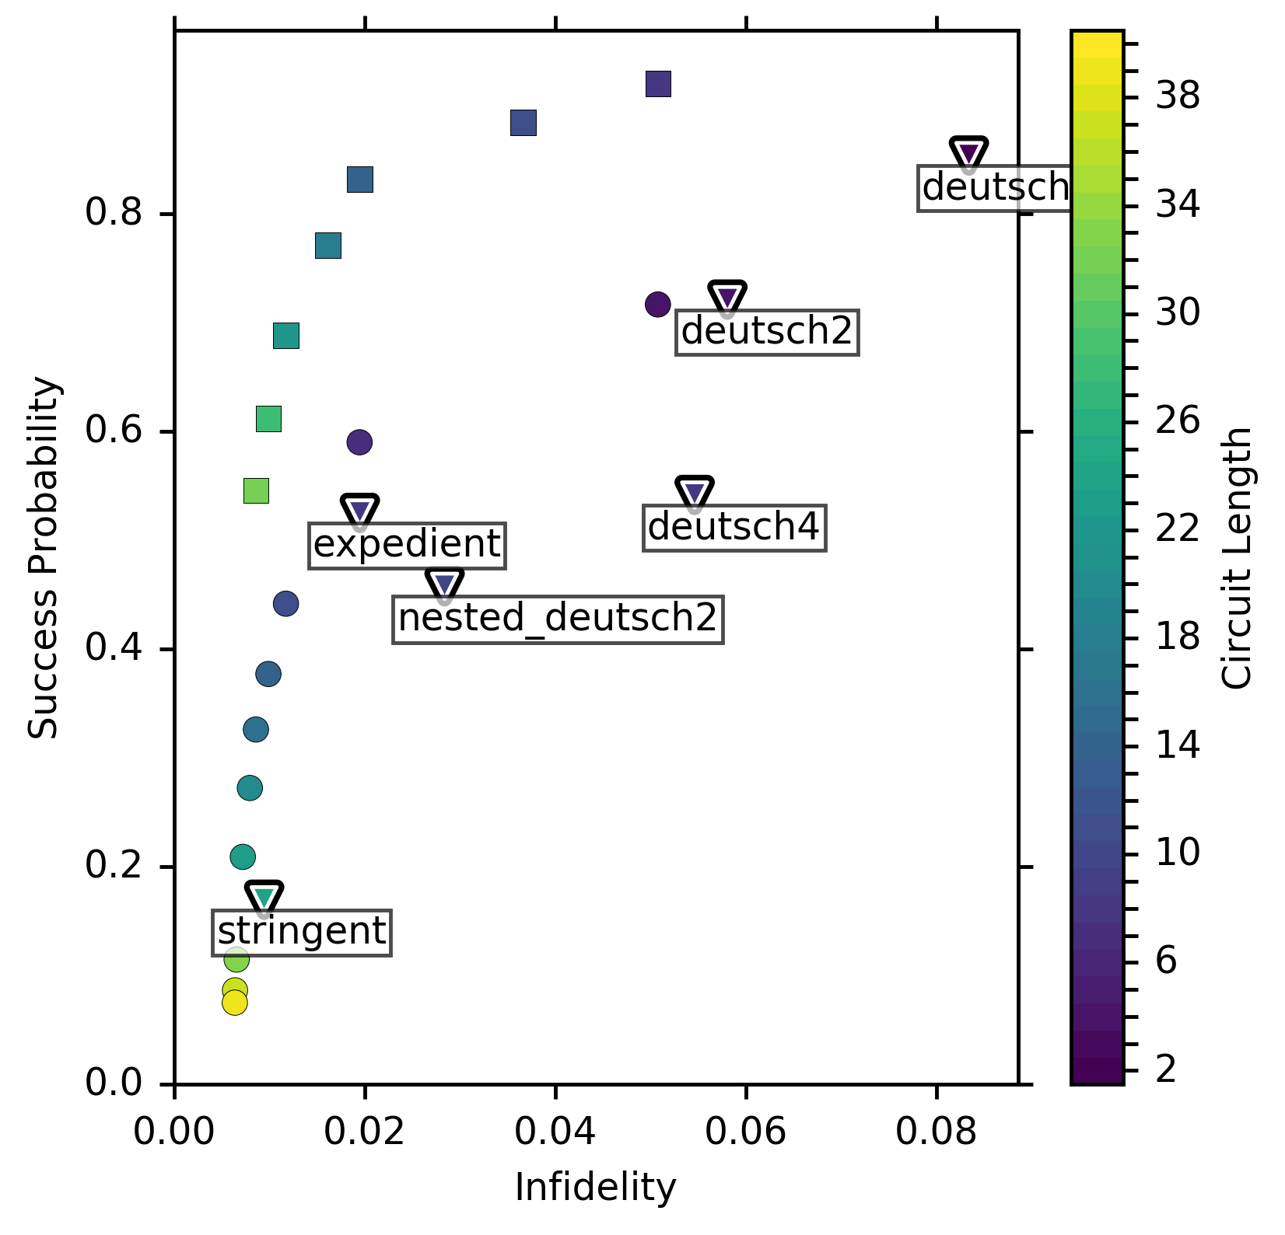
With Naive
Feed-Forward
Chain two circuits together.
If the first succeeds, accept.
If the first fails, try the second circuit.

Slide 18
Conclusions (Thanks for listening)
Optimizing a “building-block” protocol to work for particular hardware is now easy and automated
~20% gain in fidelity for same-length (or even shorter) circuits
A new, much bigger than previously available collection of circuits to try
Available at qevo.krastanov.org
Applications in quantum communication and fault-tolerant computing
Caveats
Do not over rely on magic! Prune and inspect your circuits!
Set cost function properly!
Having a canonical form can be important!

Slide 19
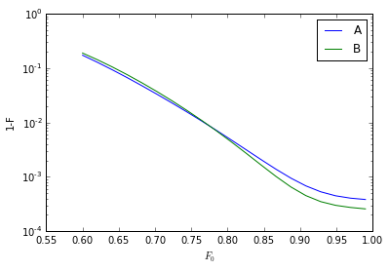
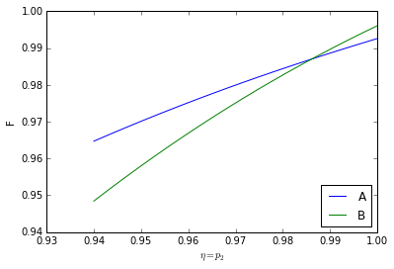
Different Circuits Work Better for Different Parameters
Different Network Efficiency Different Local Gates’ Quality
A and B are circuits obtained after optimizing for different hardware parameters.

