Slide 1
Quantum Control of Coupled Cavities
Using χ⁽²⁾ bulk nonlinearities
Presented by Stefan Krastanov
Mikkel Heuck, Kurt Jacobs, Prineha Narang, Dirk Englund

Slide 2
Long-term goal
∣1̃⟩ = ∣1⟩ + ∣3⟩
∣1̃⟩ = ∣1⟩ + ∣3⟩
Purely photonic quantum computer
χ⁽²⁾ and ancillas
∣0̃⟩ = ∣1⟩ - ∣3⟩
∣1̃⟩ = ∣1⟩ + ∣3⟩
Or at least a one way quantum repeater
∣1̃⟩ = ∣1⟩ + ∣3⟩
∣Err1̃⟩ = ∣vac⟩ + √3∣2⟩
∣1̃⟩ = ∣1⟩ + ∣3⟩
χ⁽²⁾ and ancillas
a leaked photon

Slide 3
Shorter-term goal
Design a (purely photonic) control scheme and an error correcting code that require few resources.

Slide 4
The hardware: three cavity modes and two pumps
Modes a, b, and c are 3 cavity modes with a non-zero spatial overlap.
ω_{a} = 2ω_{b} creates an ab†b† + h.c. term in the hamiltonian
ω_{p} = ω_{c}- ω_{a} creates a controllable ac† term
ω_{q} = ω_{c}- ω_{b} creates a controllable bc† term
Control 1
Control 2
λ_{c}=0.78μm
λ_{q}=1.03μm
λ_{p}=1.51μm
λ_{a}=1.6μm
λ_{b}=3.2μm

Slide 5
The Hamiltonian
ω_{a} = 2ω_{b} creates an ab†b† + h.c. ω_{p} = ω_{c}- ω_{a} creates a controllable ac† + h.c. ω_{q} = ω_{c}- ω_{b} creates a controllable bc† + h.c.
ab†b† + p_{(t)}ac† + q_{(t)}bc† + h.c.
Control 1
Control 2
λ_{c}=0.78μm
λ_{q}=1.03μm
λ_{p}=1.51μm
λ_{a}=1.6μm
λ_{b}=3.2μm

Slide 6
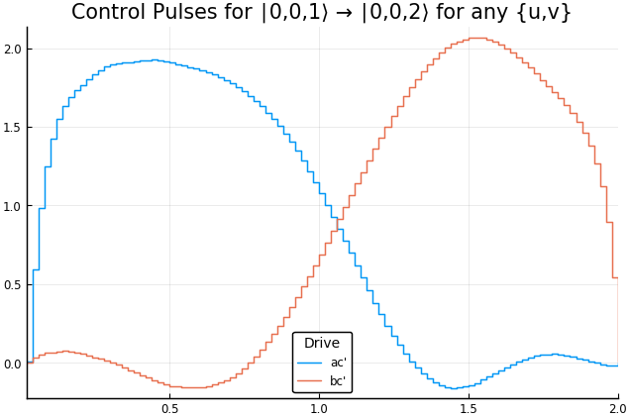
Simple task achieved through this Hamiltonian
Pulse Strength
Time

Slide 7
Example of an error correcting procedure we want
Logical states encoded in a cavity (Fock basis):
∣0̃⟩ = ∣1⟩ + ∣3⟩ ∣1̃⟩ = ∣1⟩ – ∣3⟩
⟼ â∣0̃⟩ = ∣vac⟩ + √3∣2⟩ ⟼ â∣1̃⟩ = ∣vac⟩ – √3∣2⟩
a leaked photon
Error states after photon loss:
Do we have enough control to perform:
the projective non-demolition measurement to detect errors?
the error-reversal unitary operation?

Slide 8
How to perform the non-demolition measurement
e.g. for code ∣1⟩±∣3⟩ stored in mode c the presence of a photon in cavity a can be how we attempt to perform the non-demolition measurement.
Do nothing to the “logic” state ∣0,0,1⟩ ± ∣0,0,3⟩ ⟼ ∣0,0,1⟩ ± ∣0,0,3⟩
Create a photon if we are in an “error” state ∣0,0,0⟩ ± √3∣0,0,2⟩ ⟼ ∣1,0,0⟩ ± √3∣1,0,2⟩
This does not work well because it tries to create a photon from the vacuum… Cano not find a p(t) and q(t) that recreate this operation.

Slide 9
What if we have a “resource” we can sacrifice
e.g. put an extra photon in mode a
Do not consume the “resource” photon if we are in a “logic” state: ∣1,0,1⟩ ± ∣1,0,3⟩ ⟼ ∣1,0,1⟩ ± ∣1,0,3⟩
Consume the “resource” photon if we are in an “error” state: ∣1,0,0⟩ ± √3∣1,0,2⟩ ⟼ ∣0,0,1⟩ ± ∣0,0,3⟩

Slide 10
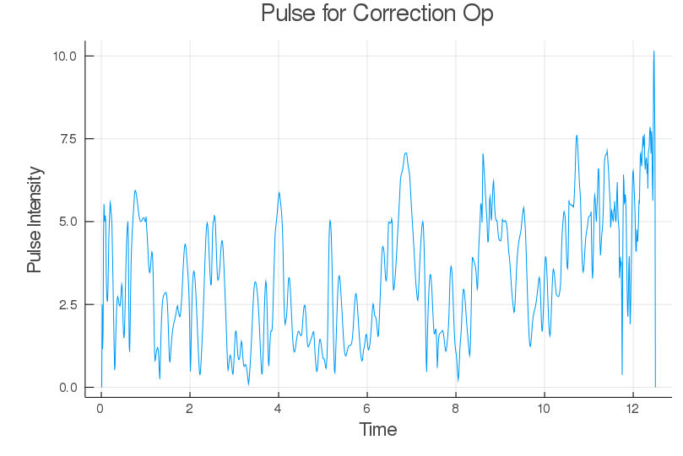
Performance can be high, but the control pulses are unrealistic

Slide 11
Workarounds in progress!
Other small bosonic codes face the same problems...
e.g. ∣1⟩±∣3⟩, ∣2⟩±∣4⟩, ∣2⟩+∣6⟩/∣3⟩
Other hardware?
Optimized codes!
Parameterize the code and optimize it, so that it is well suited for the available control.

Slide 12
Tools Appreciation Slide
A shout-out to Julia and Flux
A multithreaded, GPU-runnable, auto-differentiated, non-allocating code in 350 lines.

