Slide 1
Optimal Control for Photons
Using χ2 bulk nonlinearities

Slide 2
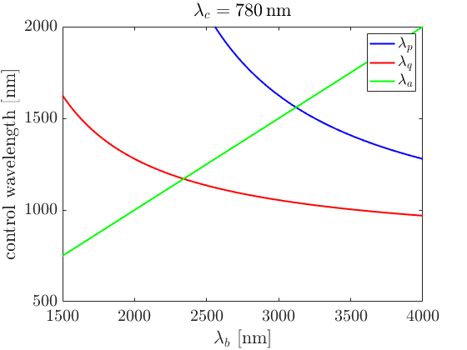
Three Cavity Modes and Two Pumps
Modes a, b, and c are 3 cavity modes with a non-zero spatial overlap.
ω_{a} = 2ω_{b} creates an ab†b† + h.c. term in the hamiltonian
ω_{p} = ω_{c}- ω_{a} creates a controllable ac† term
ω_{q} = ω_{c}- ω_{b} creates a controllable bc† term
Control 1
Control 2
λ_{c}=0.78μm
λ_{q}=1.03μm
λ_{p}=1.51μm
λ_{a}=1.6μm
λ_{b}=3.2μm

Slide 3
Do something non-classical
Turn 1 photon in C into 1 in A,
which then becomes 2 photons in B,
which becomes 2 photons in C.

Slide 4
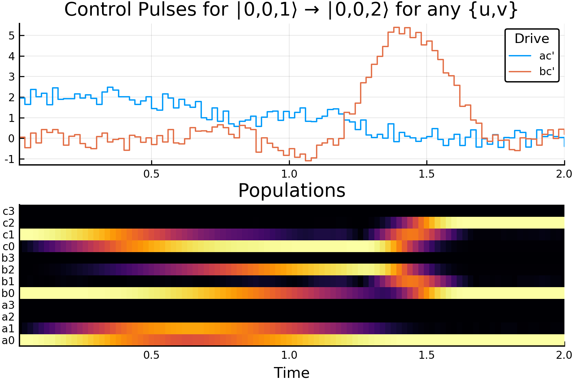

Slide 5
Something more fun
u∣1⟩ + v∣2⟩ → u∣1⟩ + v∣3⟩

Slide 6
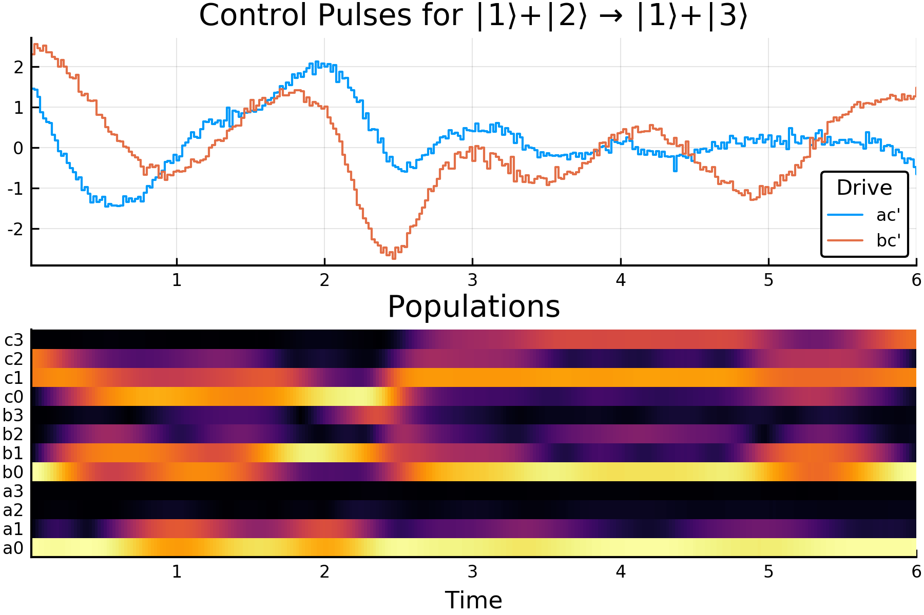

Slide 7
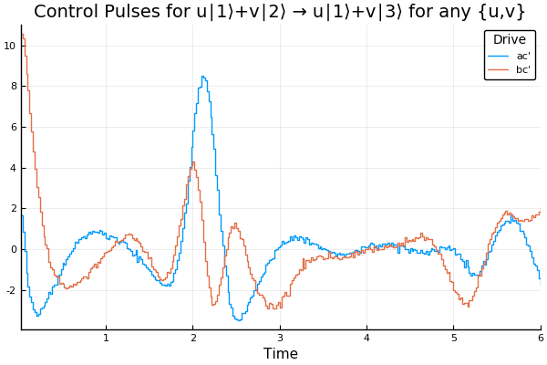

Slide 8
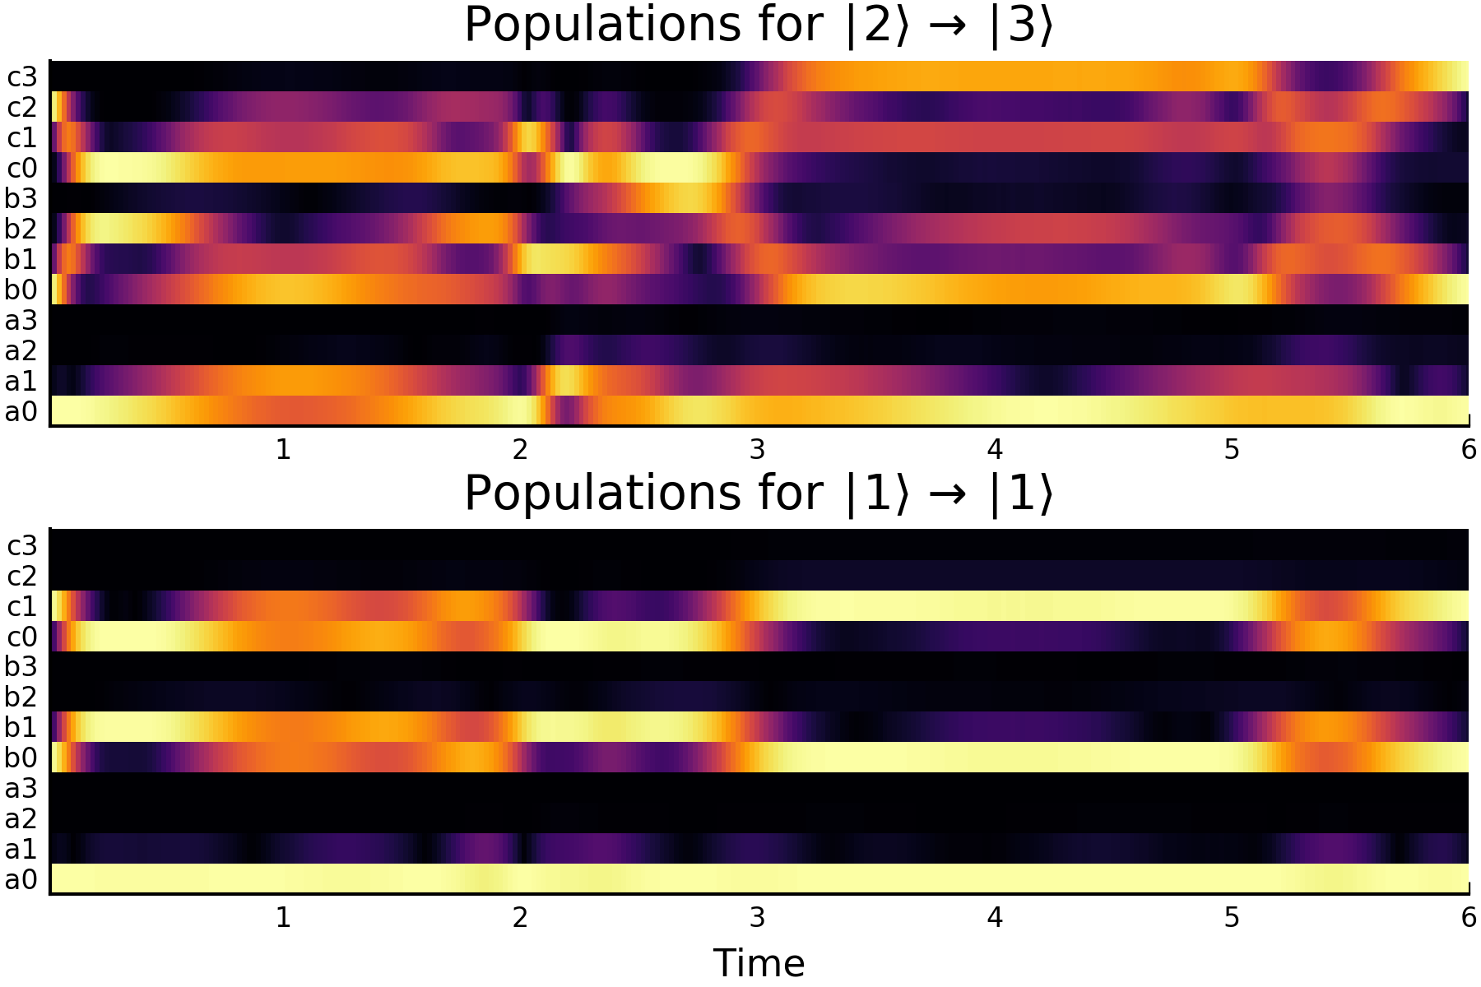

Slide 9
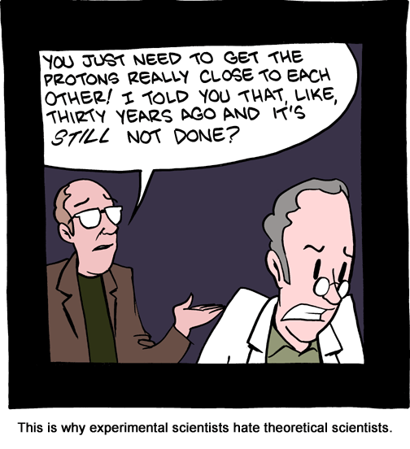
Realistic Pulses
Add regularization…
Do it in frequency space…
Do not melt the device…
Too many cavities…
Verification procedure…

Slide 10
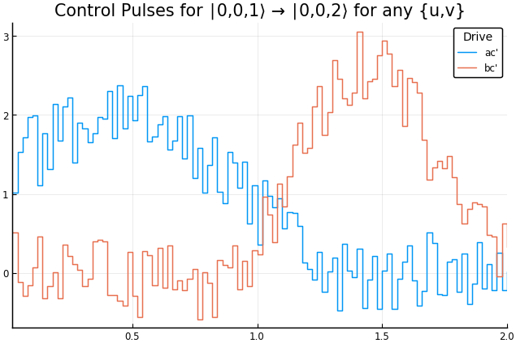
This needs regularization!

Slide 11
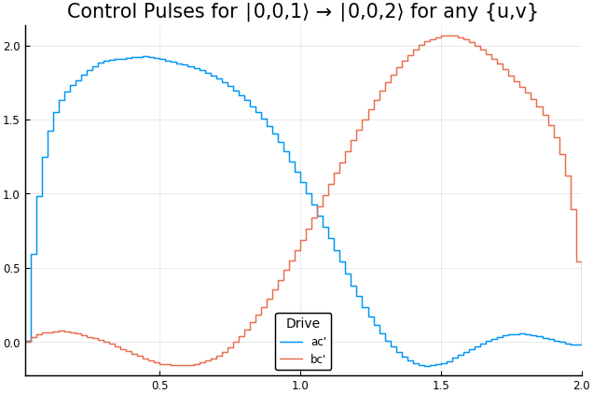
This pulse has the same fidelity! But it is regularized.

Slide 12
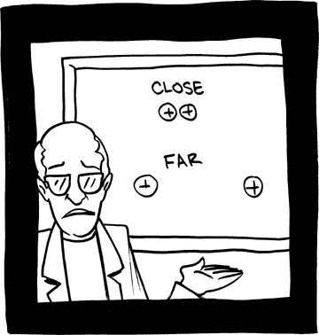
What we can totally, seriously, for real, non sarcastically do
Implement an error correcting code and some way to measure the syndrome by sending a photon in, and seeing whether a photon was returned.

