Slide 1
Room Temperature Logical Qubits
via Optical Nonlinearities
group meeting update Stefan Krastanov, Mikkel Heuck, Jeffrey Shapiro, Prineha Narang, Dirk R. Englund, and Kurt Jacobs

Slide 2
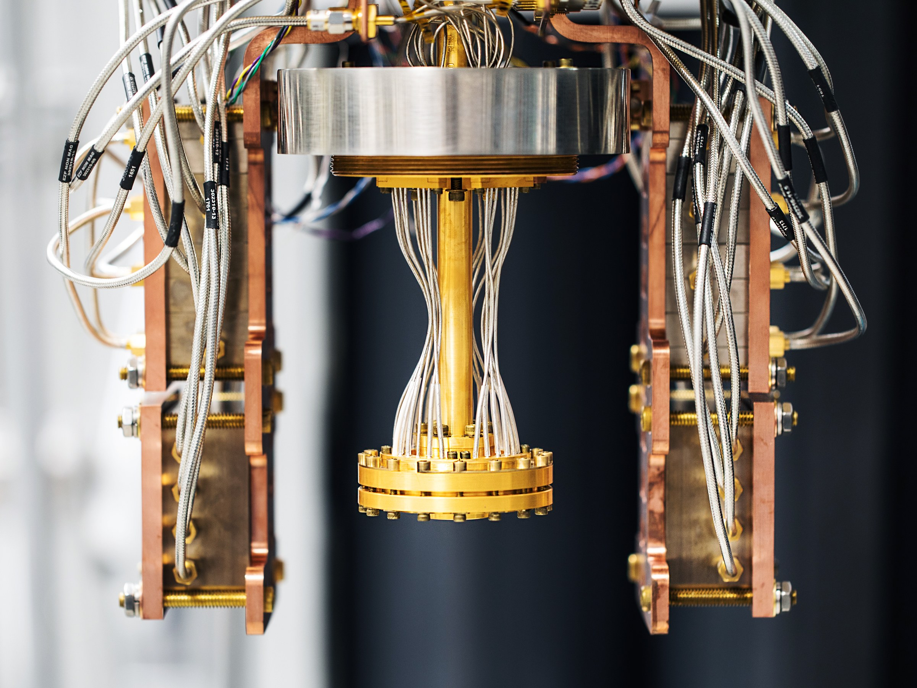
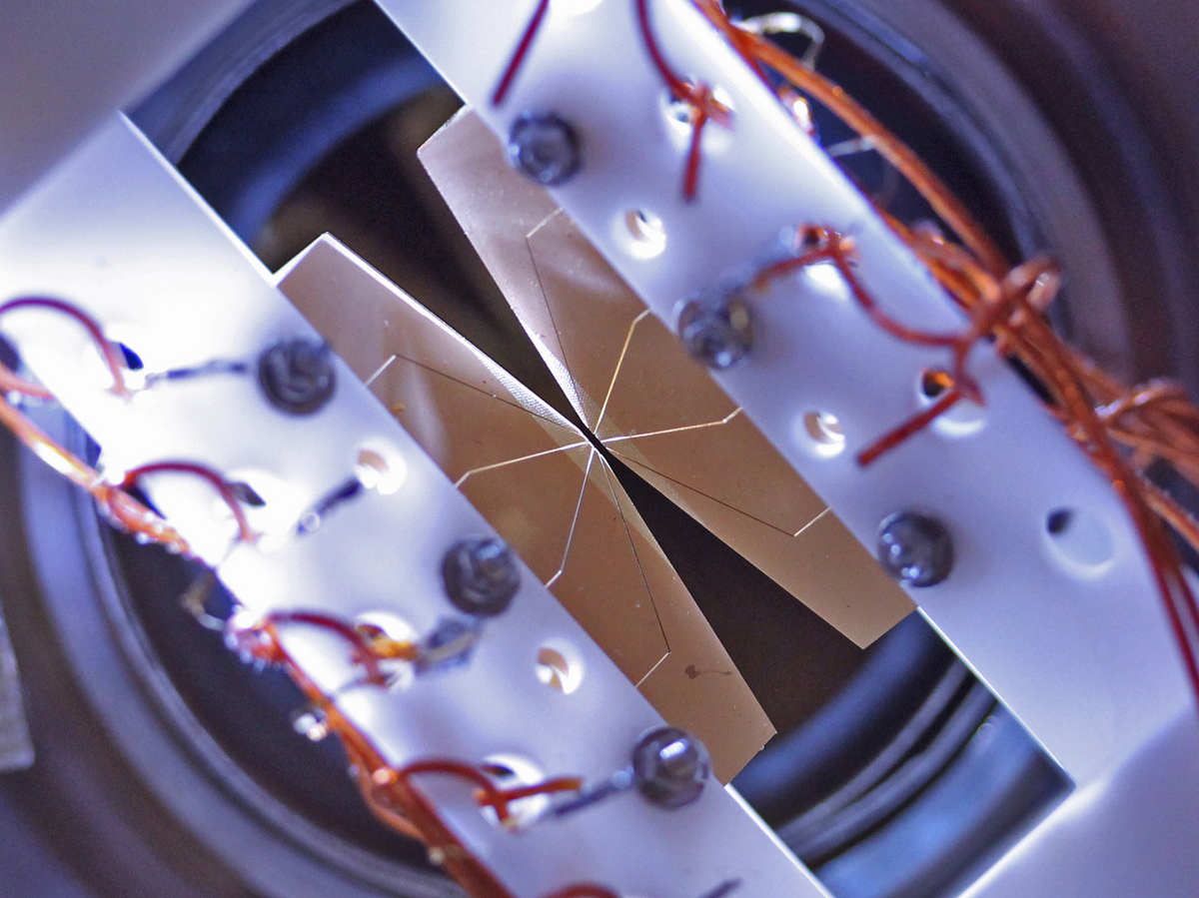
Biased View of Photonics in the Quantum Landscape
Transmons: Easy Control Mature Classical Tech Slow Clock Rate Extreme Cooling Requirements
Ion Traps Neutral Atoms Silicon and many others have similar cooling requirements
Photons: Fast Clock Rate Required for Quantum Networks Alternative Modes of Computation Relaxed Cooling Requirements

Slide 3
However, Photons (oscillators) without nonlinear resources are not enough!

Slide 4
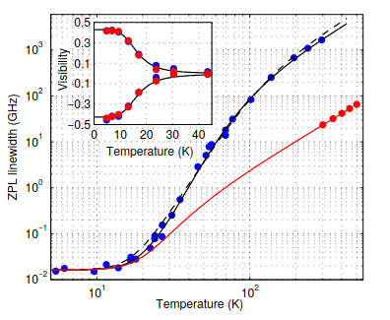
Room Temperature Nonlinear Photonics?
Small things get jittery when heated (thermal broadening)!
Plot of Linewidth vs Temperature for NVs More than GHz linewidth at room temperature.
Plakhotnik et al. Physical Review B 92.8 (2015): 081203

Slide 5
Quantum Control of Bulk Nonlinear Optics
Quantum Second-Harmonic Generation
Three-wave mixing with a controllable classical pump

Slide 6
These are
Compact
Versatile
Re-Programmable
Room Temperature
Quantum Processing Units

Slide 7
Programmable by an Optimal Control Approach

Slide 8
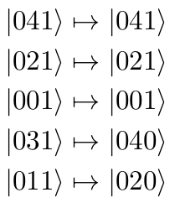
Programmable by an Optimal Control Approach
Example realization:
Example target operation:
Pumping mode b conditioned on parity

Slide 9
Exciting Examples of Room Temperature Control

Slide 10
Room Temperature Compiled Toffoli Gate
Others: At least 6 multi-qubit gates.
Our approach: A single application of our triply-resonant cavity gate.

Slide 11
Compact Measurement-Free Error Correction (did I mention it is room temperature)
Codeword for an encoded qubit:
Possible error words after photons loss:

Slide 12
Compact Measurement-Free Error Correction (did I mention it is room temperature)
First correction step (with the use of some ancillas):
Second correction step:

Slide 13
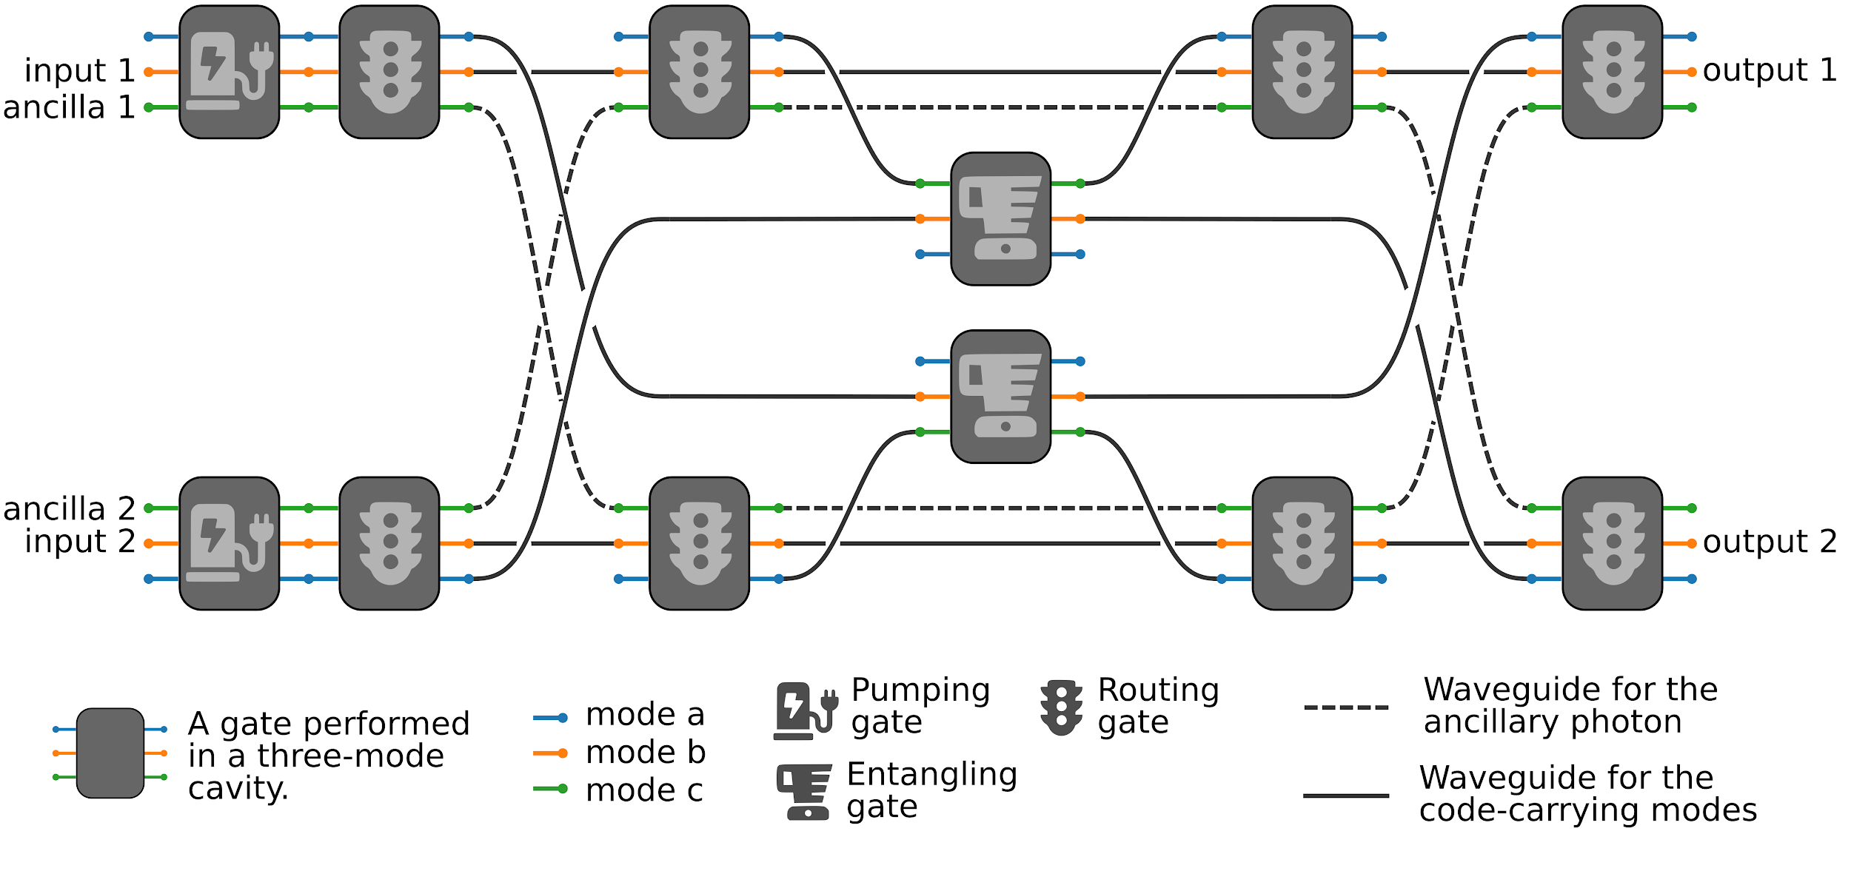
Compact Measurement-Free Error Correction (did I mention it is room temperature)

Slide 14
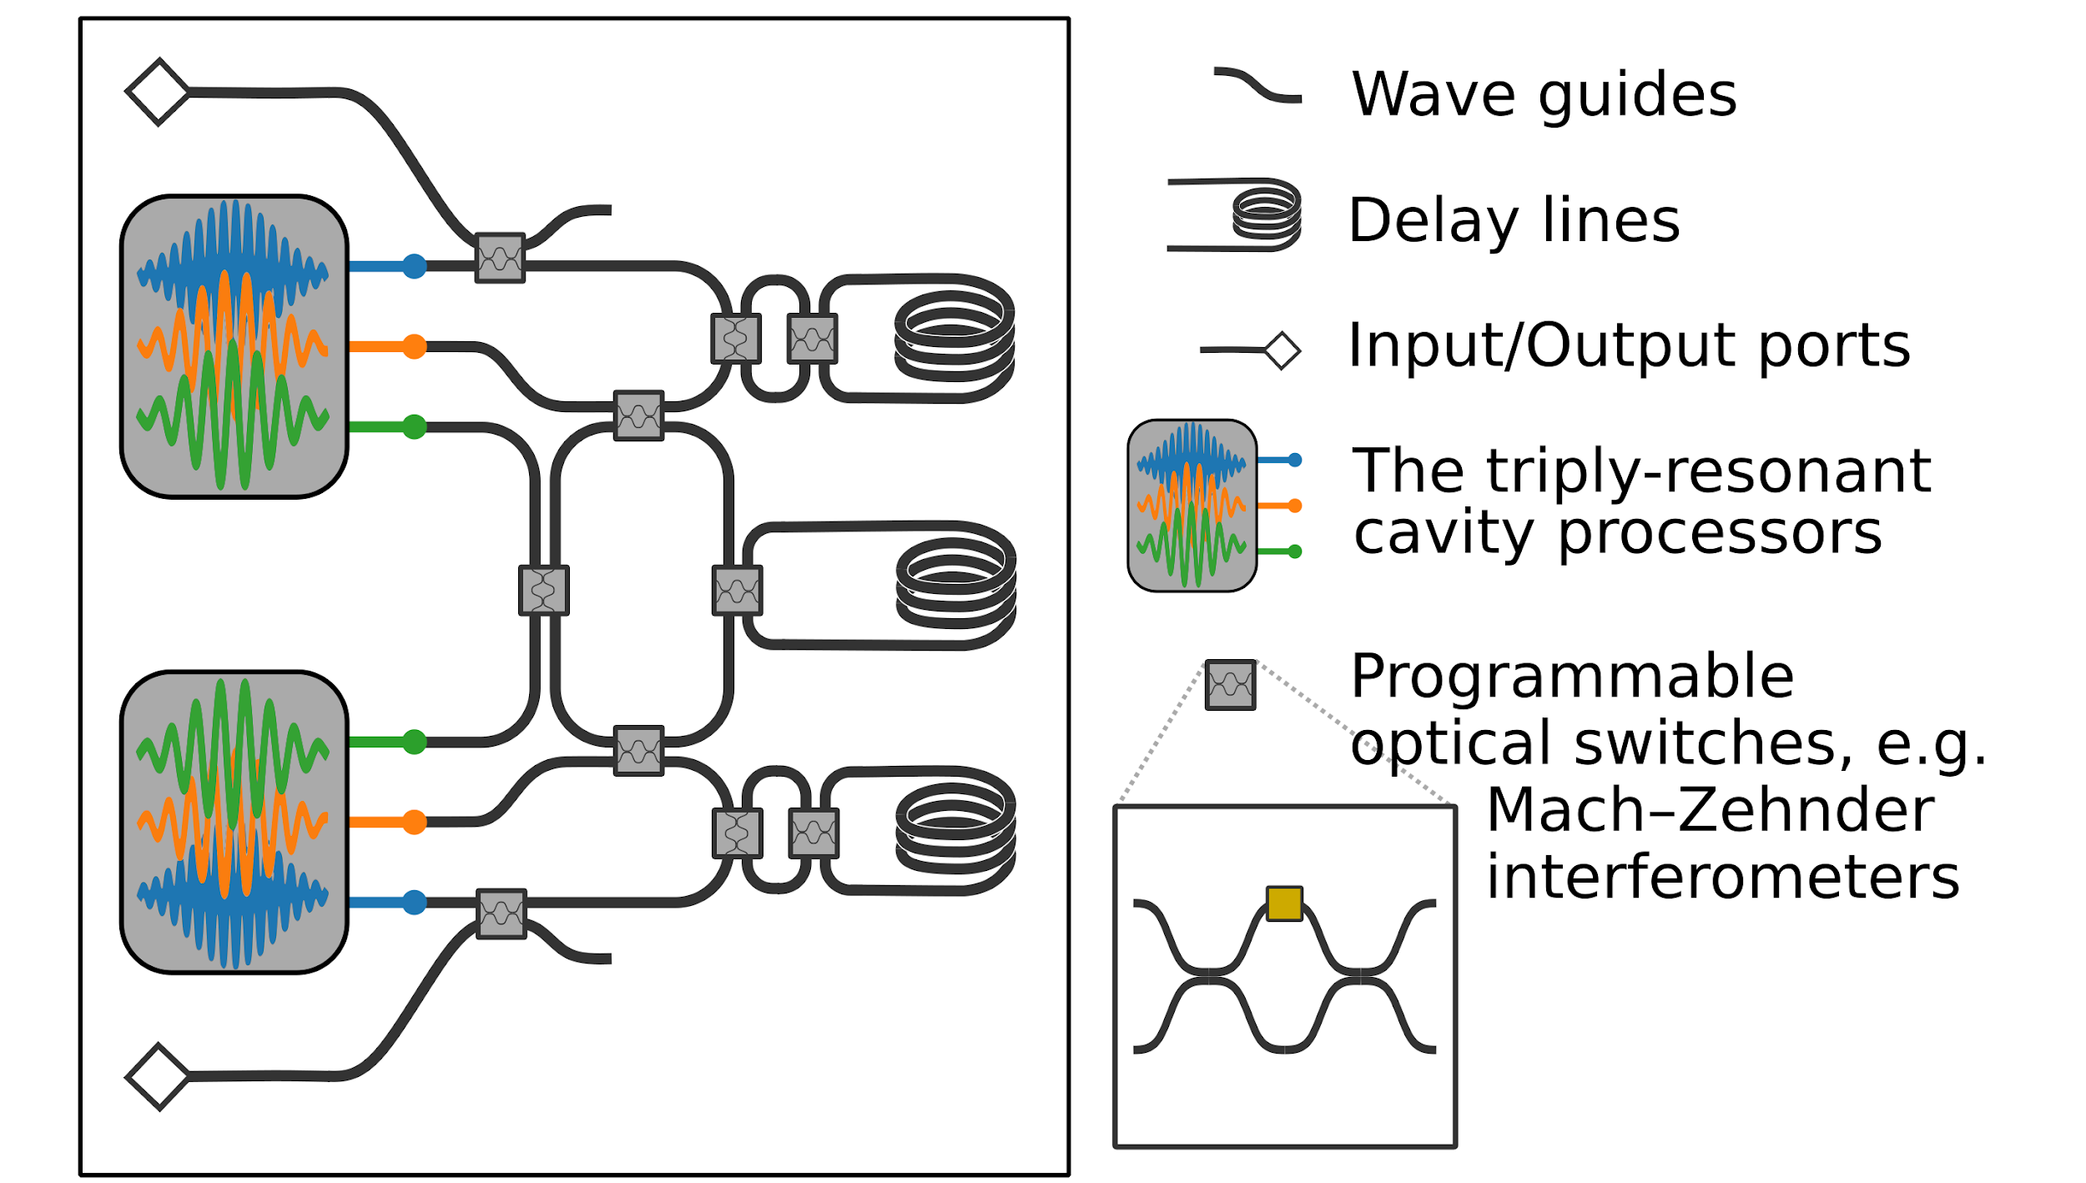
Compact Measurement-Free Error Correction (did I mention it is room temperature)

Slide 15
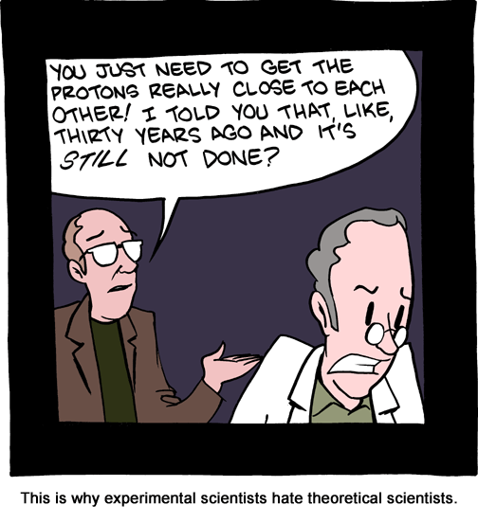
Reality Check!
Photons are great for quantum computing, because they do not interact with all the terrible things around them.
Photons are terrible Photons offer exciting challenges for quantum computing because they do not readily interact with each other.
© SMBC

Slide 16
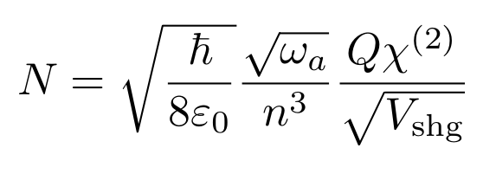
Photon-Photon Interactions are Weak (but getting stronger thanks to heroic experimental efforts)
“N” is the number of “elementary operations” we can perform in a single cavity lifetime. Currently it is at ~0.03. A value of 1000 is within reach this decade.
Lifetime Might improve by an order of magnitude or two
Interaction Strength Difficult to improve but colleagues in other fields are working on it
Mode Overlap Potential for many orders of magnitude improvement

Slide 17
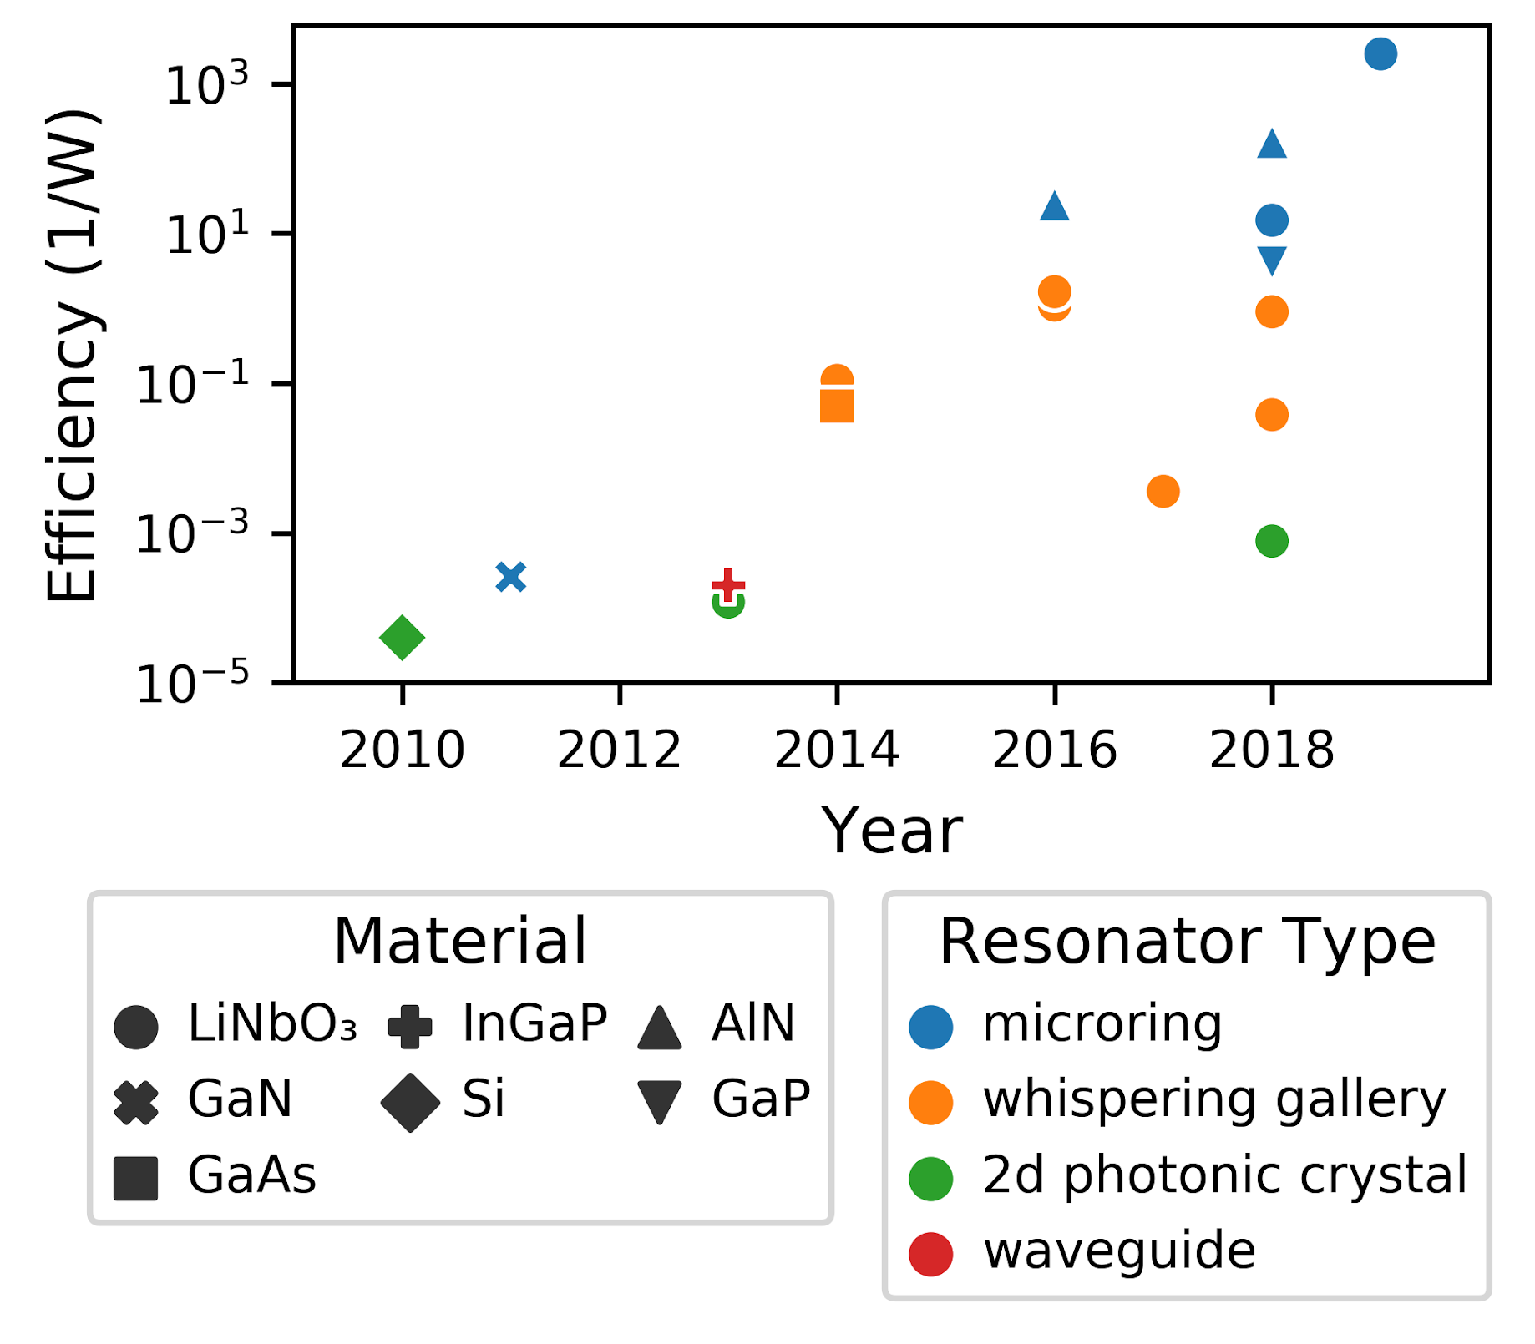
Second Harmonic Generation Experiments
Photon-Photon Interactions are Weak
but getting stronger thanks to heroic experimental efforts

Slide 18
Second Harmonic Generation Experiments
Photon-Photon Interactions are Weak
but getting stronger thanks to heroic experimental efforts

Slide 19
If we extrapolate, in the next decade we will have hardware with N on the order of 1000,
That would enable “engineeringly useful” operations, not just interesting physics experiments.
Thank you for your attention!
This work was partially funded by the Mitre Quantum Moonshot initiative. And thanks to Christopher Panuski and Ryan Hamerly for numerous helpful conversations.

